Slide 1
Action Planning Workshop (APW) Facilitation Guide
Continuous Improvement Technical Assistance Program (CITAP)

Slide 2
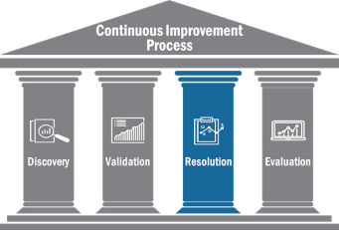




The Continuous Improvement Process
The Continuous Improvement process provides a consistent and systematic approach for effectively building and sustaining capabilities by connecting past and future operations.
CONSISTENT DATA COLLECTION PROCESSES
ROOT CAUSE ANALYSIS & METHODOLOGY
RESOLUTION PATHS FOR PRIORITY ISSUES
EVALUATION &
ASSESSMENT CAPABILITIES

Slide 3
Agenda
Determining Action Planning Workshop (APW) Objectives and Activities
APW Planning & Preparation
APW Document Creation
Conducting an APW
Post-APW Activities

Slide 4

Action Planning Workshop (APW)
An Action Planning Workshop (APW) is a means of creating and/or addressing the observations and courses of action (COAs) identified in an After-Action Report.
An APW brings together those who are responsible for the processes identified in the observations and who have the authority to enact potential COAs, as well as those responsible for tracking progress on actions.
The goal of the workshop is to come to decisions on what actions should be taken, the timelines for completing those actions, and who is responsible for taking ownership of the actions.

Slide 5
Potential APW Activities
Whole Group Facilitated Discussions: Participants discuss priorities, possible solutions, and responsibilities for COAs.
Presentations: Participants share important information pertaining to the Observations.
Trend Analysis: Illustrate how often a particular Observation has been identified in the past.
Breakout Discussions: Focused discussions on key issues that are important/relevant to a specific set of participants.
Problem Solving Exercises: Participants help identify COAs that will address the root cause of a problem and consider other steps to addressing these issues. When applicable, participants implement root cause analysis, risk and resource analysis, and/or SWOT analysis.
Analysis Training: Participants learn to continue the necessary analysis with their program office or jurisdiction as they work to implement COAs.

Slide 6
Agenda
Determining Action Planning Workshop (APW) Objectives and Activities
APW Planning & Preparation
APW Document Creation
Conducting an APW
Post-APW Activities

Slide 7
APW Planning
Identify Participants
  Which program areas do the Observations relate to?
  Who has the responsibility and authority to take actions which may resolve the issues or reinforce the best practices?
Identify Senior Leadership
  Who is responsible for coordinating the actions of participants?
    This leader coordinates the division of responsibility for COAs between participants.
    A successful APW will require participants to prepare ahead of time, engage in productive discussion during the workshop, and follow through on the COAs.
Identify Action Plan Manager
  Who will be responsible for tracking and managing the Action Plan?
    This manager is responsible for tracking updates to the action plan, maintaining plan accountability, and providing updates to participants on progress made.

Slide 8
APW Planning
Selecting the Content of the APW
  How many observations (and associated COAs) can you expect to cover during the workshop?
    The AAR may have more observations than can reasonably be expected to be addressed at one time.
Selecting the Time for the APW
Schedule the APW soon after finalizing the AAR.
    Give the participants enough time to read the AAR and provide priority observations.
    Ensure that you schedule the APW far enough in advance that all the participants are able to reserve the time on their calendars.
    Consider scheduling the APW as soon as there is a clear timeline for the AAR to be completed.
PRO-TIP
A reasonable expectation for a 3 hour APW would be to cover 8-10 observations or 20-25 COAs

Slide 9
APW Preparation: Scheduling and Logistics
Set time for the APW well in advance
Set up logistics
  Reserve a room or rooms for the workshop.
  Set up a conference call number, virtual teleconference (VTC), and Adobe Connect as needed.
  Print materials for the workshop including copies of the COAs, draft Action Plan, and Agenda.
PRO-TIP
Schedule the time based on the availability of the most senior participant. With enough notice, others will be able to adjust their calendars to be able to attend.
PRO-TIP
If participants are in different locations, use VTC to help everyone be more engaged in the workshop. Find someone there who can help you with setting up the VTC, printing materials, and providing facilitation support during the workshop.

Slide 10
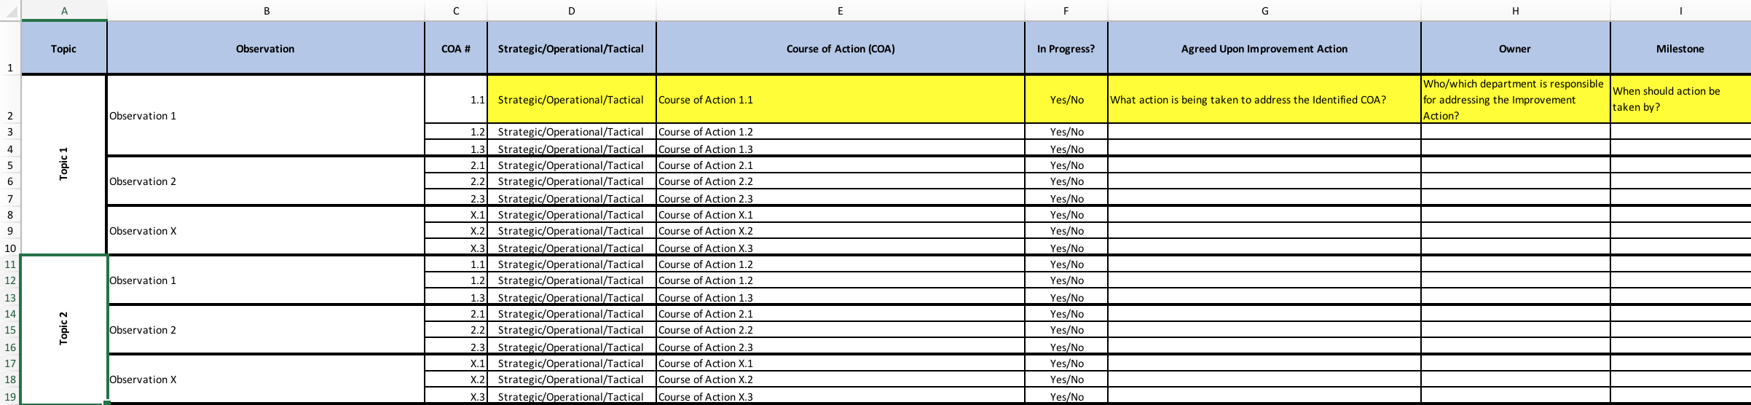
APW Preparation: Action Plan
Transfer the Observations and COAs from the AAR into an Action Plan

Slide 11
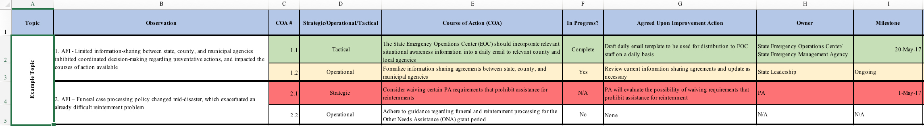
APW Preparation: Action Plan
Action plans present a common picture of what actions are being taken, and provide accountability to ensure that the agreed upon timelines are met.
  Determine who will be responsible for updating the status of the actions on a regular basis and communicate with them to create an action plan that works for them and/or their agency/organization.

Slide 12
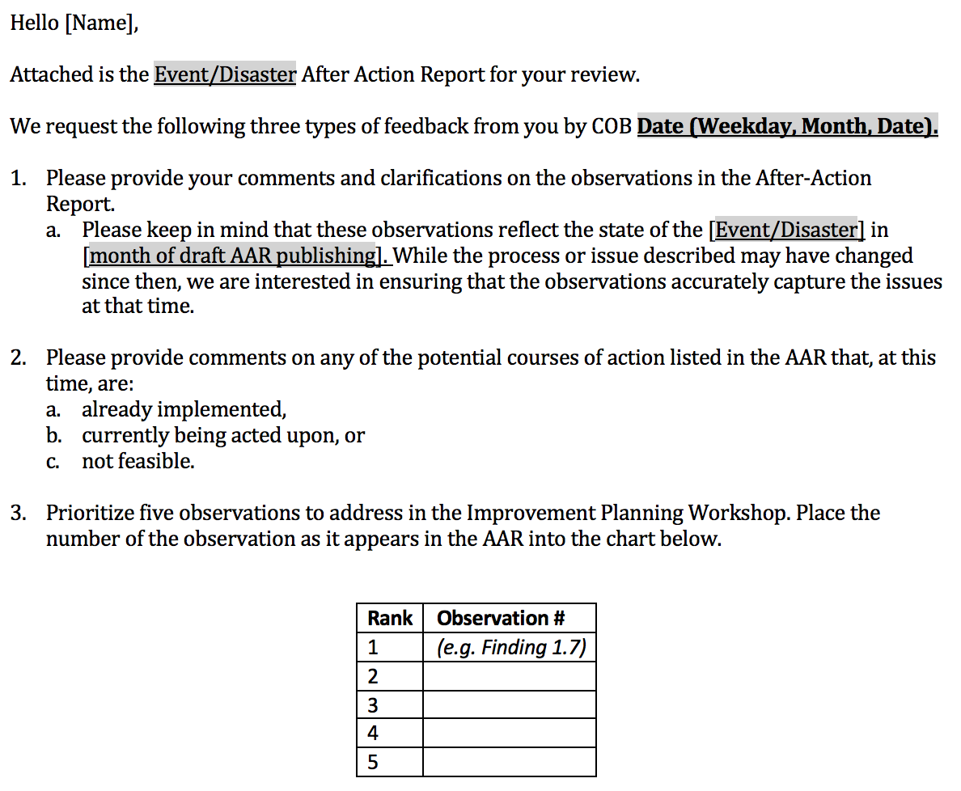
APW Preparation: Prioritization Request
Using the APW Message, determine suggested criteria for prioritizing observations.
  Identifying priorities ahead of the APW allows for the most impact within limited time of the APW.
  Prioritization helps the participants get engaged in the process and encourages them to read the Observations in advance.

Slide 13
APW Preparation: Invitations
Invitations: Request that a senior participant send a meeting invitation to all the desired participants
  This invitation should include:
    The After-Action Report (AAR)
    The APW Message - A request that the participants to read the AAR in advance and prioritize the observations according to given criteria and instructions (including a deadlines to submit the priorities).
    The draft Action Plan
    A request for the participants to look at the Action Plan and identify what actions have already been completed or are underway related to the COAs in the Action Plan (with instructions and a deadline).
PRO-TIP
Determine what process will be used to track the actions decided on in the APW ahead of time and who will be responsible for tracking them.

Slide 14
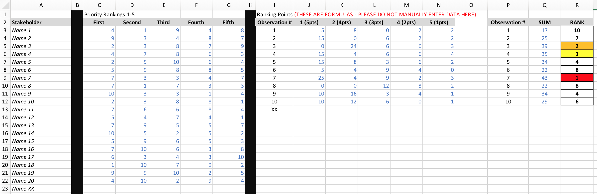
APW Preparation: Prioritization Matrix
Calculate the prioritized Observations using a weighted variable matrix (or Prioritization Matrix) to so that higher ranked votes count for more than lower ranked votes

Slide 15
Agenda
Determining Action Planning Workshop (APW) Objectives and Activities
APW Preparation
APW Document Creation
Conducting an APW
Post-APW Activities

Slide 16
APW Document Creation
Create the PowerPoint slides and printed documents for the APW
  Agenda
  Action Plan
  Communication Plan
  Next Steps
  Objectives and Ground Rules

Slide 17
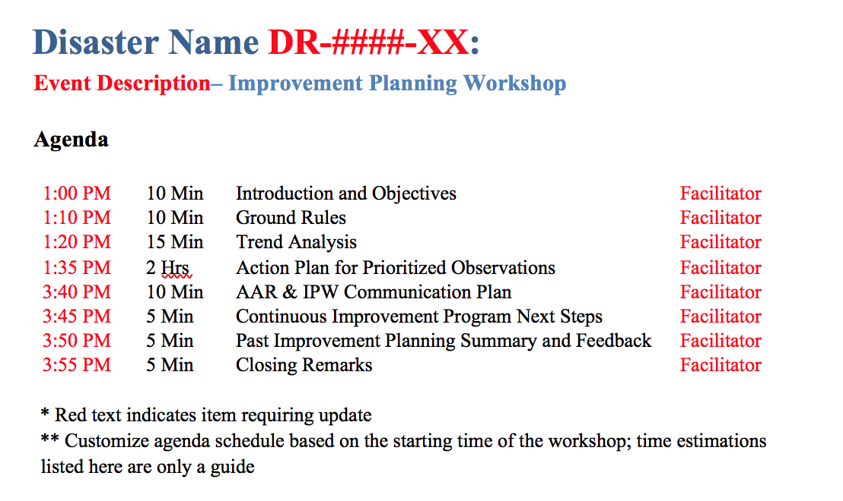
APW Document Creation: APW Agenda
Create the agenda for the Action Planning Workshop (APW) which can be created the same way as its predecessor the Improvement Planning Workshop (IPW) below:
Example IPW Agenda

Slide 18
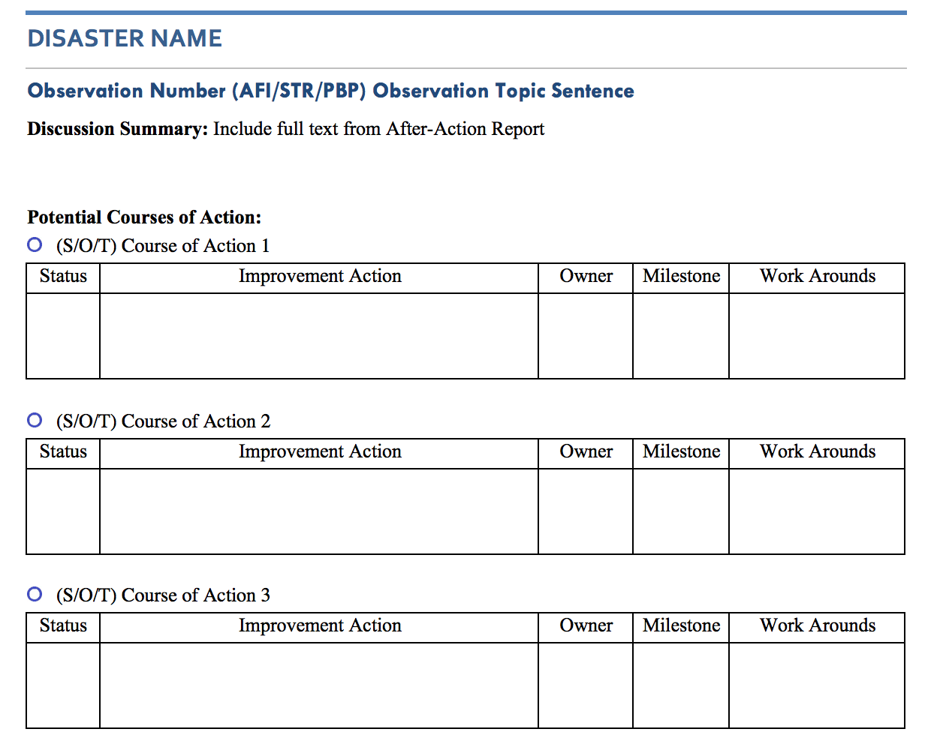
APW Document Creation: Action Planning Document
Create a word document for the highest prioritized observations.
  Include full Topic Sentences and Discussion text from the most updated draft of the AAR.
Example Action Plan

Slide 19
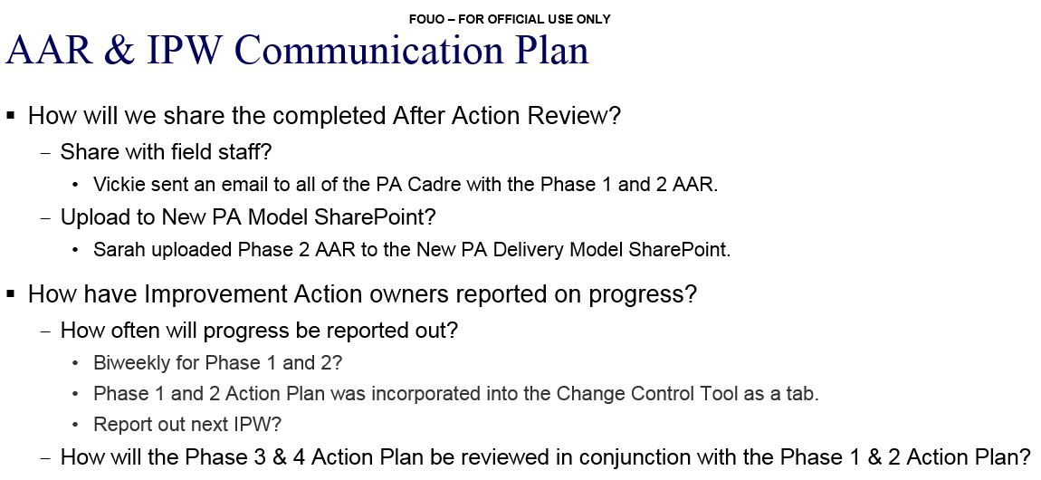
APW Document Creation: Communication Plan
Create a communication plan slide
  Ensure that everyone is on the same page about how the AAR will be used going forward and how the actions decided on will be tracked and who will do it.
Example Communication Plan

Slide 20
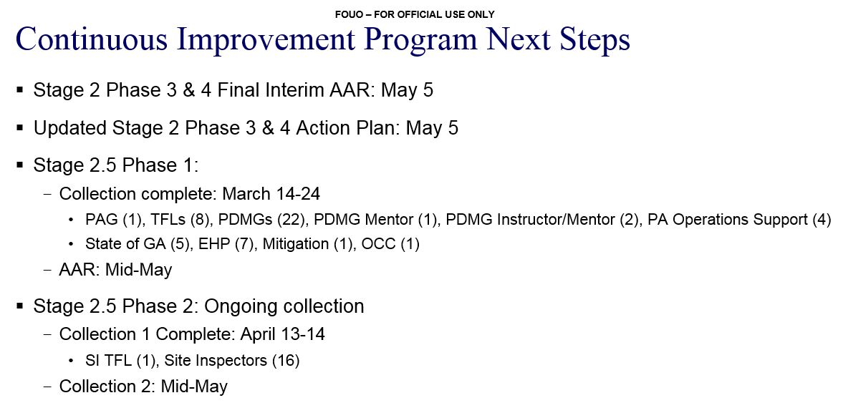
APW Document Creation: CIP Next Step
Create a next steps slide
  Provide an explanation of what actions will be taken following the APW.
Example Next Steps Slide

Slide 21
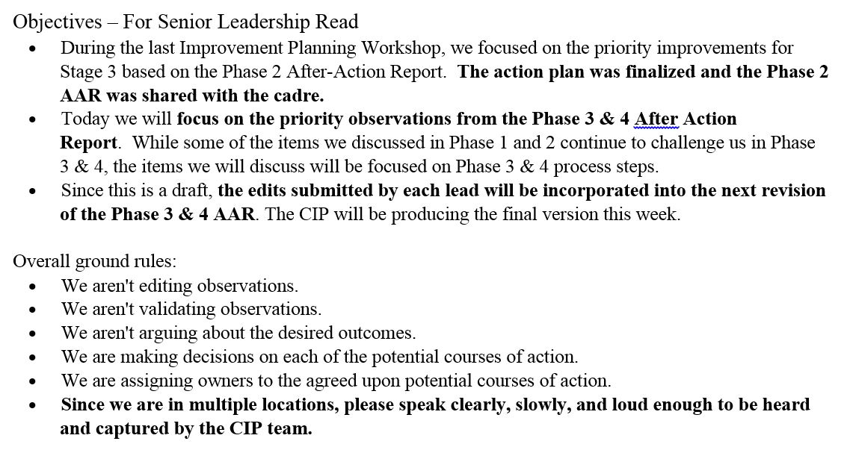
APW Document Creation: Objectives & Ground Rules
Prepare senior leaders
  Create talking points for a senior participant to use in opening the workshop.
  These should be written to ensure that all participants understand the purpose of the APW.
PRO-TIP
Get feedback on preferred format for talking points prior to delivering it to the leader.

Slide 22
Agenda
Determining Action Planning Workshop (APW) Objectives and Activities
APW Preparation
APW Document Creation
Conducting an APW
Post-APW Activities

Slide 23
Conducting an APW: Set Up
Set up the room
  Arrive early – There may be more rearranging of tables and chairs than you expect.
  Provide printed copies of the Action Plan and related documents– If technology stops working you still need to be able to conduct the meeting.
PRO-TIP
If you are conducting the APW in multiple locations, try to have the senior leader be co-located with the main facilitators.
PRO-TIP
Seat the senior leader and other key participants where they can easily engage in the conversation.

Slide 24
Conducting an APW: Facilitation
Facilitate the workshop
  Guide participants in identifying the actions that will address gaps and institutionalize strengths.
  Facilitate discussion on possible solutions and responsibilities for actions.
  Encourage participants to be a detailed as possible about what actions should be taken, who will take them, and the timeline for the actions to be completed.
  Write down each of the decided upon actions including who will take those actions and when.
  Be prepared for participants to develop a different solution than one of the COAs identified. Should this occur, make sure to understand the solution so it can be accurately recorded on the Action Plan. And, if it makes any of your other COAs no longer relevant, be prepared to skip over them in the discussion.
PRO-TIP
After each Observation, briefly review the actions that have been decided including the timelines for their completion.
PRO-TIP
Find someone who can be solely dedicated to typing up the actions as they are decided on. It is difficult to facilitate and record the decisions at the same time.

Slide 25
Agenda
Determining Action Planning Workshop (APW) Objectives and Activities
APW Preparation
APW Document Creation
Conducting an APW
Post-APW Activities

Slide 26
Post-APW Activities
Communication Plan Follow up: Contact POC identified to conduct communication plan steps to determine if plan is complete.
Edit Action Plan: Incorporate all the decisions made in the APW into the Action Plan.
Disseminate Action Plan: Send the Action Plan to all the participants that attended the APW.
Update Action Plan: Determine process for appropriate POC to update, maintain, and distribute Action Plan going forward
PRO-TIP
Convene a meeting following the APW to discuss next steps for the Action Plan with POCs assigned to ongoing roles.

