Slide 1
Getting started with HamPI
By dave slotter, w3djs

Slide 2
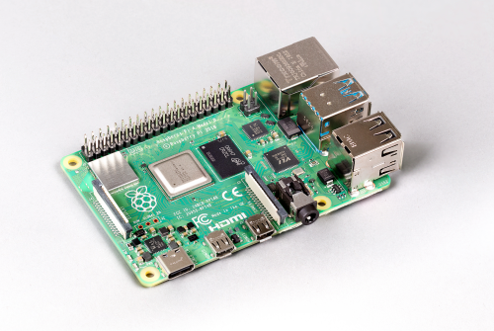
What’s a raspberry pi?
RPi 4 : low cost completely functional computer ($30 - $75 USD) size of card deck
CPU (ARM v8) | Micro HDMI
RAM (2GB – 8GB) | Micro SD Card Slot
USB (2x USB 2.0 + 2x USB 3.0) | Audio Jack
Ethernet (Gigabit) | Camera Port
WiFi (802.11ac) | GPIO Header!
Bluetooth (5.0 + BLE)

Slide 3
What Operating systems does raspberry pi use?
Raspbian Linux (based on Debian) | LibreELEC
Windows 10 IoT Core | Mozilla WebThings
Ubuntu | PiNet
Ubuntu MATE | RISC OS
OSMC | Weather Station

Slide 4
What can I do with raspberry Pi?
LibreOffice Suite (Word, Sheet, Present) | BitTorrent Server
Chromium (Web Browsing) | Home Automation
Media Player (Living Room PC) | Wireless network printer
Game Emulator | Music Streaming
Robotics | Kids First Computer
Windows 3.0 | Computing Cluster
Learn to Program | Weather Station
File Server (NAS) | Ham Radio Station

Slide 5
Raspberry pi 4 power requirements
Input voltage of 4.0 V to 5.5 V with absolute max rating of 6V before damage occurs
Reasonable power range is 4.7 V to 5.25 V
Power supply recommended provides 3A (15W) with minimum current of 2.5A if USB peripherals consume less than 500mA in total
Original Pi 4 has non-compliant USB-C power port. This has now been fixed.

Slide 6
Why use raspberry pi for ham radio?
Great in the shack or for going portable
Small form-factor
Lightweight
Low power needs
  Some people even power from solar!
Uses Linux which is already well supported

Slide 7
Where do I start?
Determine needs for Raspberry Pi – will determine equipment
Buy Raspberry Pi + power supply + micro sd card from local retailer
  Alternatively: SATA SDD + Cable or NVME SSD + NVME USB3 Adapter
Reuse USB keyboard, mouse and display. Don’t forget the micro HDMI cable!
Download software image to flash
  HamPi Image v1.0 (hampi.radiowaves.ca)
Download BalenaEtcher for Windows, Mac or Linux & flash micro SD card
Plug it all together, insert SD card and watch!

Slide 8
HamPi Image v1.0
Custom-built ham radio software image chock full of ~80 applications:
Created using Ansible, software automation tool.
FlDigi Suite | CHIRP | CQRLog
WSJT-X | BlueDV | wsjtx_to_n3fjp
JS8Call | ADS-B Flight Tracker | Pat WinLink + ARDOP
CubicSDR | NOAA Weather Imaging | CW Applications
GQRX | DX Cluster Client + Server | Ham Test Trainers
Direwolf | Xnecview | GPredict
Xastir | YAAC | Support for SDR Hardware
D-Rats | TrustedQSL | …and DOZENS MORE!

Slide 9
Where do I find HamPi Image v1.0?
http://hampi.radiowaves.ca/
Image is compressed with XZ in TAR format and is ~4GB.
Over 6,000 direct downloads in first 60 days!

Slide 10
Where do I get support for HamPi v1.0?
HamPi Forum on Groups.io
  https://groups.io/g/Ham-Pi
GitHub Wiki:
  https://github.com/dslotter/hampi/wiki
QRZ
  https://forums.qrz.com/index.php?threads/hampi-1-0-released.711515/
GARS Workshops!

Slide 11

How can I put image on (micro) SD Card?
You just can’t copy the image as a file on to the (micro) SD card.
  (some people have tried – and failed)
One solution: dd (for Linux)
But what if I have a Windows PC?
Solution: BalenaEtcher, available at https://www.balena.io/etcher/

Slide 12
What is the initial username and password?
Username: pi
Password: raspberry
Security note: please change the password to something unique, especially if you put your Raspberry Pi on the Internet like me.

Slide 13
How can I change the password?
Quick answer: run “passwd” command from command line / shell
  (will need old password to change it, unless you are logged in as root)

Slide 14
How can I change the username “pi”?
YOU DON’T – It causes a huge security risk, according to Kyle, W4KDA.
But you can add a new user to the system!
  sudo adduser <username>
  Don’t forget to add security groups!
  sudo groupmems –group dialout ---add <username>

Slide 15
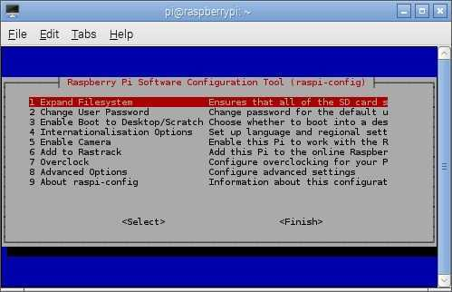
How do I expand the image to use entire (micro) sd card?
You have a 128GB microSD card and the Pi is only using 16GB. What do you do?
This is automatic on Raspbian Buster
On older versions of Raspbian:
  sudo raspi-config
    Expand Filesystem

Slide 16
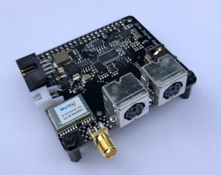
How do I connect the pi to my radio?
Short answer: USB
  Cable from RIG
  USB Sound Card
    SignaLink: $135
    Sabrent USB Sound Adapter $7
Another short answer:
DRAWS Ham Radio HAT by
NW Digital Radio $150

Slide 17
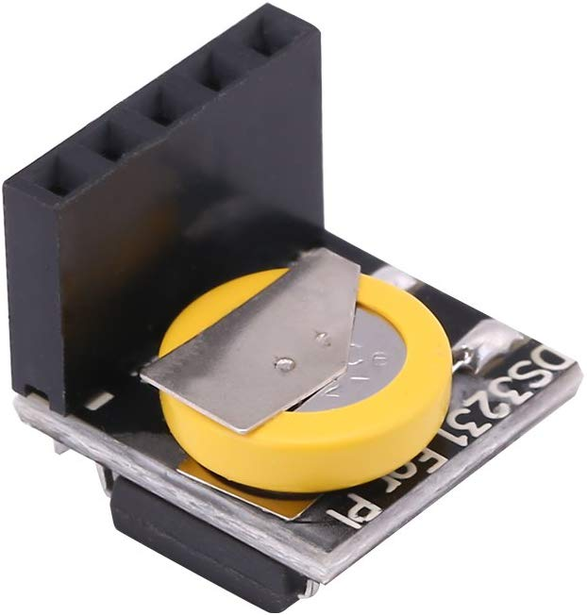

How to keep accurate time on the pi?
In the Hamshack: use timedatectl and NTP
  Command: timedatectl
  Command: ntpdate –q 0.us.pool.ntp.org
  For more info, see
  https://raspberrytips.com/time-sync-raspberry-pi/
In the Field: use GPS receiver & gpsd
  GLONASS GPS Tracker Module for
  Raspberry Pi: $8
Alternative: RTC Module $15
Alternative: DRAWS Hat GPS Receiver $150

Slide 18
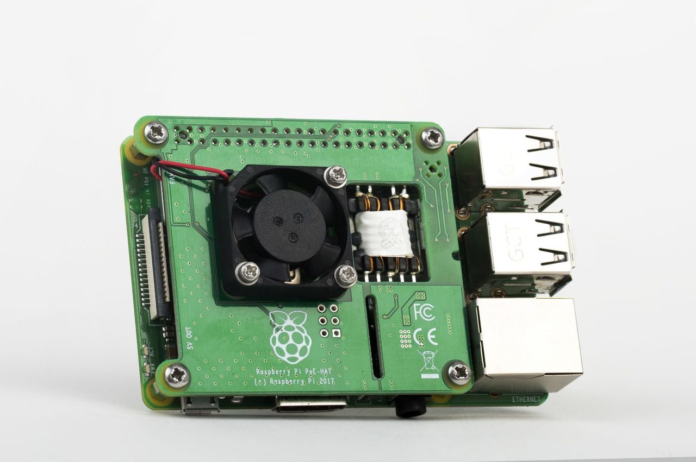
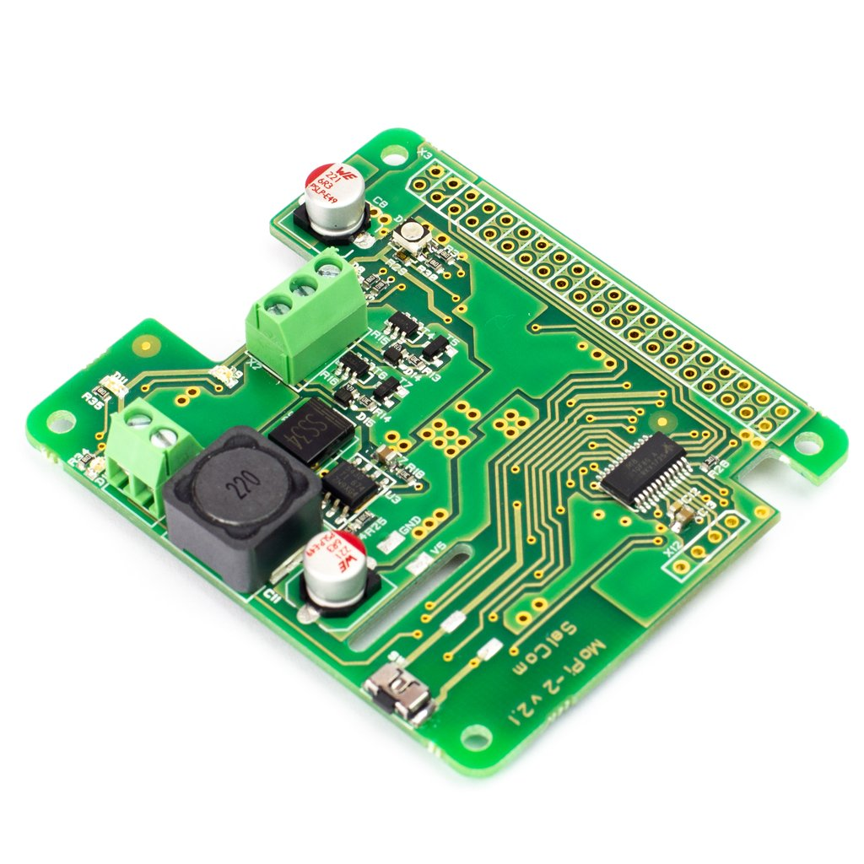

How do I Power My Raspberry Pi?
In the Ham Shack: Power Adapter aka “wall wart”
Also in the Ham Shack: Power over Ethernet (PoE) $20
GPIO Pin #2 (5V) GPIO Pin #6 (GND)
Dangerous – only use if you know what you’re doing
Mobile Power – USB Battery Pack $15+
MoPi 2 – Hot-Swap Mobile Power £29
PiJuice Solar Panels

Slide 19
HamPi v1.0
Use Case: Operating Digital Modes
FlDigi Suite by W1HKJ | gnss-sdr - GLONASS satellite system Software Defined Receiver
WSJT-X - Weak Signal (FT8, FT4, etc.) by W1JT | linpsk - amateur radio PSK31/RTTY program via soundcard
GridTracker - Graphical mapping companion program for WSJT-X or JTDX | multimon - multimon - program to decode radio transmissions
JTDX - Alternate client for Weak Signal (FT8, FT4, etc.) | multimon-ng - digital radio transmission decoder
JS8Call - Messaging built on top of FT8 protocol by KN4CRD | psk31lx - a terminal based ncurses program for psk31
JS8CallTools - Get Grid coordinates using GPS | twpsk - a psk program

Slide 20
HamPi v1.0
Use Case: Logging
Software included:
  TrustedQSL - LotW client from ARRL
  CQRlog - Ham Radio Logging Application
  PyQSO - Logging software (written in Python)
  klog - The Ham Radio Logging program
  tlf - console based ham radio contest logger
  tucnak2 - VHF/UHF/SHF Hamradio contest log version 2
  twlog - basic logging program for ham radio
  wsjtx_to_n3fjp - Logging adapter to allow WSJT-X to log to N3FJP by yours truly, W3DJS
  xlog - GTK+ Logging program for Hamradio Operators

Slide 21
HamPi v1.0
Use Case: APRS
Software included:
  Direwolf - Software "soundcard" AX.25 packet modem/TNC and APRS encoder/decoder
  Xastir - APRS GUI client / Digipeater / Igate
  YAAC - Yet Another APRS Client
  APRS Message App for JS8Call
  aprsdigi - digipeater for APRS
  aprx - APRS Digipeater and iGate
  soundmodem - Sound Card Amateur Packet Radio Modems

Slide 22
HamPi v1.0
Use Case: CW / Morse Code
aldo - Morse code training program | morse - training program about morse-code for aspiring radio hams
cw - sound characters as Morse code on the soundcard or console speaker | morse2ascii - tool for decoding the morse codes from a PCM WAV file
cwcp - Text based Morse tutor program | morsegen - convert file to ASCII morse code
xcwcp - Graphical Morse tutor program | qrq - High speed Morse telegraphy trainer
cwdaemon - morse daemon for the serial or parallel port | twcw - sends morse code via the sound card or serial card (Needs RTC installed)
ebook2cw - convert ebooks to Morse MP3s/OGGs | xdemorse - decode Morse signals to text
ebook2cwgui - GUI for ebook2cw | rscw - Receive CW through Soundcard

Slide 23
HamPi v1.0
Use Case: D-Star
Software included:
  d-rats - A communication tool for D-STAR
    NOTE: THIS INCLUDES INSTANT UPDATE ABILITY
  BlueDV - Client for D-Star, DMR and YSF (Phone)

Slide 24
HamPi v1.0
Use Case: Software Defined Radio (SDR)
CubicSDR - Software Defined Radio receiver | SoapyMultiSDR - Multi-device support module for SoapySDR
cutesdr - Simple demodulation and spectrum display program | SoapyNetSDR - Soapy SDR module for NetSDR protocol
GQRX - Software defined radio receiver | SoapyRemote - Use any Soapy SDR remotely
SDRAngel - SDR player | SoapyRTLSDR - Soapy SDR module for RTL SDR USB dongle
lysdr - Simple software-defined radio | SoapySDR - Vendor and platform neutral SDR support library
quisk - Software Defined Radio (SDR) | SoapySDRPlay - Soapy SDR module for SDRPlay
SoapyAudio - Soapy SDR plugin for Audio devices
SoapyHackRF - SoapySDR HackRF module | (and More!)

Slide 25
HamPi v1.0
Use Case: Satellite Communication
Software included:
  Gpredict - Satellite prediction
  predict-gsat - Graphical Predict client
  gnss-sdr - GLONASS satellite system Software Defined Receiver
  wxtoimg - NOAA weather imaging software

Slide 26
HamPi v1.0
Use Case: WinLink / EmComm
Software included:
  Pat WinLink - WinLink for Raspberry Pi (and other platforms)
  ARDOP support for Pat WinLink
  ARDOP-GUI - Provides graphical representation of ARDOP connections
  Find ARDOP - Retrieves local ARDOP sources by KM4ACK
  AX25 support for Pat WinLink
  PMON - a PACTOR® Monitoring Utility for Linux

Slide 27
HamPi v1.0
Use Case: Antenna Modeling
Software included:
  antennavis - Antenna Visualization Software
  gsmc - A GTK Smith Chart Calculator for RF impedance matching
  nec2c - Translation of the NEC2 FORTRAN source code to the C language
  xnecview - NEC structure and gain pattern viewer
  yagiuda - software to analyse performance of Yagi-Uda antennas
  VOACAP - HF propagation prediction

Slide 28
HamPi v1.0
Use Case: Ham Training / Testing
Software included:
  fccexam - Study tool for USA FCC commercial radio license exams.
  hamexam - Study guide for USA FCC amateur radio (ham radio) license examinations.

Slide 29
HamPi v1.0
Use Case: Miscellaneous Applications
Software included:
  CHIRP - Radio Programming Software
  QTel - EchoLink client
  QSSTV - Slow Scan TV (e.g. "Fax")
  FreeDV - Free digital voice vocoder
  WsprryPi - WSPR software
  ADS-B Flight Tracking Software
  Xdx is a DX-cluster client
  DXSpider - DX Cluster Server

Slide 30


HamPi V1.0 Supports These charities
TFRM and AFESP – 50/50 Shared Parenting

Slide 31
DEMO + QUESTIONS
Demo of remote station operation.
  (Hey, I tested it this morning!)
RFI sensitivity concerns
  Use Ferrite chokes

