Slide 1



CERT Tools for Leadership
Success
Community Emergency
Response Team

Slide 2
Participant Introductions
Introduce yourself to the class by providing your:
  Name
  Reason you want to learn more about leadership
Notes:
1

Slide 3
Administrative Announcements
Breaks
Emergency exits
Restrooms
Smoking policy
Silence cell phones
Module completion
Notes:
2

Slide 4
What Do You Think?
Why do CERT members need to learn leadership skills?
Notes:
3

Slide 5
CERT Members and Leadership
In emergencies, every CERT member will encounter situations where they need to lead
Sometimes you may be a leader of your team
Being a leader during an emergency requires special training
Are you comfortable being team leader?
Do you know how to support your team leader by being an effective team member?
Notes:
4

Slide 6
Module Purpose
To train CERT members to be successful team leaders and team members
To choose suitable team leaders during CERT activations
To apply appropriate leadership styles to various situations

Slide 7
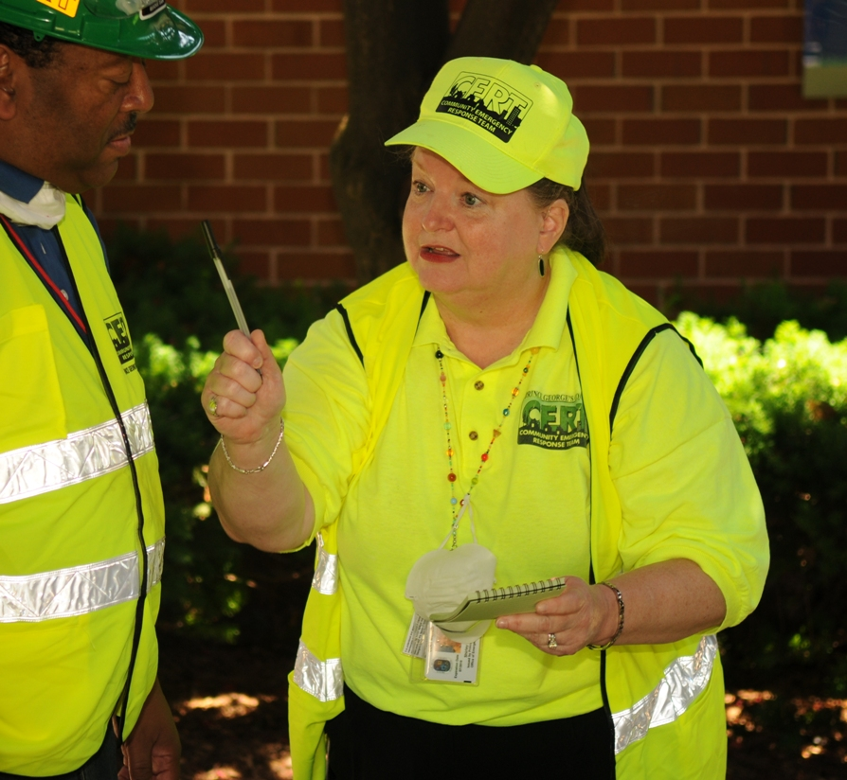
Leader Defined
Inspires act of following
Unites people as a team to work toward the accomplishment of a common mission
Notes:
6

Slide 8
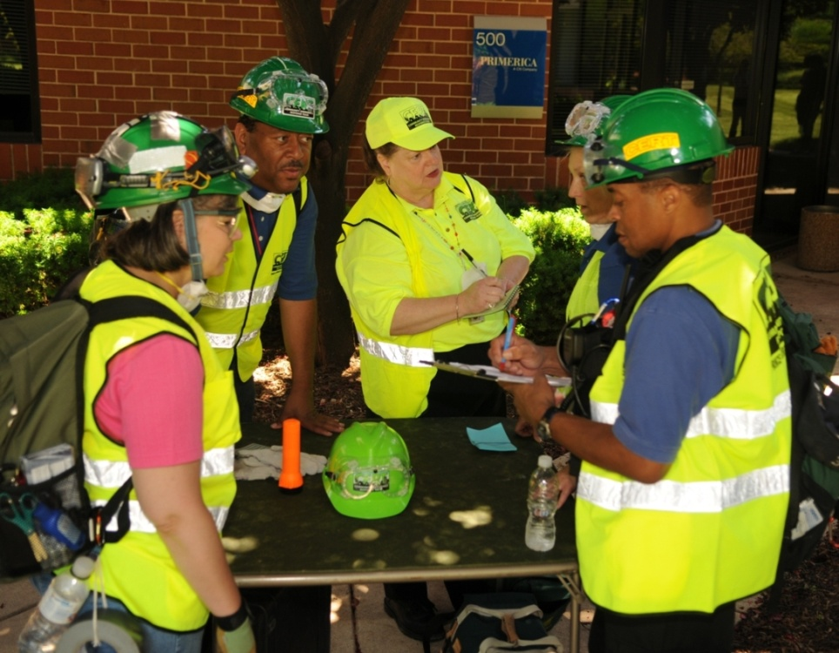
Team Member Defined
Works together with others in a team to accomplish specific goals
  Goals are identified by person appointed to lead the team
Notes:
7

Slide 9
What Do You Think?
What is your common mission as members of a Community Emergency Response Team?
Notes:
8

Slide 10
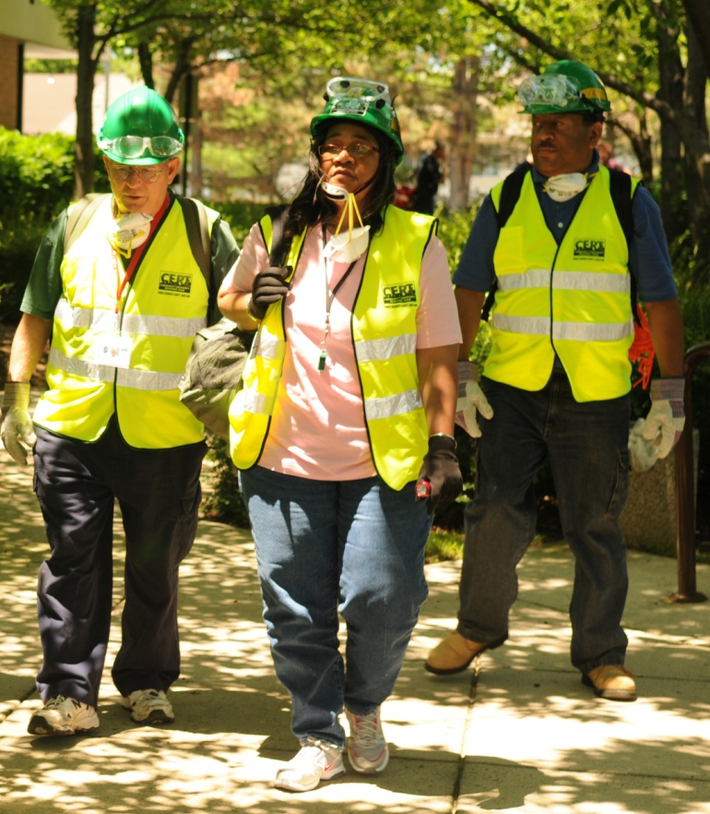
Your Mission as CERT Members
Reduce hazards in your community
Respond to immediate needs of your family and community after disaster
Respond as a team to do the greatest good for the greatest number of people
Notes:
9

Slide 11
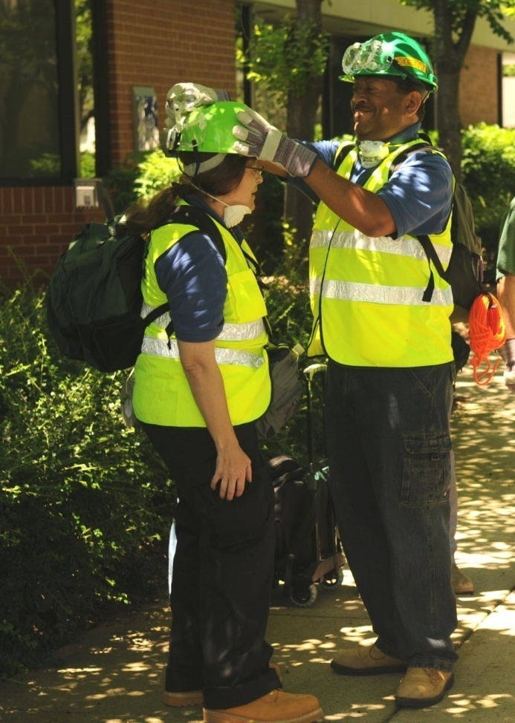
What You Will Learn
Review of CERT Basic Training Concepts That Apply to Leadership
Leaders and Team Members
Leadership Styles
Leaders in Action
Notes:
10

Slide 12
Module Objectives
At the end of this module, you will be able to:
  Define leadership and team membership
  Describe CERT Basic Training concepts that apply to leadership
  Describe characteristics, skills, and responsibilities of an effective team leader and effective team members
  Describe each style within a range of leadership styles that may be useful during CERT response
  Identify the appropriate leadership response for a given situation

Slide 13
Module Objectives (cont’d)
At the end of this module, you will be able to:
  Recognize your personal leadership style
  List the steps a leader should take to direct team operations during an activation
  Describe tips for making decisions under stressful conditions
  Describe tips for addressing various leadership concerns
  As a team, choose a leader and develop an action plan for a given scenario

Slide 14
Review of CERT Basic Training
Incident Command System or ICS
CERT sizeup
Disaster psychology
Local protocol for choosing a team leader

Slide 15
Incident Command System
Generally CERT is part of established ICS for an incident
  CERT members follow orders from professional responders
If no professional responders are on scene, CERT sets up ICS
  CERT members defer to professional responders when they arrive

Slide 16
CERT IC/TL Responsibilities
Provides overall leadership for incident response
Ensures incident safety
Establishes incident objectives
Is responsible for all functions until can be delegated
Delegates authority to others
Provides information to internal and external parties
Establishes and maintains liaison with other agencies
Manages media inquiries when necessary
Takes direction from agency official
Notes:
15

Slide 17
Team Organization
CERT operates in one of two ways
  One team performing all tasks
  Smaller teams performing specific tasks
Role of identified leader
  Supervise tasks
  Account for team members
  Report information to his or her leader
Notes:
16

Slide 18
What Do You Think?
What are the steps of the CERT sizeup?
Notes:
17

Slide 19
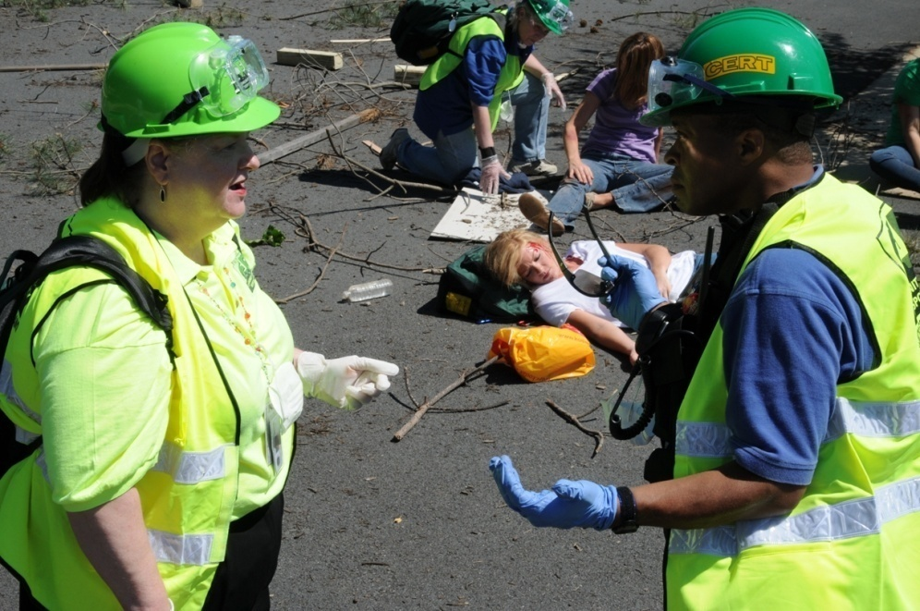
Disaster Psychology
An effective team leader needs to be aware of:
  The mental state of team members
  His or her own mental state
Notes:
18

Slide 20
Leader: Reduce Stress in Team Members
Brief team members before effort begins
Emphasize team support
Encourage resting and re-grouping
Have team take breaks away from incident
Encourage proper food and fluid intake
Rotate teams for breaks or new duties
Phase out workers gradually
Notes:
19

Slide 21
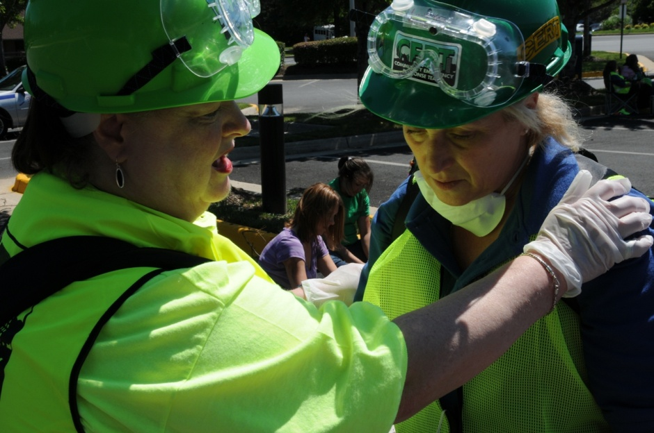
Empathetic Listening
Try to see team members’ perspectives
Listen for meaning and pay attention to nonverbal communication
Paraphrase to make sure you understand
Notes:
20

Slide 22
Choosing a Team Leader
Insert local protocol for choosing a team leader
Notes:
21

Slide 23
Leaders and Team Members
Characteristics of effective team leader
Skills for effective leadership
Responsibilities of effective team leader
The Leadership Competence Model
Characteristics of effective team member
Responsibilities of effective team member
Notes:
22

Slide 24
Team Composition
Team is unit of two or more individuals coordinating and cooperating to accomplish specific goals
Leaders and team members are all part of same team
The team leader and members work together and look out for each other
Notes:
23

Slide 25
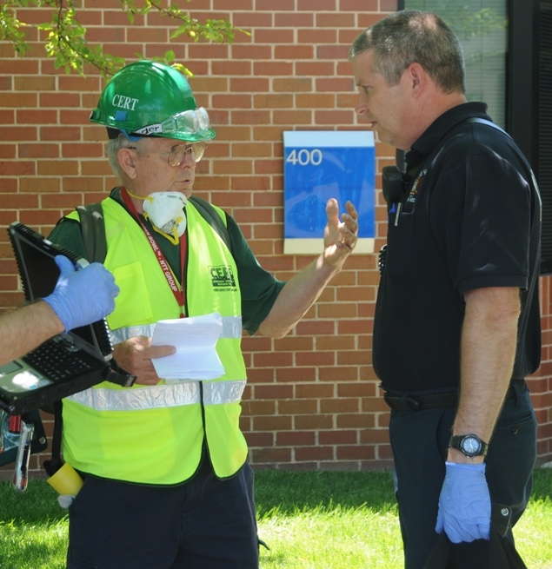
Team Leaders
“Great leaders are made, not born”
Effectiveness of a leader depends on applying specific principles
Everyone can learn to be an effective leader through study and practice
Notes:
24

Slide 26
What Do You Think?
What are the characteristics of an effective CERT leader?
Notes:
25

Slide 27

Team Leader Characteristics
Motivated
Inspiring
Goal-oriented
Good at prioritizing
Decisive
Trustworthy
Ethical
Good at communicating
Level-headed
Flexible
Notes:
26

Slide 28
Team Leader Characteristics (cont’d)
Not necessarily a “star”
Open about what he or she does not know
Open about errors
Prepared to accept responsibility
Prepared to give credit to others
Reflection of the team to Incident Command
Notes:
27

Slide 29

Skills for Effective Leadership
Motivate
Take responsibility
Act decisively
Communicate effectively
Behave ethically
Build trust
Notes:
28

Slide 30
Motivate
Show passion for team’s mission
Get team members involved in decision-making
Give team members meaningful responsibilities
Praise team members
Build sense of team cohesion
Create positive working environment
Notes:
29

Slide 31

Take Responsibility
Act as final decision-maker for team
Accept consequences
Admit mistakes or errors
Ask for guidance when needed
Re-evaluate plans
Improve situations that go wrong
Notes:
30

Slide 32
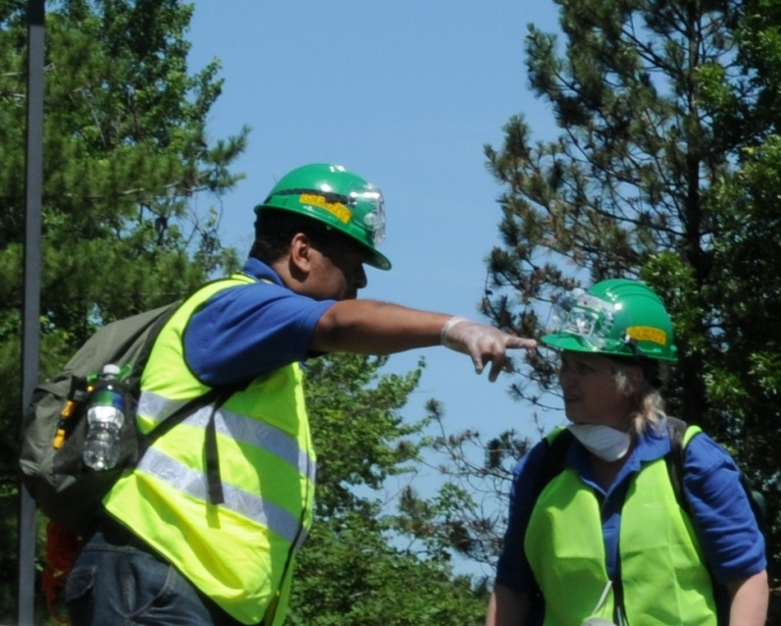
Act Decisively
Make decisions based on facts
Listen to feedback, but make final decisions
Trust personal instincts
Make decisions that are timely
Do not second guess decisions
Resolve conflicts quickly
Notes:
31

Slide 33
Communicate Effectively
Use questions to guide exchanges and keep focus
Ask for opinions and observations of team members
Read verbal and non-verbal cues
Give clear directions
Ensure balanced exchanges within team
Notes:
32

Slide 34
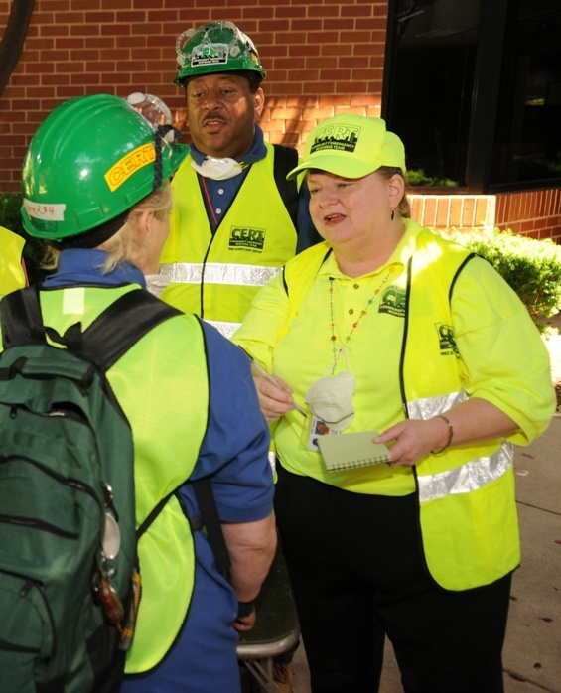
Behave Ethically
Be honest
Treat others with respect
Take your duties seriously
Treat everyone fairly
Stay within your capabilities
Set good example by modeling behavior you expect
Notes:
33

Slide 35
Build Trust
Make your actions and words consistent
Behave by values and morals expected of team
Be honest about personal strengths and weaknesses
Be open and honest about situation
Admit to mistakes or failures
Listen to input from team members
Trust team members’ judgment
Expect team members to be successful
Notes:
34

Slide 36
What Do You Think?
What are the responsibilities required of an effective CERT leader?
Notes:
35

Slide 37
Leader Responsibilities
Establish team chain of command
Delegate responsibility to team members
Develop goals and tasks
Maintain view of entire situation
Anticipate changes
Resolve problems within team
Ensure safety of team members
Take care of personal well-being
Be available and visible to team
Notes:
36

Slide 38
Leadership vs. Management
Leadership
Management
Setting direction
Encouraging vision
Getting people to work together
Motivating
Inspiring
Creating change
Planning
Organizing
Staffing
Controlling
Notes:
37

Slide 39
Conscious Incompetence
This person:
  Knows nothing about leadership
  Is aware of lack of knowledge
  Steps aside to let others lead
Notes:
38

Slide 40
Conscious Competence
This person:
  Knows a little about leadership
  Has desire to improve – and works at it
75% of people fit into this category
Most can be good team leaders
Notes:
39

Slide 41
Unconscious Competence
This person:
  Knows how to lead without thinking about it
  Assumes role of leader and others willingly follow
This person is a natural leader
Notes:
40

Slide 42
Unconscious Incompetence
This person:
  Has no natural leadership abilities
  Doesn’t realize that he or she lacks leadership abilities
This is the least desirable leader, especially in an emergency setting
Notes:
41

Slide 43
Exercise
What Is Your Leadership Competence?
Notes:
42

Slide 44
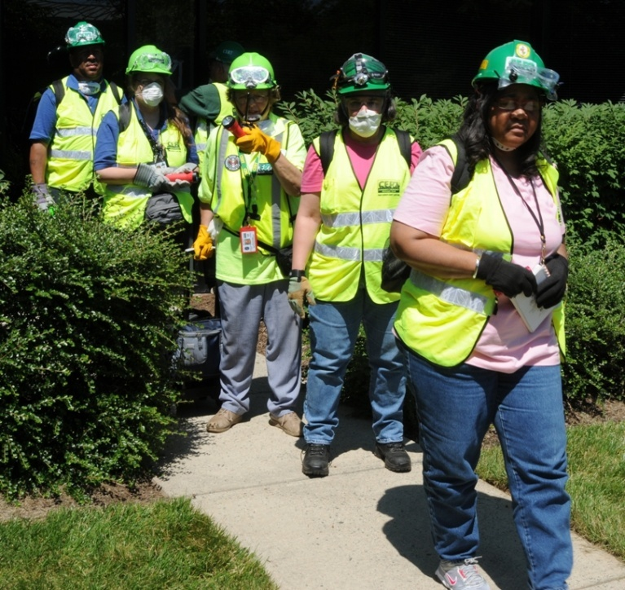
Team Members
Team members define success of leader
A team accomplishes more than an individual can accomplish alone
Behavior of individual team members will determine the team’s success
Notes:
43

Slide 45
What Do You Think?
What are the characteristics of an effective CERT member?
Notes:
44

Slide 46
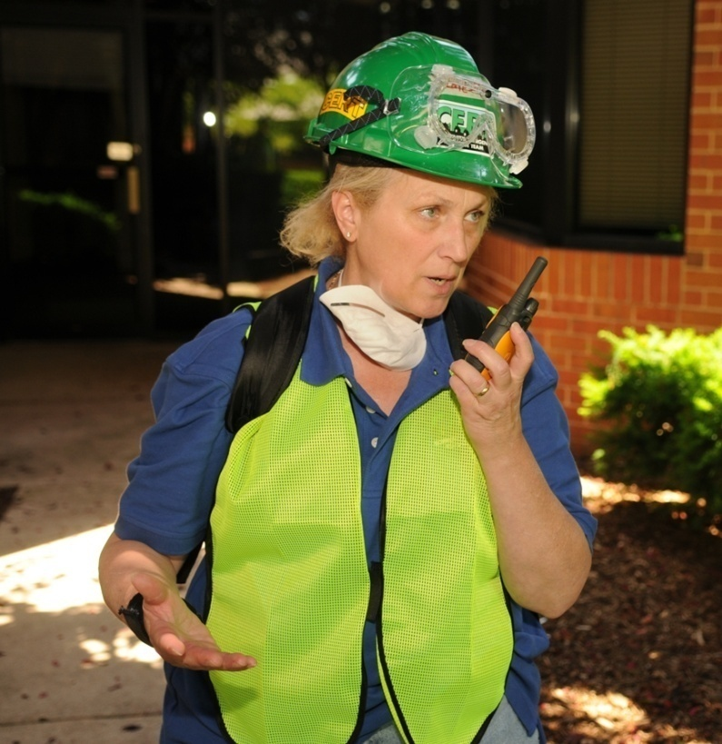
Team Member Characteristics
Motivated
Energetic
Hard-working
Adaptable
Helpful
Loyal
Responsible
Notes:
45

Slide 47
Exercise
Characteristics of an Effective
Team Member
Notes:
46

Slide 48
What Do You Think?
What are the responsibilities of an effective CERT member?
Notes:
47

Slide 49
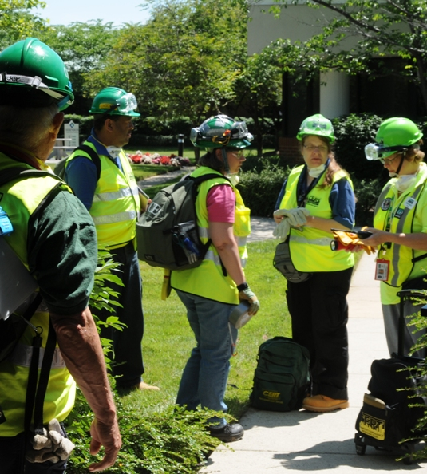
Team Member Responsibilities
Comply willingly
Follow directions per chain of command
Complete assigned tasks
Give your best effort
Keep team leader informed
Notes:
48

Slide 50
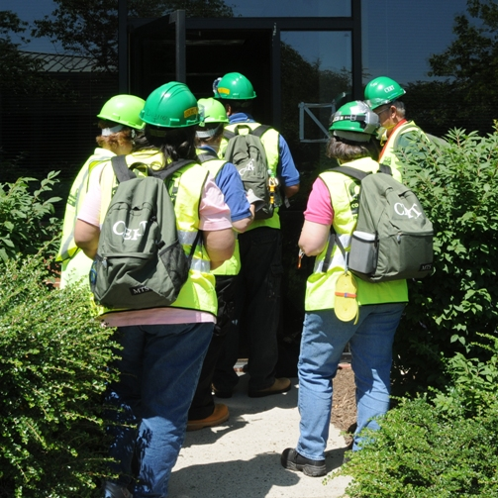
Team Member Responsibilities (cont’d)
Seek clarification if you don’t understand
Support team leader’s actions
Support teammates
Maintain scene safety
Notes:
49

Slide 51
Successful Team Interactions
Put team mission first
Be supportive of each other
Recognize each other’s strengths
Make use of your skills and be honest about weaknesses
Notes:
50

Slide 52
Successful Team Interactions (cont’d)
Trust each other
Communicate honestly
Work out conflicts quickly and respectfully
Providing the service requested of them without issues or attitudes
Notes:
51

Slide 53
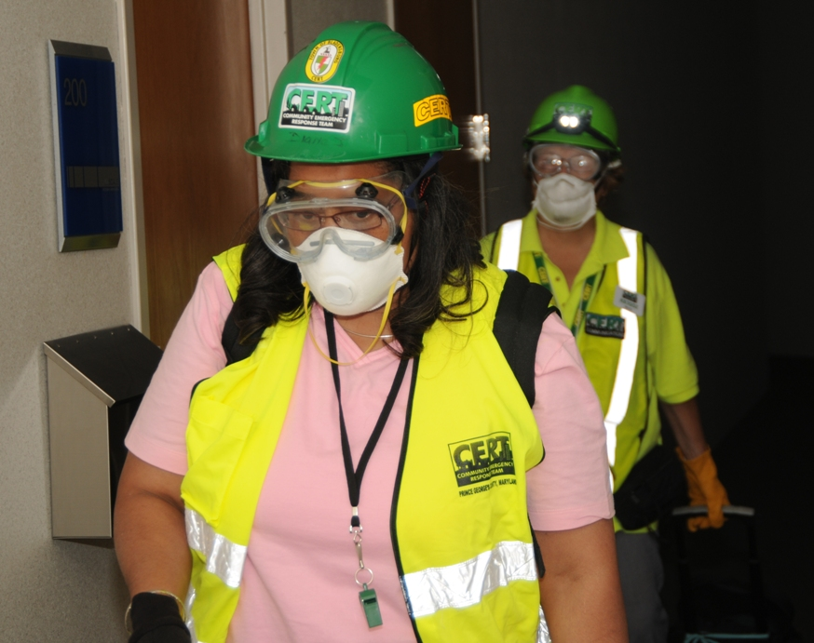
Successful Team Operations
Choose team leader to quickly resolve feelings of uncertainty
Follow leader’s directions
Tell leader if plan is not working
Adapt if things don’t go as planned
Notes:
52

Slide 54
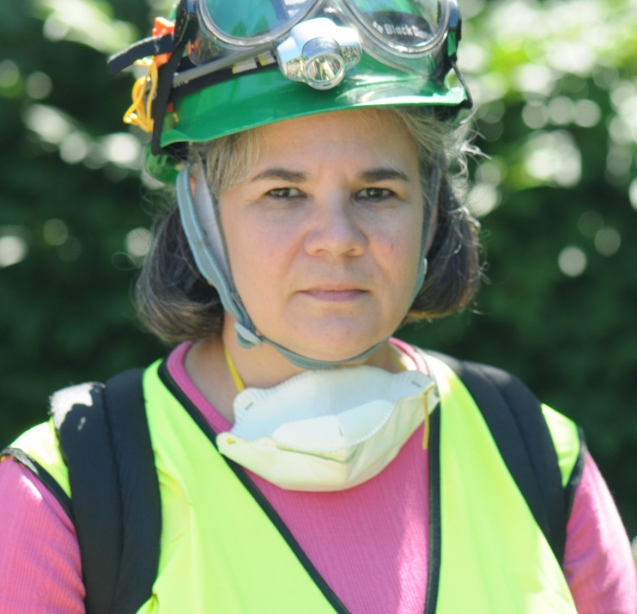
Successful Team Operations (cont’d)
Ask yourself:
  Am I doing my part?
  Am I doing everything I can to support my team and team leader?
  Am I giving my leader enough information to make a decision?
Notes:
53

Slide 55
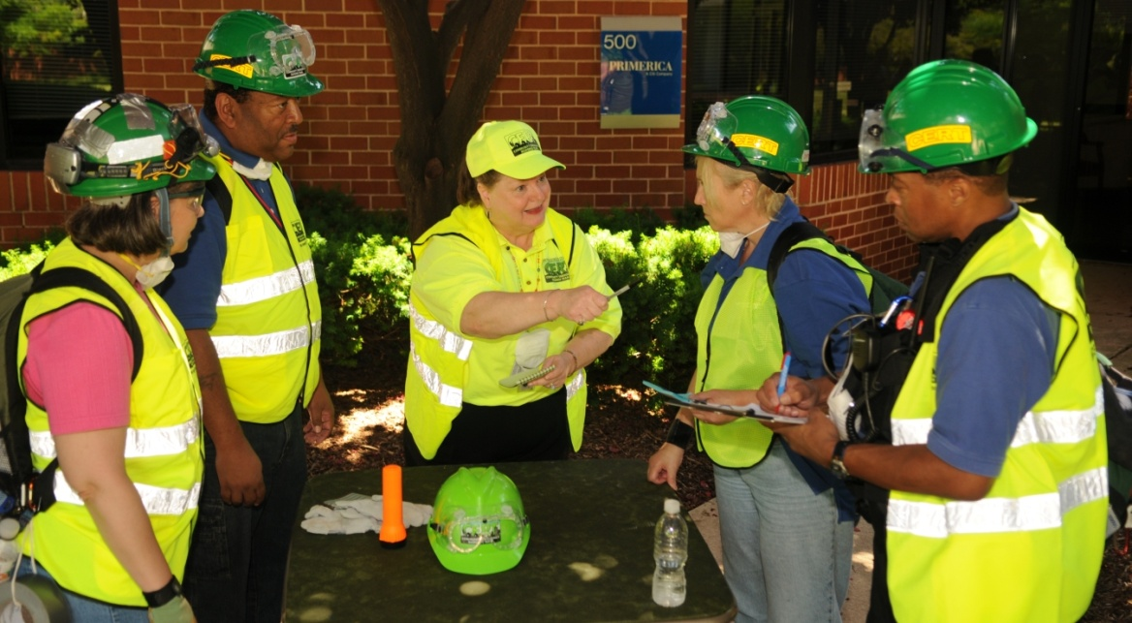
Leadership Styles
Situations that require leadership
Categories of CERT situations
Leadership styles for CERT situations
Notes:
54

Slide 56
What Do You Think?
What are some situations you’ve dealt with in your personal life that required leadership skills?
Notes:
55

Slide 57
What Do You Think?
What situations have you been involved in with CERT that required leadership skills?
Notes:
56

Slide 58
Situational Leadership
The way you respond to one situation will not always work for another situation
When faced with problems, use your judgment to decide best way to respond
The same person can lead differently based on the situation
Notes:
57

Slide 59
Situational Leadership (cont’d)
Situational leadership is knowing when, where, and with whom to use each particular leadership style
The best way to respond in a CERT activation is by urgency of situation
Notes:
58

Slide 60

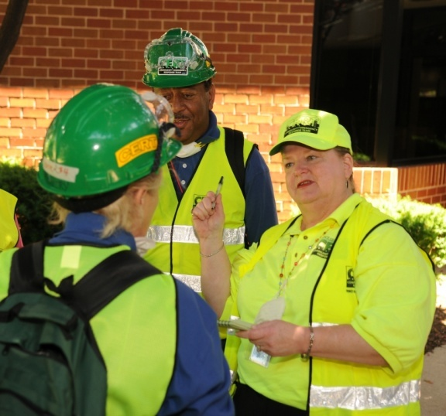
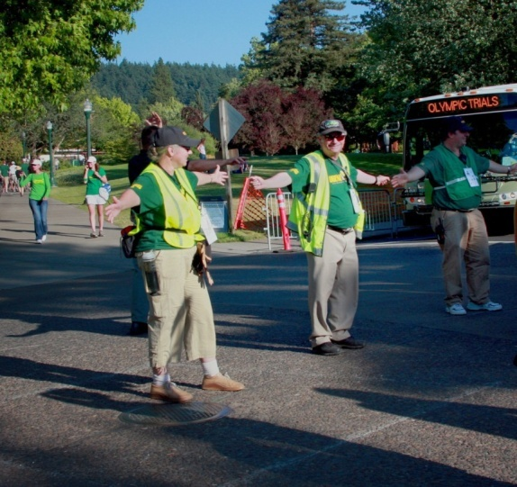
CERT Situations
Three levels based on urgency:
Urgent
Controlled
Planned
Notes:
59

Slide 61
Urgent Situations: Decisive Leadership
Situation requires immediate action
Leadership style: Directive, task driven, and risk driven
Leadership process:
  Receive input from team but make decisions alone
  Provide clear expectations to team members
Notes:
60

Slide 62
Controlled Situations: Participative Leadership
Situation is managed
  Lives and property are not in immediate danger
Leadership style: Requests more feedback and advice from team members
Leadership process:
  Encourage and motivate team members
Notes:
61

Slide 63
Planned Situations: Delegative Leadership
Situation is organized in advance
  Established plan of action
  No immediate safety risks
Leadership style: More inclusive
Leadership process:
  Team members are allowed to make decisions and implement tasks themselves
Notes:
62

Slide 64
Delegative Leadership
Caution: Team may be less productive
Suggestions:
  Have team members clearly define their roles
  Have team members define all tasks that need to be accomplished
  Maintain awareness of all team operations
  Provide direction to team whenever needed
  Remain available to team members who have questions
  Maintain role of team leader
Notes:
63

Slide 65
Exercise
Choosing the Right Leadership Style
Notes:
64

Slide 66
Exercise
What Is Your Preferred Leadership Style?
Notes:
65

Slide 67
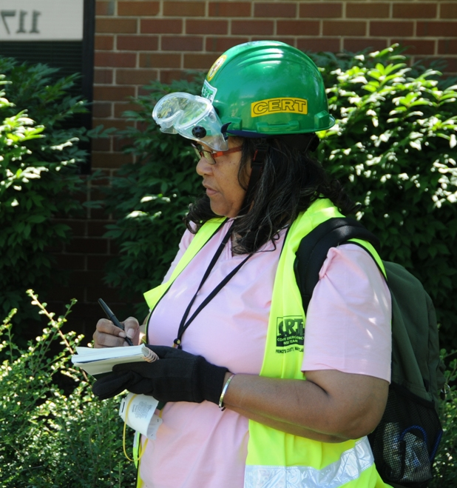
Leaders in Action
What leaders do and how they do it
Situational awareness
Tasks for leading team operations
Leading in stressful situations
Your concerns about CERT leadership
Practice activity
Notes:
66

Slide 68
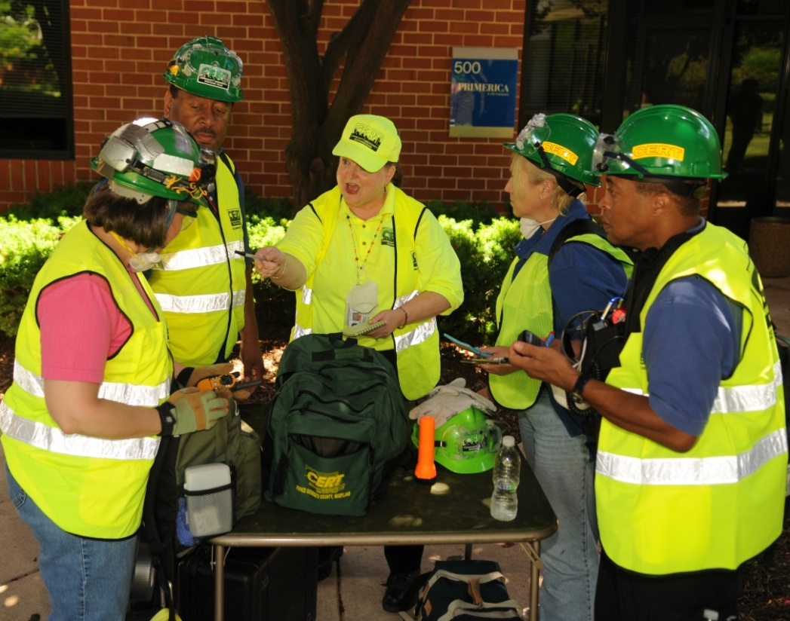
What Do Leaders Do?
Guide the way
Direct and control the plan
Motivate and influence team members
Ensure progress toward team goals
Notes:
67

Slide 69
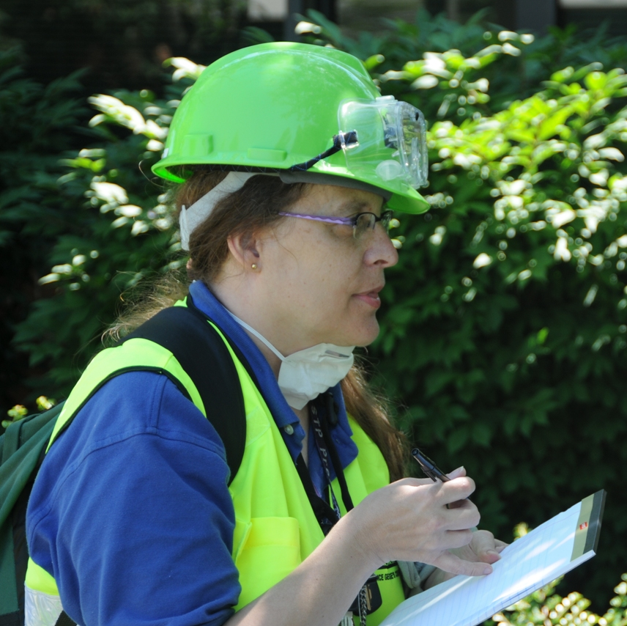
How Do Leaders Do It?
They are not afraid to make mistakes
They get their plan moving and make things happen
They know that there is never a perfect solution
Notes:
68

Slide 70
Situational Awareness
CERT leaders oversee people, operating procedures, and equipment
CERT leaders maintain situational awareness at all times:
  Physical conditions of incident
  Where team members are and what they are doing
  Psychosocial conditions of team
  Current status of all aspects of incident
Notes:
69

Slide 71
If Lose Situational Awareness May …
Show confusion, fixation, impaired thinking
Provide too much or conflicting information
Demonstrate narrow focus or inability to think ahead
Give incomplete directions
Overlook unmet goals
Lose control of situation
Neglect team standards
Notes:
70

Slide 72
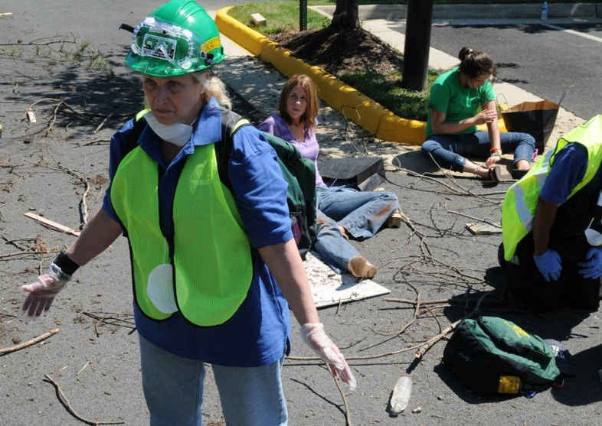
Loss of Situational Awareness
May lead to:
  No plan
  No personal accountability
  Random, undisciplined communication
  No regular situation assessment
  Unfocused span of control
Notes:
71

Slide 73
Loss of Situational Awareness (cont’d)
May lead to failure of team operations and inability to accomplish team tasks:
  Team members working alone instead of as a team
  Tasks not accomplished as assigned
  IC unaware of what the team is doing
Notes:
72

Slide 74
Maintain Situational Awareness
Anticipate scope and adjust span of control
Filter out, control, or redirect irrelevant information
Expect the unexpected and prepare for it
Keep big picture in mind
Develop a system of standard procedures
Monitor and evaluate constantly
Notes:
73

Slide 75
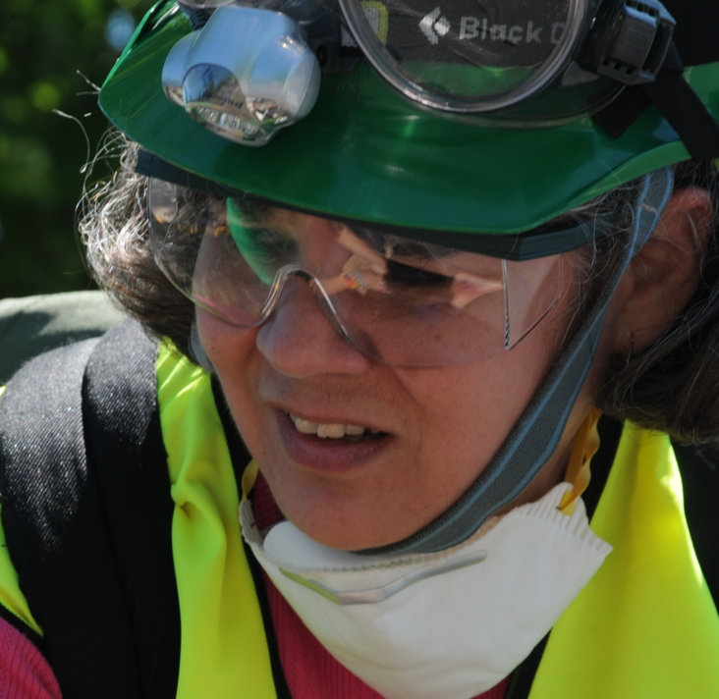
Leaders in Stressful Conditions
May experience:
  Confusion or disorientation
  Indecisiveness
  Shortened attention span
  Difficulty concentrating
  Memory loss
  Self-blame
Notes:
74

Slide 76
When a Leader Needs a Break
Team leaders are responsible for taking breaks or delegating leadership responsibility
  Sometimes leader might not step down
Team member action:
  Ask leader if he or she needs a break or more help
If the team believes it necessary, one or two members should approach the leader and discuss a change of command
Notes:
75

Slide 77
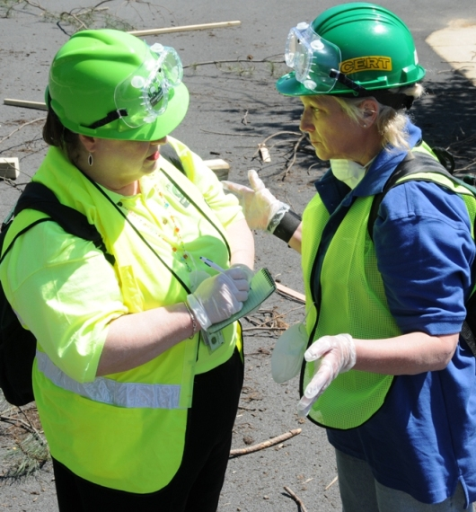
Making Decisions Under Stress
Define all problems
Evaluate information carefully
Identify problems that team can handle
Prioritize problems
Choose course of action for each problem
Select alternative approach if initial course of action is ineffective
Notes:
76

Slide 78
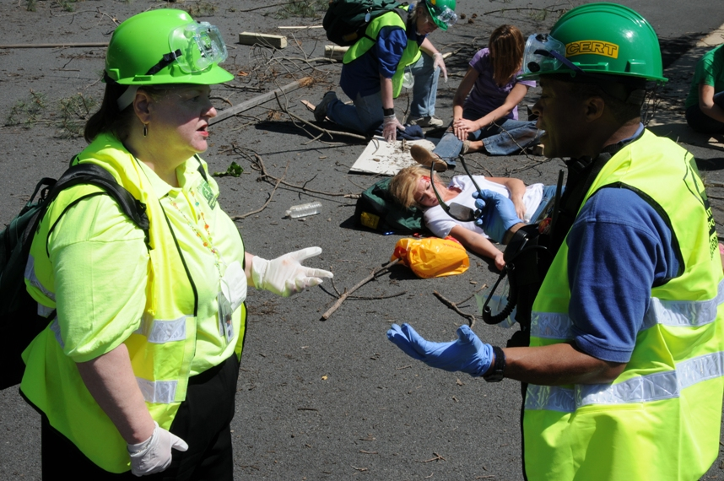
Leading in Stressful Situations
Limit discussion and make unilateral decisions
Provide clear direction
Have team members paraphrase instructions
Use simple language and short sentences
Notes:
77

Slide 79
Exercise
Leading in Stressful Situations
Notes:
78

Slide 80
What Do You Think?
Does anyone have any remaining concerns about leading during a CERT activation?
Notes:
79

Slide 81
Exercise
Your Leadership Concerns
Notes:
80

Slide 82
Exercise
Team Roleplay
Notes:
81

Slide 83
Module Summary
CERT Basic Training Concepts That Apply to Leadership
Leaders and Team Members
Leadership Styles
Leaders in Action
Notes:
82

