Slide 1


Unit 10: Keeping Your Program Going
CERT Program Manager

Slide 2
Unit Objectives
At the conclusion of this unit, the participants will be able to describe how to sustain a local CERT program:
  Describe the knowledge, skills, and abilities a Program Manager must possess in order to coordinate a program
  Identify elements necessary for sustaining a program
  Explain a technique for identifying program activities that contribute most significantly to program maintenance
PM 10-1

Slide 3
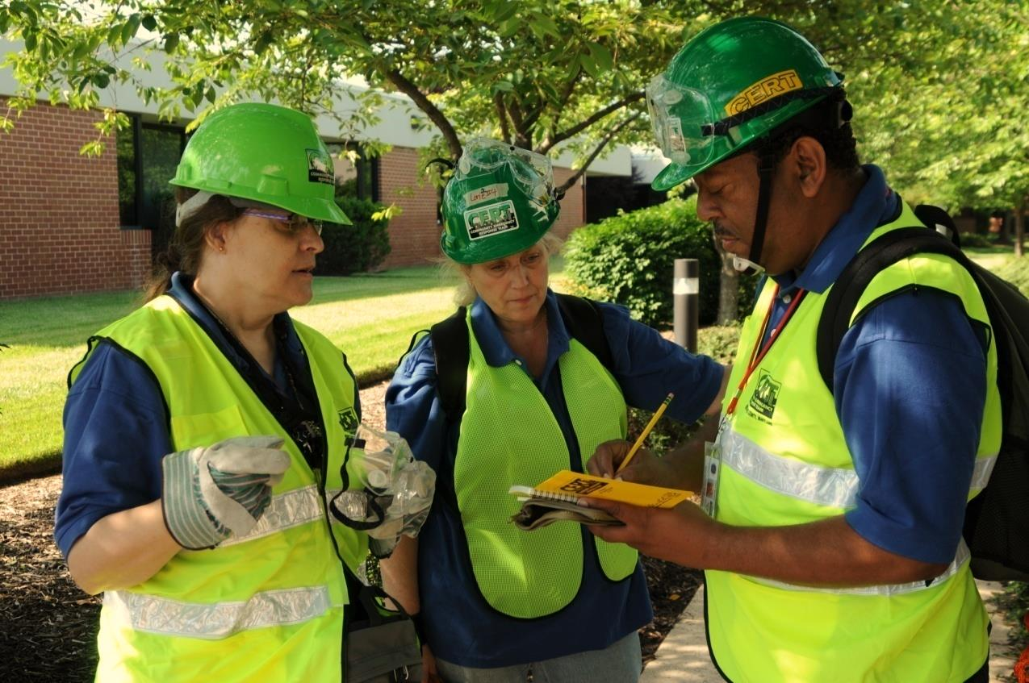
Unit Topics
Essential Skills and Abilities
Keeping a Program Alive
PM 10-1

Slide 4

Who Are Program Managers?
Two types of people start CERT programs:
  Forward-thinking champion
  Person told to go start a program
PM 10-2

Slide 5
What Do You Think?
If you started your CERT program or are planning to start a program, which type best describes you?
  You believed in the concept and wanted to help create a program
  You were given the job of starting a CERT program along with other assigned duties
PM 10-2

Slide 6
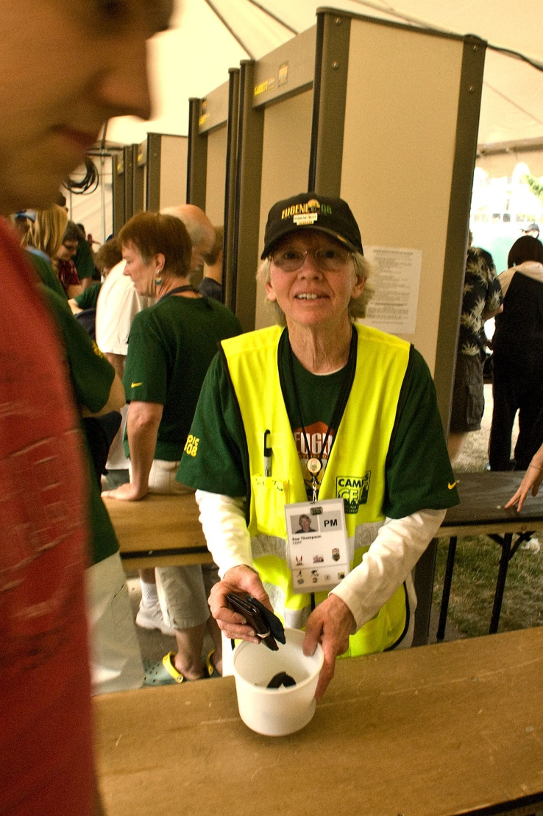
The Challenge
Keeping program going
Making sure that
program is effective
and stays strong
and viable
PM 10-2

Slide 7
Important Info to Know
How to:
  Manage volunteers
  Accommodate all volunteers
  Promote program to community, media, elected officials, potential sponsors, etc.
  Convince veteran police and fire chiefs to use volunteers
  Manage time commitment and amount of resources required to run a successful program
PM 10-2

Slide 8

Important Info to Know (cont’d)
How to:
  Address legal hurdles and aspects
  Prove the value of the program
  Develop program support from elected officials for program activities
What your CERT program’s role is in your specific community’s
emergency operations plan
PM 10-2

Slide 9
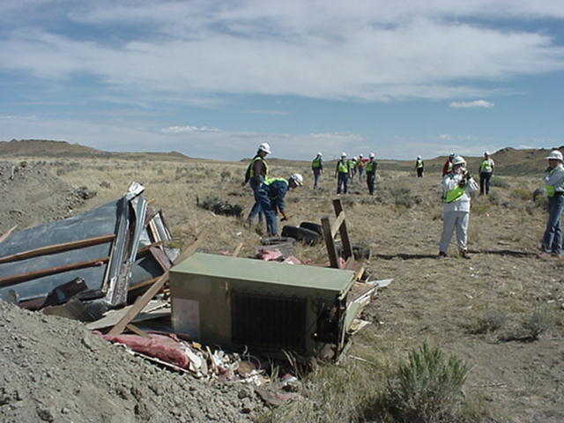
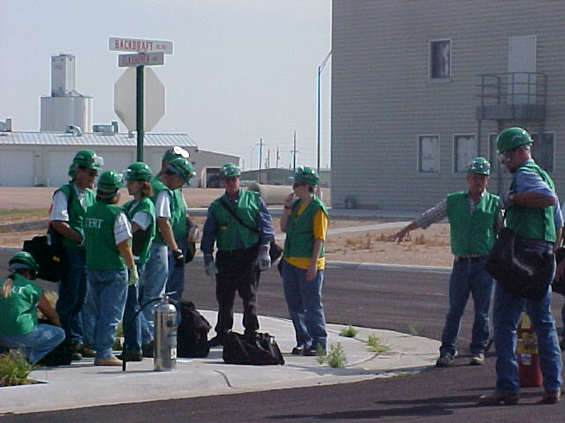
Requirements Vary
Vary by:
  Community
  Region
PM 10-3

Slide 10
What Do You Think?
What else would you add to the list we have just reviewed?
PM 10-3

Slide 11
Program Manager Skills
Experienced Program Managers know that:
  Being a Program Manager is rewarding
  Being a Program Manager is not easy
Program Managers need toolbox of skills in order to accomplish responsibilities of the job
PM 10-3

Slide 12
Skills and Abilities
What are the specific skills and abilities the Program Manager needs to possess?
  Tact
  Political savvy
  Passion
  Flexibility
  Leadership skills
  Comfort with public speaking
  Ability to motivate
  Trustworthiness
PM 10-3

Slide 13
Skills and Abilities (cont’d)
Specific skills and abilities the Program Manager needs to possess (cont’d):
  Ability to be cool under pressure
  Organizational triage skills
  Commitment/dedication
  Good communication skills
  High energy level
  Team concept
  Ability to plan and write
PM 10-3

Slide 14
Activity
Group and Draft Program Plan:
My Development Goals
PM 10-4

Slide 15
Keeping Program Alive
More than just CERT Basic Training
Program may have many activities
Program Manager may be responsible for most of them
PM 10-5

Slide 16
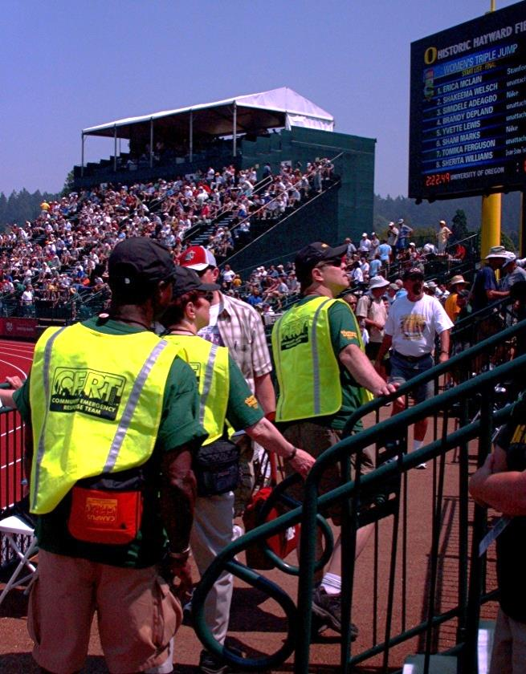
What Do You Think?
What are tasks and activities that a CERT Program Manager might take on to help sustain the program?
PM 10-5

Slide 17
Five Critical Elements
Volunteers are retained
Skills are sharpened
Teams respond appropriately
Program is administered capably
There is external program support
PM 10-5

Slide 18
Activity
Program Maintenance Matrix
PM 10-6

Slide 19
Unit Summary
Essential skills and abilities the Program Manager needs to possess
Critical elements involved in keeping a program alive
Use of a program maintenance matrix to identify activities that contribute most significantly to program maintenance
PM 10-9

