Slide 1


Unit 8: Policies and Procedures
CERT Program Manager

Slide 2
Unit Objectives
At the conclusion of this unit, the participants will be able to describe the role of policies and procedures in operating a local CERT program:
  Explain why policies and procedures are necessary for running a successful program
  Identify policies and procedures necessary for starting and maintaining a program
  Identify resources for developing program policies and procedures
PM 8-1

Slide 3
Unit Topics
Importance of Policies and Procedures
Policies and Procedures for CERT
Resources for Developing Policies and Procedures
PM 8-1

Slide 4
Importance of
Policies-Procedures
Terms sometimes used interchangeably
“Policy”
  Plan of action that links organization’s “vision” and day-to-day operations
“Procedure”
  Series of steps organization will take to implement policy
  Functionally same as “protocol”
PM 8-2

Slide 5
Important Thing to Remember
Don’t worry about definitions
Bottom line: CERT program needs to know what it plans to do and how it plans to do it
Policies and procedures are required when there is need for consistency in day-to-day operational activities
PM 8-2

Slide 6
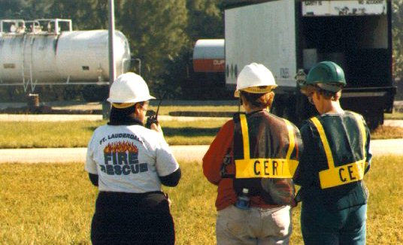
Write Them Down
They are guideposts for program:
  Used to operate
  Turned to whenever there is a question
They give guidance to staff and volunteers on how to perform job correctly
PM 8-2

Slide 7
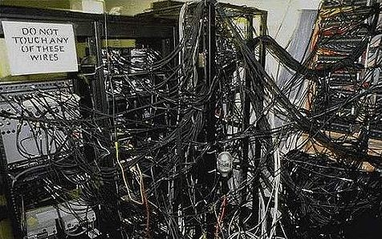
Write Them Down (cont’d)
They help eliminate common misunderstandings
  Define roles and responsibilities
  Establish boundaries
PM 8-2

Slide 8
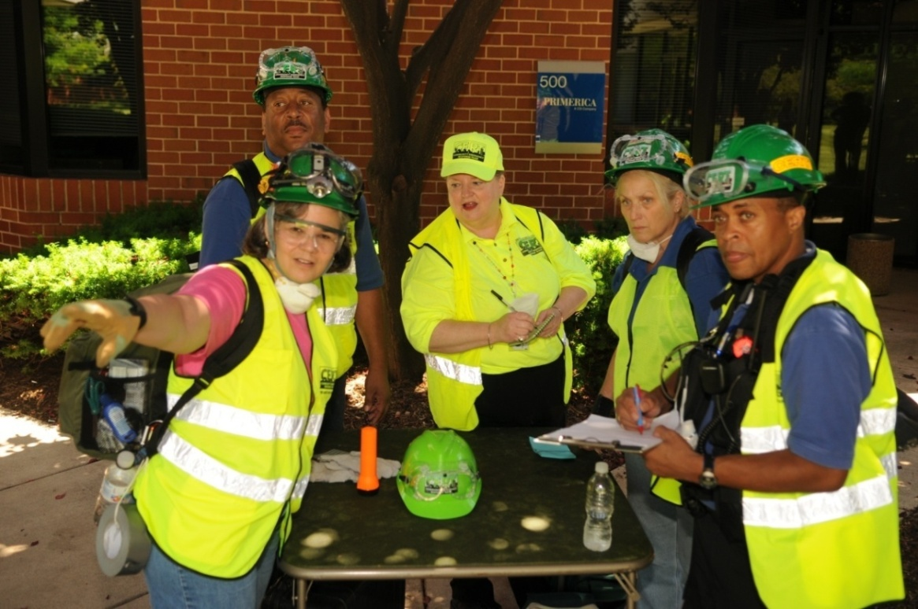
For Experienced PMs
Periodically ask
  Are policies and procedures still meeting program’s needs?
PM 8-4

Slide 9
“Signs”
Some “signs” that review and update are needed
  Increase in number of injuries?
  Ineffective team operations?
  More questions on “normal operations”?
  Feeling of general confusion?
  Inconsistent performance of CERT members?
  Increase in stress levels of CERT members?
  Complaints about poor performance?
PM 8-4

Slide 10
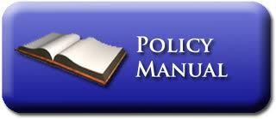
Format
Determined by program
  One document with all policies
  Each policy is its own document
Need to be well written and complete
PM 8-4

Slide 11
Policies-Procedures for CERT
Over years of experience Program Managers have identified the key policies and procedures that CERT program needs to operate smoothly and effectively
See CERT Policies and Procedures
PM 8-5

Slide 12
Development Resources
CERT policies and procedures cannot be developed in a vacuum
Must be developed with input from sponsoring agency and partners
Need to be consistent with:
  Sponsoring agency’s needs and procedures
  EOP or CEMP
  State and local statutes and regulations
PM 8-11

Slide 13
Liability
Risks associated with taking CERT Basic Training and with being CERT member
  CERT training and CERT program require physical activity; possibility of personal injury
  Participation in a CERT may lead to exposure to potentially hazardous conditions
  CERT members must only respond within scope of their training
PM 8-11

Slide 14
Tips for Reducing Liability
Reducing liability during training, exercises, and activation must be prime concern for Program Manager
  Keep safety at forefront, whatever CERT activity
  Become familiar with regulatory requirements for volunteers in your State
  Visit CERT Liability Guide at www.fema.gov/community-emergency-response-team-liability-guide
PM 8-11

Slide 15
More Tips
Visit Web site of Legal Information Institute, U.S. Code Collection, Limitation on Liability for Volunteers at:
https://www.law.cornell.edu/uscode/text/42/14503

Slide 16
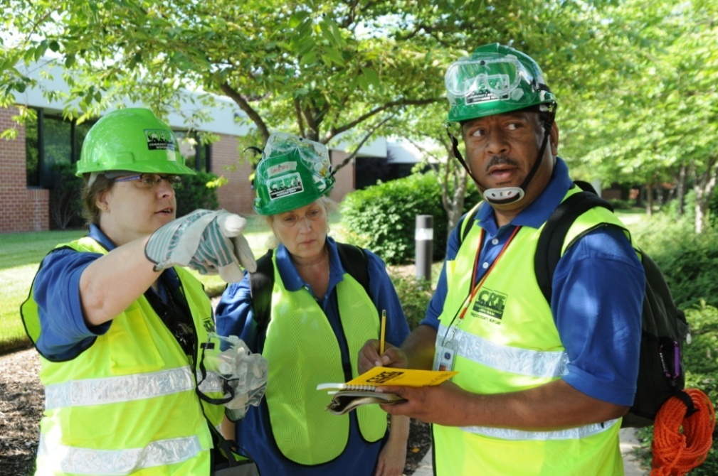
Find Policies and Procedures
Don’t need to be developed from scratch
Many already exist in another CERT program or in one of the entities that has authority over CERT program
PM 8-13

Slide 17
What Do You Think?
Experienced Program Managers:
Where have you found sample or actual policies or procedures to use when you were developing the ones for your program?
PM 8-13

Slide 18
Activity
Draft Program Plan:
Develop Policies and Procedures
PM 8-13

Slide 19
Unit Summary
Importance of Policies and Procedures
Policies and Procedures for CERT
Resources for Developing Policies and Procedures
PM 8-13

