Slide 1


Unit 7: Training and Exercises
CERT Program Manager

Slide 2
Unit Objectives
At the conclusion of this unit, the participants will be able to build a plan for delivering and managing safe training and exercises
  Identify training and exercises that are required or available for CERT volunteers
  Explain how to tailor content from CERT Basic Training
  Identify tasks required for managing CERT trainings
  Describe the elements of a CERT Training and Exercise Plan
  Explain how to ensure safety during training and exercises
PM 7-1

Slide 3
Unit Topics
CERT Training and Exercises
Tailoring CERT Basic Training
Managing Training and Exercises
The CERT Training and Exercise Plan
PM 7-1

Slide 4
Benefits of Training and Practice
What are some reasons for providing training and practice opportunities for CERT members?
  To keep skills sharp
  To improve capabilities of program
  To maintain volunteer interest and involvement
  To give Program Manager and instructors an opportunity to interact with volunteers
PM 7-2

Slide 5
CERT Training and Exercises
CERT volunteers use training and exercises to develop and sharpen skills
  Training is required to participate in CERT program
  Some training is recommended
    May be required by local program
  Some training is optional
    May be offered by local program
  Exercises refresh skills; keep them current
PM 7-2

Slide 6
Required Training
What training is required to participate in the CERT program?
  All volunteers must complete CERT Basic Training
  Course Manager and instructors for CERT Basic Training must complete CERT Train-the-Trainer
    Exception for individuals who conduct only one or two units; should be briefed on CERT, CERT Basic Training, and how unit they are teaching fits into course
PM 7-2

Slide 7
Recommended Training
What training courses are recommended for CERT members?
  FEMA IS-100.b: Introduction to Incident Command System (ICS)
  FEMA IS-200.b: ICS for Single Resources
  FEMA IS-700: National Incident Management System (NIMS) Introduction
  FEMA IS-800.b: National Response Framework Introduction
  CPR/AED
PM 7-3

Slide 8
Exercises
Skills must be practiced to stay current
Where can skills be practiced?
  Periodic meetings of CERT members
  Annual refresher training with multiple CERTs
  Exercises of all types conducted specifically for CERT members and teams
  Large-scale municipal or regional exercises
PM 7-6

Slide 9
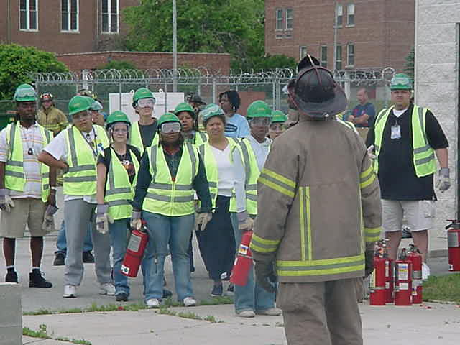
Types of Exercises
Discussion-based
  Tabletop exercises
  Functional exercises
Operations-based
  Drills
  Full-scale exercises
  Gaming exercises
  (e.g., “CERT rodeo”)
PM 7-6

Slide 10
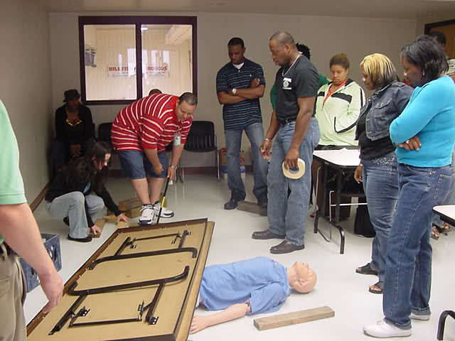
Experienced Program Managers
What kinds of exercises do you conduct?
PM 7-6

Slide 11
HSEEP
Department of Homeland Security has developed Homeland Security Exercise and Evaluation Program (HSEEP)
HSEEP = national standard for all exercises
All programs receiving Homeland Security Grant Program funding must use HSEEP standards
See What Does It Mean to Be “HSEEP Compliant”?
PM 7-7

Slide 12
Know About HSEEP
CERT should and will be involved in HSEEP exercises
  Be familiar with terminology and basic requirements of HSEEP
  Keep informed about events in Exercise Plan of jurisdiction or State, and possible opportunities for CERTs to participate
  Include CERT exercises in jurisdiction’s Exercise Plan
PM 7-7

Slide 13
Follow Concepts of HSEEP
CERT programs should follow general concepts of HSEEP
  Develop training and exercise plan
  Exercises should be performance-based and should focus on validating existing capabilities
    Require CERT members to do tasks that they have been taught and will be expected to do
    Evaluate by seeing how well CERT members correctly and safely do tasks required
PM 7-10

Slide 14
Follow Concepts of HSEEP (cont’d)
CERT programs should follow general concepts of HSEEP (cont’d)
  At conclusion of exercise, develop After-Action Report/Improvement Plan
    Include findings and recommendations
  Improvement Plan action items must:
    Be measurable
    Have deadline
    Have designated lead
    Be tracked to completion
PM 7-10

Slide 15
Tailoring CERT Basic Training
CERT Basic Training intended for national audience
Local program tailors it for:
  Local hazards
  Local resources
  Local protocols, procedures, terminology
  Audience
  Training facility
PM 7-10

Slide 16
Review CERT Basic Training
Become familiar with content
Customize Instructor Guide, Participant Manual, and PowerPoint visuals
  Case studies
  Scenarios
  Photographs
  Anecdotes
  Examples
  Success stories
  Handouts
PM 7-11

Slide 17
Materials on CERT Web Site
How to tailor Unit 1
How to hide PowerPoint visuals that are not relevant
How to insert photos into PowerPoint
How to keep Word files accessible for people with disabilities
PM 7-12

Slide 18
Activity
Develop a Local Scenario
PM 7-12

Slide 19
Debrief
Questions participants need to answer
  What are the pertinent facts that must be gathered?
  What kind of prediction can you make regarding damage, based on the incident and the building construction?
  What probable search and rescue problems can you identify?
  What specific safety considerations can you identify?
PM 7-13

Slide 20
Activity
Draft Program Plan:
Identify Ideas for Tailoring Training
PM 7-14

Slide 21
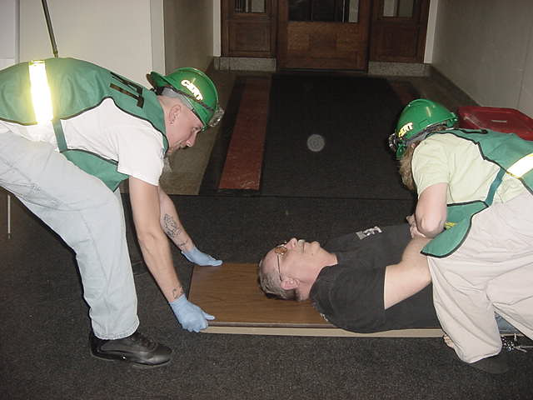
Managing Training and Exercises
Holding CERT training class requires coordination and planning
Develop list of tasks and schedule to make process manageable
PM 7-14

Slide 22
What Do You Think?
Imagine that you will be holding a CERT Basic Training class in 10 weeks
You are putting together a plan to get ready for the class
What tasks need to be included in the plan?
PM 7-14

Slide 23
What Do You Think? (cont’d)
Now that we have identified the tasks, we need to develop a schedule
Let’s figure out what needs to happen week by week
What things on this list need to happen 8 weeks before the class?
PM 7-14

Slide 24
CERT Web Site Training Tips
Starting a Program, Step 7
  Starting and Maintaining a CERT Program document is available at:
  www.fema.gov/start-and-maintain-community-emergency-response-team-program
PM 7-17

Slide 25
CERT Training and
Exercise Plan
Training is not over at end of CERT Basic Training
Ongoing training and exercises are core part of CERT program
  More than half of continuing education embellishes content of CERT Basic Training
  The rest deals with other emergency- or disaster-related subjects of interest to members and program
PM 7-17

Slide 26
Develop Training
Exercise Plan
See Sample Training and Exercise Plan
  Objective
  Plan for Meeting Objective
  Logistical Needs to Meet Objective
  Risk to Members
  Evaluation of Objective
PM 7-18

Slide 27
Objective
Statement of particular milestone that CERT program would like to accomplish that year
Example:
“To have 50% of active CERT members complete IS-100.b by (date)”
Good objectives are SMART
PM 7-19

Slide 28
Choose Objectives
Do your homework
  Review program’s goals and strategic plan
  Talk to local emergency manager
    Community hazards and resource gaps that CERT members might help fill
  Consult with program’s municipal sponsor
    What agency needs from CERT program
  Ask CERT members
    What do they need to feel effective
Set realistic priorities
PM 7-19

Slide 29
Plan for Meeting Objective
Describe how objective will be met
Example:
“Offer three options to CERT members:
  Take IS-100.b course online
  Take IS-100.b course as self-study
  Attend classroom IS-100.b course that CERT program will set up”
Include full description with as many details as possible
PM 7-20

Slide 30
Logistical Needs to
Meet Objective
List resources needed to put plan into action
Example:
  “Communicate with volunteers (describe in detail resources needed to motivate and communicate with volunteers)
  Set up training class (describe in detail resources needed and where to find training)”
See Unit 6 for resource requirements
PM 7-20

Slide 31
Risk to Members
Evaluate risk versus benefit
Assess any safety concerns
Example:
  “Online and self-study courses: free; no risk to members
  Classroom course: free; take standard safety measures including having a safety officer”
Addressing safety concerns is positive way to manage liability
  See CERT Web site for resources
PM 7-20

Slide 32
Evaluation of Objective
After event has occurred
  Observations
  Lessons learned
  Recommendations
Use information to write After-Action Report/Improvement Plan
PM 7-23

Slide 33
Repeat Process Annually
Revise Training and Exercise Plan once a year
  Measure degree of achievement of previous year’s objectives
    Review successes and “less than successes”
  Develop new objectives
  Write plan for meeting objective
  Identify logistical needs for meeting objective
  Evaluate risk to members
PM 7-23

Slide 34
Activity
Draft Program Plan:
Identify Possible Objectives
for Training and Exercises
PM 7-23

Slide 35
Unit Summary
CERT Training and Exercises
Tailoring CERT Basic Training
Managing Training and Exercises
The CERT Training and Exercise Plan
PM 7-24

