Slide 1


Unit 6: Procuring and Managing Resources
CERT Program Manager

Slide 2
Unit Objectives
At the conclusion of this unit, the participants will be able to establish a process for acquiring and managing program resources:
  Identify types of resources needed to coordinate a CERT program
  Identify types of data that need to be collected and maintained for the program
  Develop strategies for locating and managing resources
  Identify program funding options and tips for approaching funders
  Develop a draft program budget
PM 6-1

Slide 3
Unit Topics
Identifying Physical Resource Needs
Managing Data
Budgeting and Funding
PM 6-1

Slide 4
Physical Resources?
PM 6-1

Slide 5
Identifying Physical
Resource Needs
Unit will address these topics
  What those resources are
  Where to find them
  What they will cost
Plans will be collected and copied to share with others
PM 6-1

Slide 6
Activity
Identify Physical Resources
PM 6-2

Slide 7
Physical Resource Needs
Anything required to complete task
  People
  Equipment
  Materials
  Supplies
  Facilities
Be as thorough as possible
PM 6-7

Slide 8
Be Thorough
Don’t just say that you need training supplies or a Unit 5 instructor
List exactly what you need
PM 6-7

Slide 9
Good Training Facility
What do you need to have in a good training facility?
Easy to find
Disability access
Parking
Bathrooms
Good lighting and heating/AC
Contact names for AV support, facility support
Chairs and tables
Easels and easel pads or whiteboard
Computer and projection system
Space for hands-on exercises
Space for burning
Burn permit
Backup location
PM 6-7

Slide 10
Activity
Locate Resources
PM 6-8

Slide 11
What Do You Think?
Did anyone talk about needing to store a resource?
PM 6-8

Slide 12
Storage
What might need to be stored? Where would you store it?
  What to store
    Training equipment
    Materials for CERT kits
  Storage considerations
    Should be at or close to training facility
  Storage options
    Get it free
    Use a trailer
  Keep list of inventory in storage
PM 6-8

Slide 13
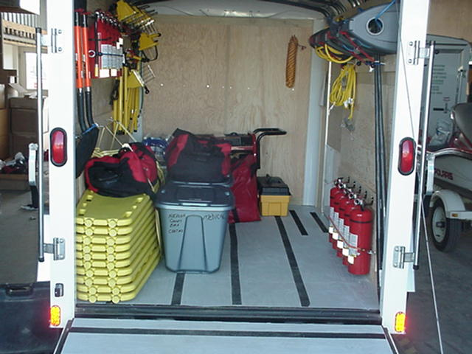
Storage (cont’d)
PM 6-8

Slide 14
Activity
Identify Costs
PM 6-9

Slide 15
Instructor Costs
Will vary depending on how jurisdiction pays for instruction
  Instructor may be on salary with department; department absorbs cost
  Contract with instructors individually; CERT program funds instructor
PM 6-9

Slide 16
Activity
Draft Program Plan:
Identify Physical Resource
Procurement Factors to Consider
PM 6-10

Slide 17
Information and Data
Significant resources for local CERT program
Support most aspects of the program
  Recruitment
  Training
  Emergency operation
Need to be collected and maintained in organized manner
PM 6-10

Slide 18
Instructor Knowledge
What types of data need to be collected for a CERT program?
  Information on each volunteer (Unit 4)
  Information on each instructor (Unit 5)
  Administrative information
  Training information
  Program activities
  Budget information
  Outreach information
  Location(s) of individual members and/or teams
PM 6-10

Slide 19
Importance of Recordkeeping
Must keep good and accessible records
Operational reasons
  For reliable and quick information when teams are activated
    Where teams are
    Size of teams
    The teams’ contact personnel
  To locate CERT members with particular skills
PM 6-11

Slide 20
Importance of Recordkeeping (cont’d)
Administrative reasons (some examples)
  To know about current volunteers and instructors
  To communicate with volunteers, instructors, partners, and supporters
  To show CERT member eligibility for benefits and insurance
  To maintain good fiscal records
PM 6-11

Slide 21
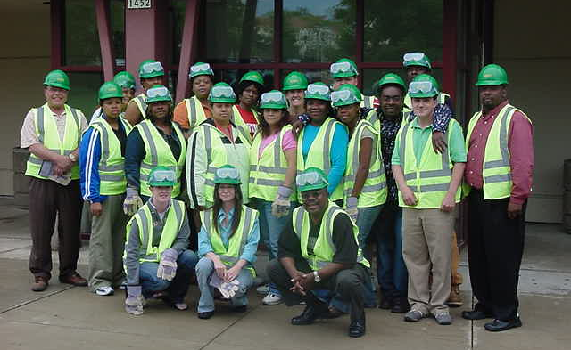
Importance of Recordkeeping (cont’d)
Political reasons (some examples)
  To generate statistics
  To prove value of program
PM 6-11

Slide 22
Reduce Liability
Ways to reduce liability
  Provide training in how to respond safely and effectively in an emergency
  Maintain accurate and complete records so that you can document what you have done
Visit CERT Web site to learn more: www.fema.gov/cert
PM 6-12

Slide 23
Recordkeeping Tips
Set up a good system early; keep current
Only keep data critical to program
  Consult your attorney for what to track and what not to track
Safeguard personal information
  Get permission to share information
Don’t reinvent the wheel
  CERT Web site
  Other Program Managers
PM 6-12

Slide 24
Activity
Draft Program Plan:
Record Data Collection and Recordkeeping Ideas
PM 6-14

Slide 25
Budgeting and Funding
Once resources and costs are identified, Program Manager needs to:
  Put together budget
  Find funding to implement budget
PM 6-14

Slide 26
Budgeting Factors
What will CERT program do?
  Disaster response
  Public service
  Community education
What resources are needed to accomplish that?
  Equipment for CERT members
  Training supplies, materials, instructors
  Team maintenance requirements
PM 6-14

Slide 27
Develop a Budget
Identify costs, both per unit and total
Total the costs
Divide total cost by number of people trained to identify per participant cost
  This number is useful when looking for funding
PM 6-15

Slide 28
CERT Web Site Resources
One companion document
  CERT Program Costs Worksheet
Document is primarily for putting on CERT Basic Training course and not for a broader program
Can be expanded for any CERT program configuration
Also link to access Excel Spreadsheet version of CERT Program Costs Worksheet tool
PM 6-17

Slide 29
Sponsoring
All local CERT programs must be recognized by or acknowledged by a local government agency in their area
  Usually fire department or police
Local Program Manager should be affiliated with sponsoring agency
Sponsoring is not the same as funding
PM 6-17

Slide 30
Funding
Many local governments use Federal grant funding to support local CERT program, in addition to local funding
  Only governmental agencies may receive Federal funding that supports CERT
Most funding comes through States
  In some metropolitan areas it is through Urban Area Security Initiative (UASI) region
PM 6-17

Slide 31
Funding (cont’d)
Grant money may be available under Federal Department of Education’s Safe and Drug Free Schools Program
  CERT program partnering with school district
REMS grants
  Awarded on competitive basis to local school districts
  Encourage partnerships with other programs to promote school safety
PM 6-17

Slide 32
Funding Sources
In addition to the sponsoring agency and other government sources, what are some other sources of funding or support for a CERT program?
  Solicit donations
  Charge a fee
  Ask for in-kind donations
  Apply for a grant
  Establish or align with a not-for-profit organization
PM 6-18

Slide 33
Approach a Funder
See Unit 3, How to Initiate and Foster Partnerships
  Create a program description
  Develop plan for approaching each partner
  Schedule one-on-one meeting
  Maintain contact
PM 6-21

Slide 34
Unit Summary
Identifying Physical Resource Needs
Managing Data
Budgeting and Funding
PM 6-23

