Slide 1


Unit 5: Working with Instructors
CERT Program Manager

Slide 2
Unit Objectives
At the conclusion of this unit, the participants will be able to establish a process for working with instructors:
  Describe how to recruit instructors
  Describe how to orient instructors
  Explain why to track instructors
  Describe methods for managing instructors
  Identify techniques for retaining instructors
  Explain what to do when terminating an instructor
PM 5-1

Slide 3
Unit Topics
The Program Manager and the CERT Instructor
Recruit Instructors
Orient Instructors
Track Instructors
Manage Instructors
Retain Instructors
Terminate an Instructor
PM 5-2

Slide 4
Heads Up
How a Program Manager completes activities may differ somewhat depending on status of instructor
  Some instructors are paid
  Some instructors are volunteers
PM 5-2

Slide 5
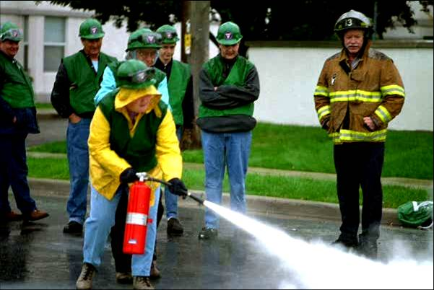
Program Mgr and Instructors
Think about requirements for CERT instructor:
  Job of instructor
  What makes a competent instructor
Consider these requirements when developing
instructor
deployment
plan
PM 5-2

Slide 6
Personnel Needed
Course Manager
  Deals with logistics of putting on course (may be Program Manager)
Lead Instructor
  Can instruct and oversee all course modules
Unit Instructor
  Has proficiency in one or more modules
Subject Matter Expert
  Provides expertise in specific area of module
PM 5-3

Slide 7
Possible Configurations
Course Manager may also be Lead Instructor
Unit instructor may also be Subject Matter Expert
Course may only require one instructor
  Course Manager stays in room during training to help
PM 5-3

Slide 8
Importance of Instructors
Instructors are program’s representatives to participants
  Participants will form opinion about CERT program from instructor
  Participants will copy behaviors that instructor models
PM 5-3

Slide 9
Importance of Instructors
Quality of instructors selected will have more to do with initial success or failure of program than anything else
PM 5-4

Slide 10
A Competent Instructor
Delivers CERT course accurately
Ensures that participants achieve objectives of CERT course
Delivers training effectively and at an appropriate level
Creates comfortable yet managed
learning environment
PM 5-4

Slide 11
Instructor Knowledge
In addition to knowing what is in the CERT course, what knowledge does a CERT instructor need to have?
  About CERT program
  How their session fits into other sessions and CERT course
  Hazards that cause most risk for community
  Community’s emergency operations plan
PM 5-4

Slide 12
Other Instructor Attributes
In addition to knowledge, what does an instructor need to bring to the CERT classroom?
  Principles of adult learning
  Ability to keep the training relevant
  Enthusiasm about CERT concept
  Ability to make training fun
  Ability to coach participants through hands-on activities
  Good training and presentation skills
  Encouraging, respectful, and positive attitude
PM 5-5

Slide 13
Instructor Deployment Plan
Plan includes these elements
  Where to find instructors
  What information to keep on instructors
  What training instructors should have
  How to “deploy” instructors
PM 5-5

Slide 14
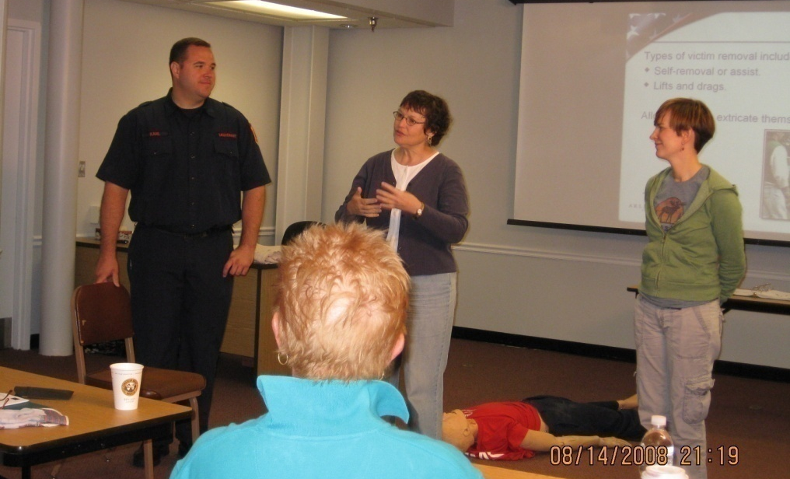
#1 Recruit Instructors
Recruit and select instructors based on:
  Their working knowledge
  Skills required for session they will be teaching
PM 5-5

Slide 15
Find Good Instructors
Who might be a good instructor for a CERT course?
  Fire and rescue instructors
  Paramedics or EMTs
  People who have completed CERT Basic Training course
  Nurses
  Course-specific Subject Matter Expert
    Animal control officer or veterinarian
    Amateur or professional radio operator
PM 5-6

Slide 16
Recommendation
At least two instructors jointly conduct each session
  One should be Subject Matter Expert who knows detailed content of session
  One should be instructor with full knowledge of CERT model and entire course being taught
PM 5-6

Slide 17
Activity
Draft Program Plan:
Identify Recruitment Options
PM 5-8

Slide 18
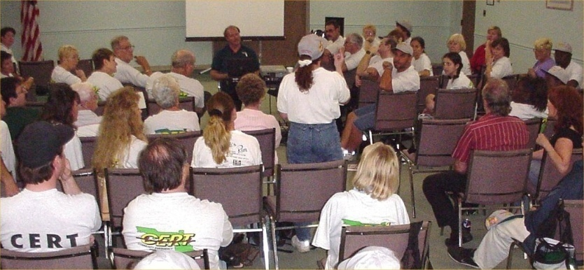
#2 Orient Instructors
Even if instructor is experienced, Program Manager will want to meet with him/her
  To learn about instructor
  To orient instructor to CERT
PM 5-9

Slide 19
Find Out Background
What do you want to find out about a potential instructor?
  Their professional background
    Their area(s) of expertise
    Gaps in their background that must be filled prior to training
  Their training background
    Instructor development training they have received
    How much training they have done
    How engaging they are as an instructor
PM 5-9

Slide 20
Questionnaire
Some information can be learned from background questionnaire
  Ask potential instructor to complete one before you sit down to talk
Then use your conversation
  To expand information provided in questionnaire
  To get sense of person as effective instructor
PM 5-9

Slide 21
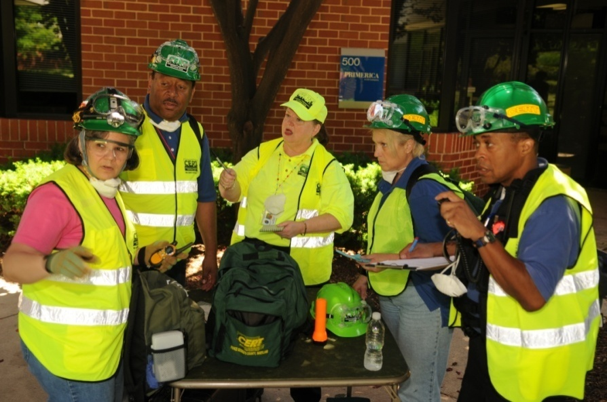
Orientation Goals
That an instructor be able to provide a positive image of CERT
That an instructor be able to present accurate and reliable information, thus reducing program’s liability
PM 5-12

Slide 22
Orientation Tasks
Establish training standards and safety requirements
Brief instructors on their responsibilities to conduct safe and effective training
Ensure that all instructors are prepared to meet objectives for their sessions
Provide co-instructors to assist instructors for all activities
PM 5-12

Slide 23
Orientation Tasks (cont’d)
Ensure that all instructors model appropriate safety behavior, e.g., safety gear for all demonstrations
Additionally, be sure that instructors understand that they can give participants permission to opt out of an activity
  If participants have a condition that they may aggravate by participating
PM 5-12

Slide 24
Information to Provide
What CERT model is
  CERT values
  Individual and family preparedness first
  How teams work
Activities of local CERT program
  Disaster response
  Volunteer services
  Public education
PM 5-13

Slide 25
Information to Provide (cont’d)
Program Manager’s expectations
  Training standards
  Importance of safety, modeling safe behavior, and use of safety gear for all demonstrations and exercises
  Behavior standards
  Importance of respecting an individual participant’s decision to opt out of an activity
PM 5-13

Slide 26
#3 Track Instructors
Collect and maintain information
  Contact information
  General availability
  Units they can teach
  Other abilities and specialties
  Number of hours they have taught (especially if the hours are donated)
  Evaluation results
PM 5-14

Slide 27
Purpose of Tracking
To know who is available to schedule for training courses
  Especially if an emergency fill-in is needed
To be able to justify program to funders
To show what service CERT program is providing to community
PM 5-14

Slide 28
#4 Manage Instructors
Fourth activity tasks are similar to those used with volunteers
  Train
    Make sure that they are qualified to teach
  Assign
    Tell them what task is
    Provide information they need to do task
PM 5-14

Slide 29
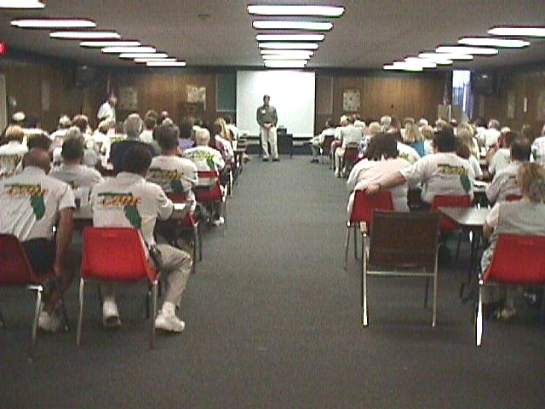
#4 Manage Instructors (cont’d)
Tasks (continued)
  Monitor
    Observe training and gather comments
  Evaluate
    Provide feedback after the event; debrief with instructors
PM 5-14

Slide 30
Train Instructors
How can you make sure that an instructor is qualified and prepared to teach?
  Ask for and check references
  Provide thorough orientation to materials
  Give instructor enough time to prepare
  For CERT Basic Training, ask instructor to attend CERT Train-the-Trainer course
    Course provides instructor development skills as well as unit-by-unit review that includes tips and techniques
PM 5-15

Slide 31
Training Delivery Options
Should all instructors be able to teach all CERT topics, or should instructors specialize?
  Requiring all instructors to be able to teach the entire program benefits program if an instructor suddenly becomes ill
  Having instructors cross-trained in different modules gives Program Manager more flexibility in scheduling
PM 5-15

Slide 32
What Do You Think?
What situations have you encountered or can you imagine that would require some intervention on the part of the Program Manager?
PM 5-17

Slide 33
Feedback
Feedback at every point is critical to developing good instructors
  Before
    Provide expectations for them and for the training
  After
    Provide constructive critique of training skills
    Monitor that lessons learned are incorporated
PM 5-17

Slide 34
Retain Instructors
Instructors need to feel that they are making a difference
After all, there would be no program if volunteers couldn’t be trained!
Recognize them!
PM 5-17

Slide 35
What Do You Think?
What are some things you have done to recognize instructors?
PM 5-17

Slide 36
Recognition
Does not have to be elaborate or formal
  Even simple “Thank you” makes a big difference
Volunteer instructors who are donating their time need an extra measure of recognition
PM 5-17

Slide 37
Terminate an Instructor
Reserve termination for those times when:
  All other measures have failed
  There has been gross misconduct
    Such as theft, abuse, being under influence of drugs or alcohol, or demonstrated disregard for CERT participants’ safety
Follow guidelines in Unit 4, Working with Volunteers
PM 5-17

Slide 38
Unit Summary
The Program Manager and the CERT Instructor
Recruit Instructors
Orient Instructors
Track Instructors
Manage Instructors
Retain Instructors
Terminate an Instructor
PM 5-18

