Slide 1


Unit 4: Working with Volunteers
CERT Program Manager

Slide 2
Unit Objectives
At the conclusion of this unit, the participants will be able to establish a process for working with volunteers:
  Describe how to recruit volunteers
  Describe how to orient volunteers
  Explain why to track volunteers
  Describe methods for managing volunteers
  Identify techniques for retaining volunteers
  Identify strategies for firing volunteers
PM 4-1

Slide 3
Unit Topics
The Program Manager and the CERT Volunteer
Recruit Volunteers
Orient Volunteers
Track Volunteers
Manage Volunteers
Retain Volunteers
Terminate a Volunteer
PM 4-1

Slide 4
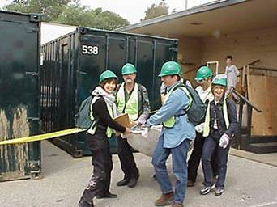
Program Mgr and Volunteers
Volunteers are backbone of program
  Provide administrative support
  Run parts of program
  Train CERT volunteers
  Make up teams that
  serve community
PM 4-2

Slide 5
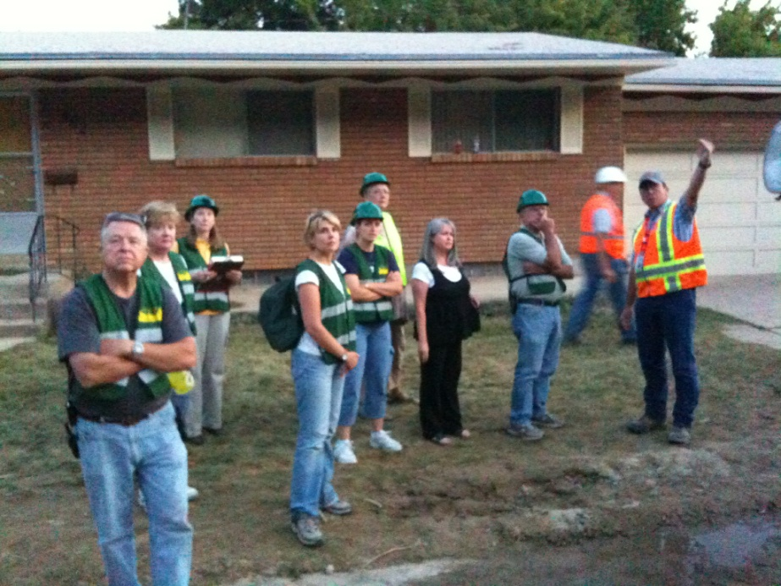
Working with Volunteers
Program Manager must know how to work with volunteers
  Skills are same as working with paid staff
  Difference is in how you apply those skills
PM 4-2

Slide 6
Prepare for Volunteers #1
Identify ways that volunteers will be used in CERT program
  May be described in the program description
  If they aren’t in the program description, write them down
  Documentation applies to program administration as well as to CERT activities!
PM 4-2

Slide 7
Uses for Volunteers
How can a CERT program use volunteers?
As a CERT member
  Disaster response
  Special events
  Community preparedness
To help run the program, e.g.,
  Data management
  Communicating with volunteers
  Working with funders and sponsors
  Tracking equipment
  Training
PM 4-2

Slide 8
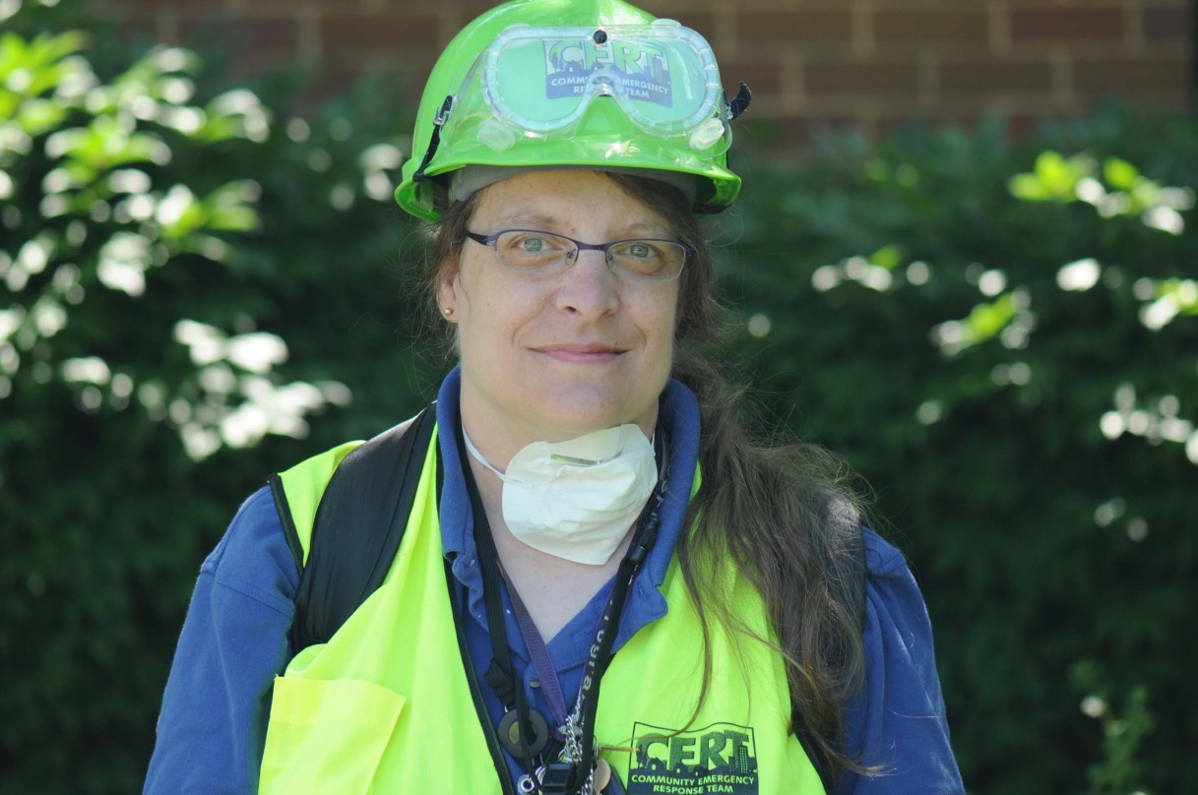
Prepare for Volunteers #2
Write job descriptions
  Team member role
  Other volunteer positions
PM 4-6

Slide 9
Written Job Descriptions
Why is it a good idea to have written job descriptions?
  They let the volunteer know what your expectations are
  They give you something to evaluate performance against and something to fall back on if performance is inadequate or unacceptable
PM 4-6

Slide 10
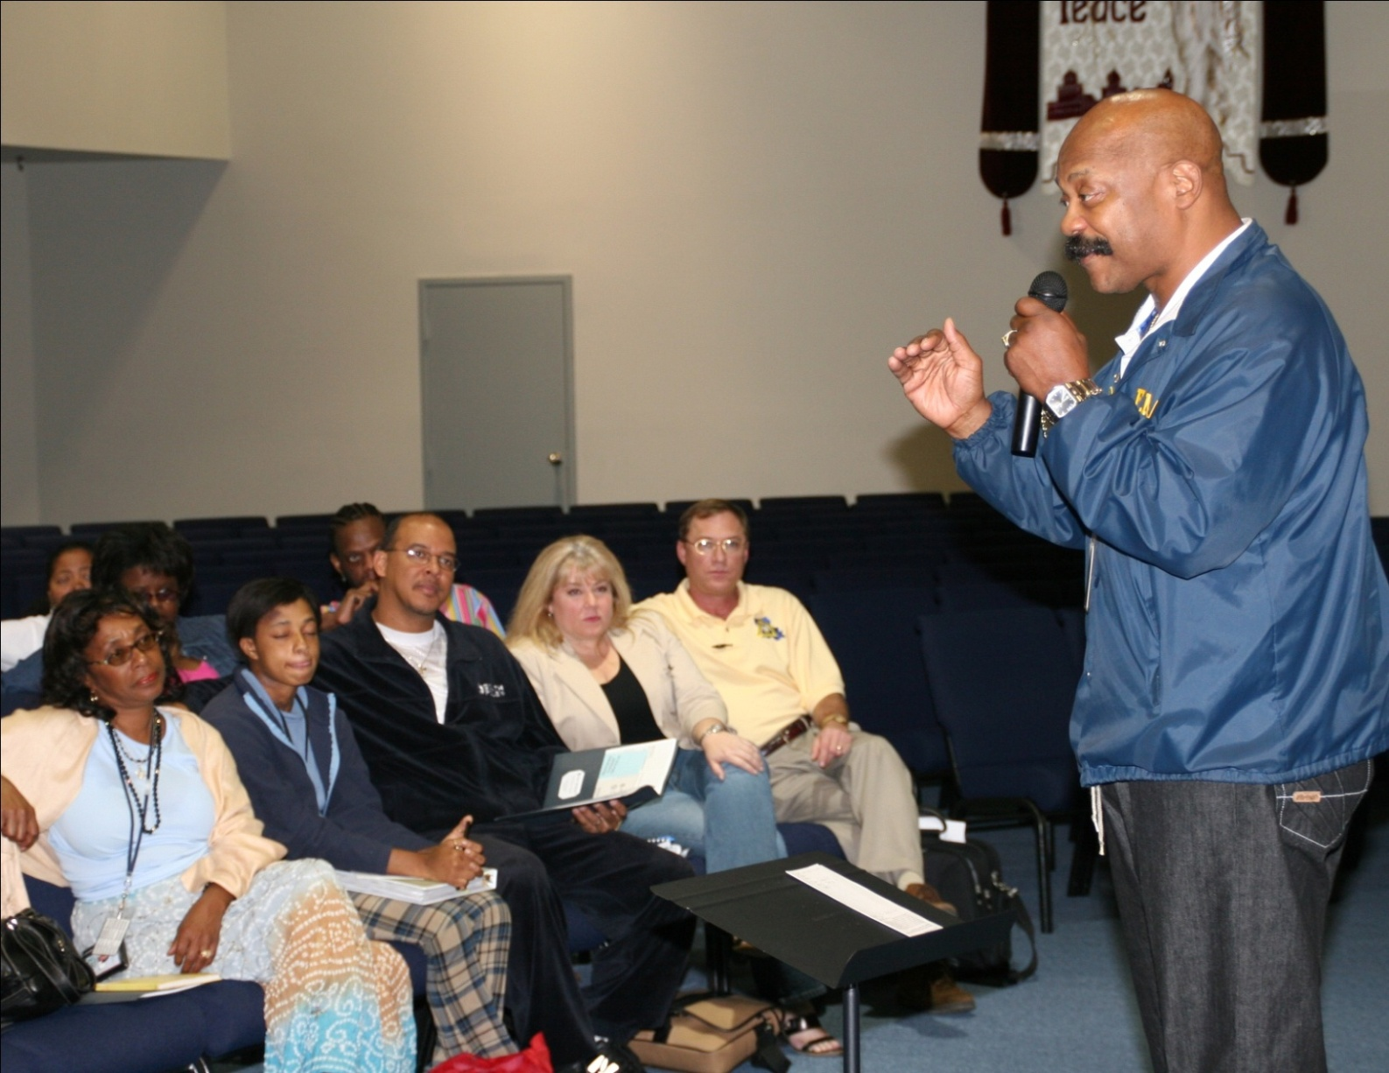
#1 Recruit Volunteers
PM 4-8

Slide 11
Gateway to CERT
Through CERT Basic Training
Helps participants identify preferred role
  To be an active member of program
  Just want information for personal use
PM 4-8

Slide 12
Volunteer Sources
How do you find people to take the CERT Basic Training course?
  Word of mouth is best way
  Readymade groups
  Groups with similar interests
  Anyone or any group you speak to
PM 4-8

Slide 13
The Dilemma
“Established Group” Advantage
  Pre-existing reason(s) for working together
  CERT can become part of their mission
“Established Group” Disadvantage
  Members of some groups are not geographically connected
  But CERTs are organized geographically
PM 4-8

Slide 14
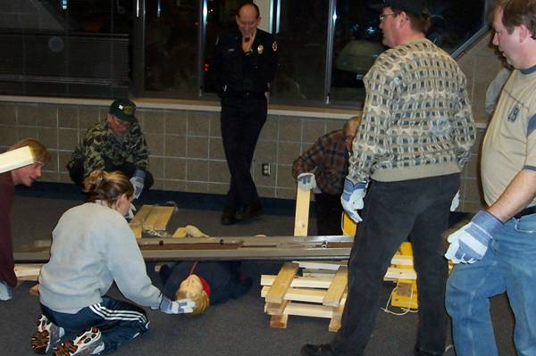
Recruitment Message
Elements
Opening
Statement of need
Statement of solution
Statement of level of knowledge needed
Statement of benefits
Contact point
PM 4-9

Slide 15
Stress Expectations
Be very clear and upfront about program’s expectations
What are you asking?
  That they complete CERT Basic Training?
  That they build a local team?
  That they help coordinate the local CERT program?
  That they participate in other non-disaster activities?
PM 4-9

Slide 16
Activity
Draft Program Plan:
Identify Recruitment Options
PM 4-10

Slide 17
#2 Orient Volunteers
Provide information on National CERT Program
Provide information about local CERT program
Set standards
Form relationship with new volunteer
Determine volunteer assignment
PM 4-10

Slide 18
Set Standards
Volunteers should know the standards from beginning of their CERT membership
  Acceptable participation in program
  Maintaining active status
  Standards of behavior
  Following the team chain of command
  Deferring to professional responders
  Maintaining any equipment issued
PM 4-11

Slide 19
Behavior is Important!
Volunteer behavior determines how program viewed by emergency responders, public officials, and community members
  Negative incidents can bring down program
PM 4-11

Slide 20
Perception of Volunteers
Some officials concerned about volunteers working without supervision
Team must be viewed as competent group of trained volunteers who:
  Diligently follow directions from chain of command
  Provide valuable support for professional response efforts
PM 4-11

Slide 21
Form Relationship
For volunteer to become official CERT volunteer
  Volunteer completes membership application
  Program Manager completes background check (may be optional)
  Program Manager has CERT ID card made
  (if part of local program)
  Program Manager adds volunteer’s contact info to CERT member database
PM 4-12

Slide 22
Determine Volunteer Task
Member of CERT, or other, or both?
Tell volunteers during orientation about other opportunities
Talk with volunteers; find out special strengths that might serve program
Include question on volunteer application about skills that might be useful to program
PM 4-13

Slide 23
Legally Out of Bounds
Race, national origin, or birthplace
Marital status
Religious affiliation
Credit card or home ownership
Age, height, or weight
Pregnancy or childcare arrangements
Arrest record (criminal background checks are permissible)
Discharge from military service
Length of residency in the community
Health
(with exception)
PM 4-13

Slide 24

Make Orientation Fun
PM 4-14

Slide 25
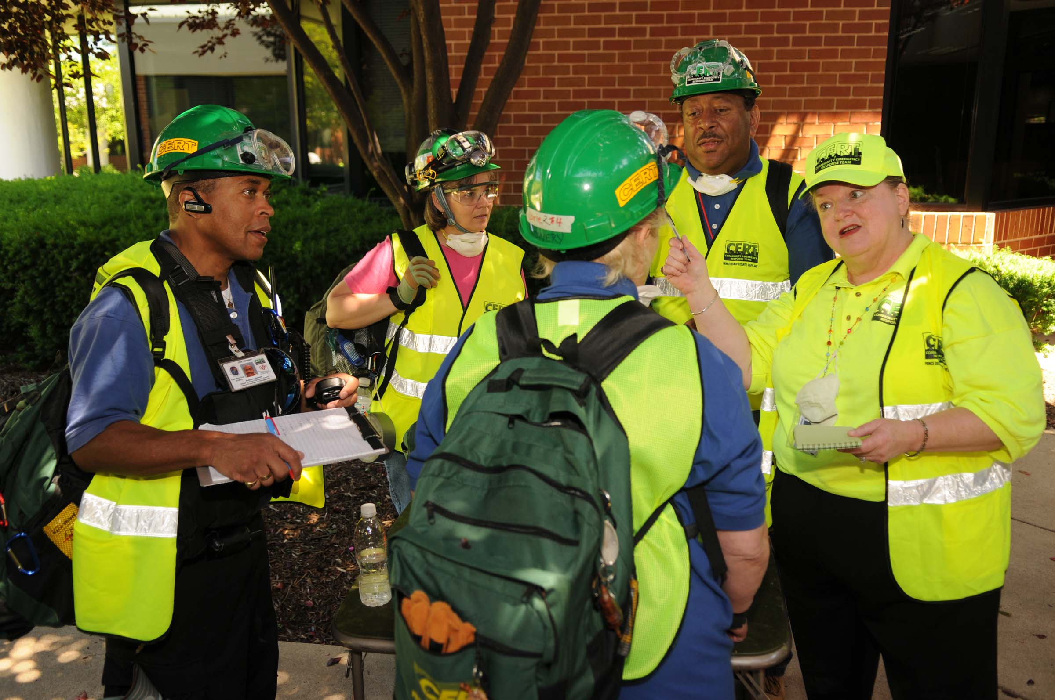
#3 Track Volunteers
PM 4-14

Slide 26
Keep Volunteer Information
What information is important to maintain on a volunteer?
  Contact information
  Date of graduation from CERT Basic Training
  Active/non-active status
  Established role within team or program
  Number of hours they have served
  Training and exercises completed and dates
  Equipment issued to them
  Their abilities and specialties
PM 4-14

Slide 27
Why Track Volunteers?
Why do you need to track this information?
  To account for who is in program
  To know whom to mobilize for special response
  To know who has what skills and if current
  To know where your equipment is and what to get back when someone leaves
  To know how to contact family of volunteer if there is an emergency
  To be able to justify your program
PM 4-15

Slide 28
Justify Your Program
CERT members are valuable community asset
Trained CERT members perform tasks that would otherwise need to be performed by paid employee
CERT members can:
  Save jurisdiction thousands of dollars
  Enhance other programs at little or no cost
PM 4-15

Slide 29
#4 Manage Volunteers
Tasks similar to managing paid staff
  Train
  Assign
  Monitor
  Evaluate
Program Manager may share these responsibilities with team leader
PM 4-16

Slide 30
Maintain Program Integrity
Why do volunteers need to be managed?
  To make sure CERT program is accountable
  To make sure standards are met
  To keep strong group of volunteers
PM 4-16

Slide 31
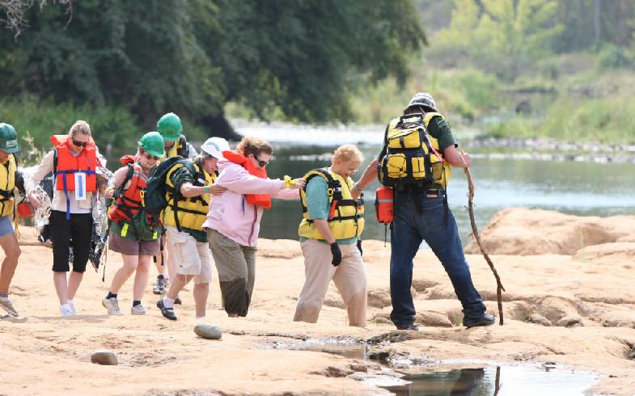
Management Challenges
Managing volunteers is different from managing staff
  Volunteers can leave without warning
  One or more unhappy volunteers can be quite damaging
PM 4-17

Slide 32
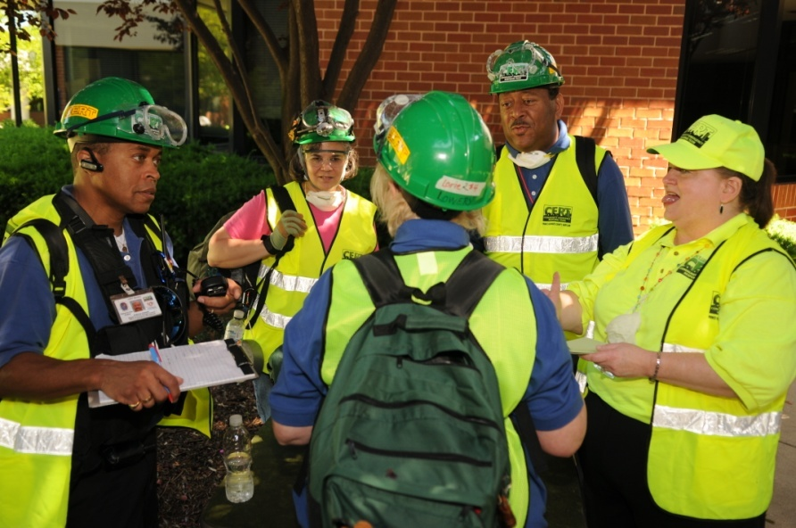
Management Challenges
Program Manager tasks
  Keep volunteers happy about being part of CERT program
  Sustain their commitment, their skills as individuals, and their capabilities as a team
It takes time!
PM 4-17

Slide 33
Activity
Managing a CERT Event
PM 4-17

Slide 34
#5 Retain Volunteers
To retain volunteers you have to understand:
  What volunteers need
  How to meet those needs
Volunteers are crucial to program’s existence
Keeping them involved and pleased with their participation is essential!
PM 4-19

Slide 35
Why Volunteer?
Why do people volunteer?
  To serve
  To help
  To learn
  To belong
PM 4-19

Slide 36
What do Volunteers Need?
  What needs do volunteers have once they are with CERT? Might be emotional, physical, or intellectual
  To be respected
  To feel capable
  To feel needed
  To not be asked to do more than they can
  To feel attended to
  To be appreciated
PM 4-20

Slide 37
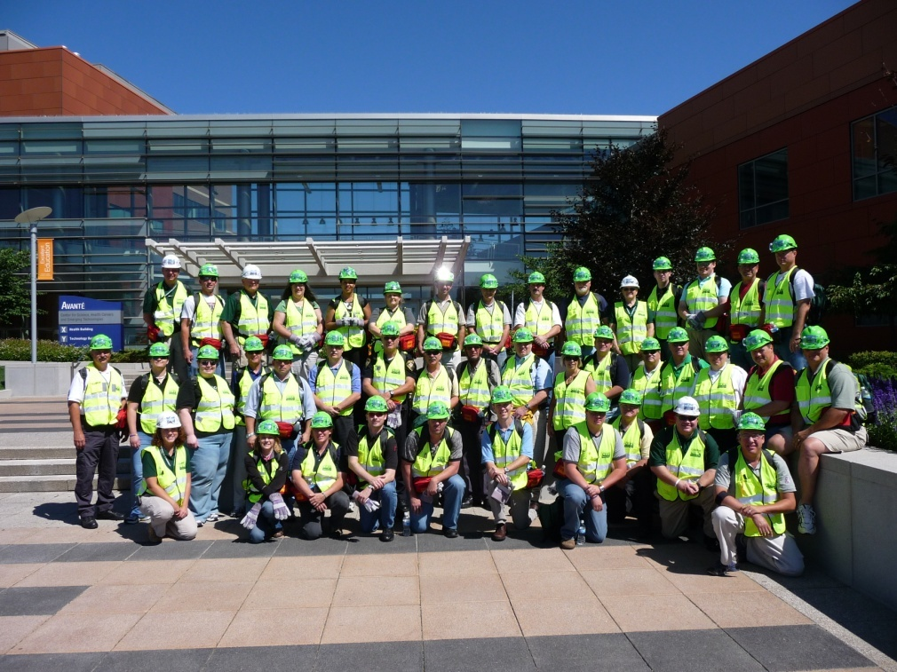
To Keep Volunteers
Provide training and exrcises
Ask them to help
Recognize volunteers
PM 4-20

Slide 38
To Keep Volunteers (cont’d)
Match assignment to abilities and interests
Provide resources that volunteers need to do their assigned tasks
Pass on feedback that program receives about impact of volunteers’ work
Have fun!
PM 4-22

Slide 39
Activity
Volunteer Recognition
PM 4-22

Slide 40
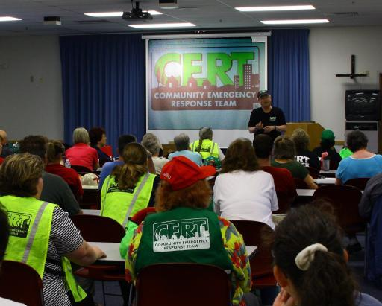
Meetings
Use volunteer meetings
  Training
  Recognition
  Socializing
PM 4-24

Slide 41
Activity
Draft Program Plan:
Capture Retention Ideas
PM 4-25

Slide 42
Terminating a Volunteer
When all other measures have failed
For gross misconduct:
  Theft
  Abuse
  Being under the influence of drugs or alcohol
PM 4-25

Slide 43
Guidelines
Document your concerns and your actions
Make sure comments are fair
Focus on work, not on individual
Follow program protocols for disciplinary procedures
PM 4-25

Slide 44
Unit Summary
The Program Manager and the CERT Volunteer
Recruit Volunteers
Orient Volunteers
Track Volunteers
Manage Volunteers
Retain Volunteers
Terminate a Volunteer
PM 4-26

