Slide 1


Unit 3: Promoting Your Program
CERT Program Manager

Slide 2
Unit Objectives
At the conclusion of this unit, participants will be able to describe the purposes and strategies for promoting a local CERT program:
  Explain expected outcomes for program promotion
  Identify community organizations to target for partnership
PM 3-1

Slide 3
Unit Objectives (cont’d)
At the conclusion of this unit, participants will be able to:
  Explain how the process of goal setting is linked to program promotion
  Articulate CERT core messages to include in program promotion
  Identify techniques for promoting a program to various audiences
PM 3-1

Slide 4
Unit Topics
Why we promote and to whom we promote
The importance of partnerships
Program promotion and goal setting
How to initiate and foster partnerships
The promotional message
PM 3-1

Slide 5
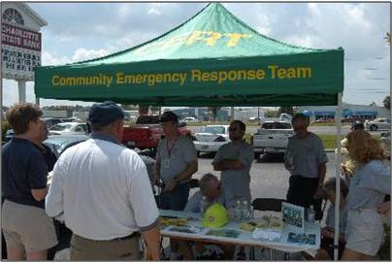
Promotion: Why and Who
Top priority for Program Managers
PM 3-2

Slide 6
Why Promote?
Why is it important to promote your CERT program?
  To get program started
  To get volunteers
  To keep program visible
  To gain support from:
    Public
    Potential sponsors
    Community officials
    Professional responders
  To educate about need for preparedness
PM 3-2

Slide 7
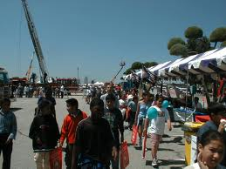
CERT Stakeholders
Every community member is a stakeholder
CERT program needs support of stakeholders to succeed
Support may be passive or active
PM 3-2

Slide 8
Why Promote?
What benefits could the CERT program have for key stakeholders and the community?
  Supports emergency management and its agencies
  Expands emergency response capability of community
  Is reliable resource for emergency responders in non-emergency situations
  Expands home and workplace preparedness
  Increases neighborhood and workplace involvement with public safety
PM 3-3

Slide 9

Importance of Partnerships
Partners are stakeholders who see usefulness of having more active relationship with CERT program
Partnerships are essential in starting and sustaining CERT
program
PM 3-3

Slide 10
What Do You Think?
Think about list of benefits that CERT program can bring to stakeholders
Who might your CERT program want as partners?
PM 3-3

Slide 11
What Do You Think?
What will the partnership with these groups bring to CERT?
PM 3-3

Slide 12
Activity
Draft Program Plan:
Identify Potential Partners
PM 3-6

Slide 13
The Overlap
Overlap between setting your program’s vision and stakeholders/partners
  CERT program has vision and initial goals
  CERT program approaches potential partner to explain how new community resource (CERT) could help partner
  CERT program asks for input and incorporates input into developing final program goals
Process results in stronger support for CERT program
PM 3-6

Slide 14

Levels of Partners
For some partners program promotion and goal setting are tied together
For other partners, CERT program sets goals first and then promotes program
PM 3-7

Slide 15
Program Partners
For which stakeholders/partners are goal setting and promotion tied together?
  Tied together for those whose approval is critical to program’s existence
PM 3-7

Slide 16
Program Partners (cont’d)
For which stakeholders/partners do you set the program goals first and then do program promotion?
  Separate for program volunteers and those who are peripherally involved in program
PM 3-7

Slide 17
Activity
Draft Program Plan:
Program Partners and Goal Setting
PM 3-7

Slide 18
Create Partnerships
Recruiting partners is like assembling a successful team
  Takes thoughtful planning
Program Managers probably will have only one opportunity to introduce CERT to many potential partners
Make sure your approach is well planned
PM 3-7

Slide 19
How to Develop Partnerships
Create Program Description
Develop plan for approaching each partner
Schedule one-on-one meetings
Maintain contact
Constantly be alert for new partners
PM 3-8

Slide 20
#1 Create Program Description
Even before Program Manager approaches potential partner, CERT program must be very clear on what program is about and what it will do
Best way is by developing program description
  Also called “white paper”
Program description presents overall approach to program
PM 3-8

Slide 21
Program Description
Development
Develop draft program description first
Refine paper after receiving input from partners
Use information in final program description as you promote your program
PM 3-10

Slide 22

#2 Develop Plan
Give careful thought to how you will approach each partner that you have targeted for participation
PM 3-10

Slide 23
#2 Develop Plan (cont’d)
Prepare for a meeting with each potential partner
  Research the organization
  Identify how you can help each other
  Develop talking points
Develop a Plan Checklist
PM 3-10

Slide 24
#3 Hold Meeting
Be on time
Be well prepared
Be clear and concise
Make sure to listen as well as talk
End meeting on time
PM 3-12

Slide 25
#3 Hold Meeting (cont’d)
Follow up meeting with letter:
  Thanks person you met with
  Briefly repeats your key points
  Indicates when you will contact them again
PM 3-12

Slide 26
#4 Maintain Contact
Have regular communication with organization's contact
Make it win-win relationship
  Promote your partners as you promote CERT program
  Offer services to partner
  Make it easy to do business with CERT program
PM 3-12

Slide 27
#5 Watch for New Partners
Job of recruiting partners is ongoing
  Keep notes of contacts you make and possible resources they can provide
  Encourage partners to identify others who can contribute to CERT program
PM 3-13

Slide 28
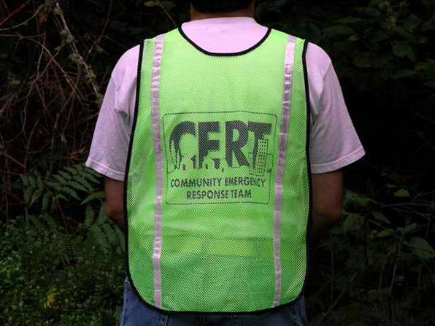
Promotional Message
PM 3-16

Slide 29
Key Messages
What are the key messages and values of the CERT Program?
  Safety, safety, safety; “safety first”
  Teamwork
  Community members helping each other in the neighborhood, workplace, school, etc.
  Valuing volunteers and CERT as an asset to the community
  Preparedness
PM 3-16

Slide 30
Key Messages (cont’d)
What are the key messages and values of the CERT Program? (cont’d)
  Importance of each individual’s contribution
  Practice, practice, practice
  Self-sufficiency and problem-solving, rather than the victim role
  Leadership
  Ability to do the greatest good for the greatest number in the shortest amount of time
PM 3-16

Slide 31
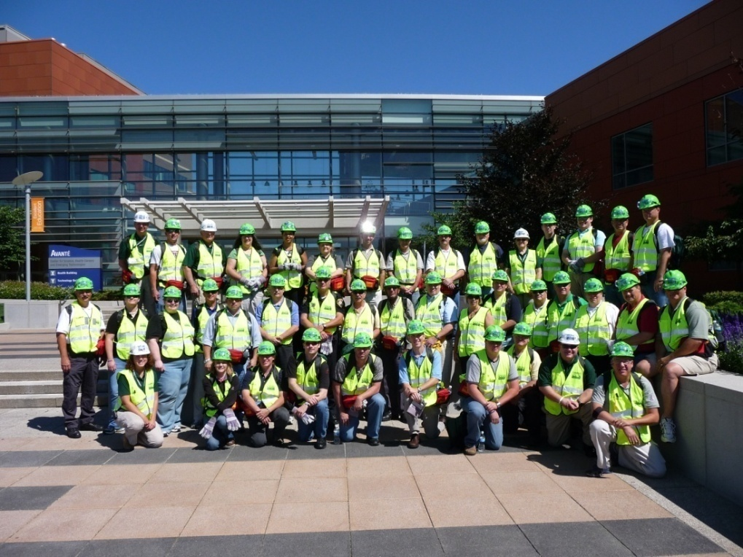
Which Message Is Right?
Needs of target audience dictate:
  What promotional message CERT program uses
  How that message
  is communicated
PM 3-16

Slide 32
Activity
Promoting the CERT Program
PM 3-17

Slide 33
Activity
Draft Program Plan:
Promoting to Target Audiences
PM 3-19

Slide 34
Unit Summary
Why We Promote and To Whom We Promote
The Importance of Partnerships
Program Promotion and Goal Setting
How to Initiate and Foster Partnerships
The Promotional Message
PM 3-19

