Slide 1


Unit 2: Setting a Program Vision
CERT Program Manager

Slide 2
Unit Objectives
At the conclusion of this unit, participants will be able to use strategic planning to define the mission and goals for a local CERT program:
  Explain why a CERT program must have clearly defined goals and objectives
  Establish draft goals and objectives for a CERT program
PM 2-1

Slide 3

Unit Topics
The importance of setting goals
Identifying program goals and objectives
The goal setting process
PM 2-1

Slide 4
Importance of Goal Setting
Every CERT program is different
  No specific model in this course
Every program must have a vision
  Program goal describes that vision
  Program goal is the starting point to measure progress against
PM 2-1

Slide 5
Activity
Brainstorm Program Goals
PM 2-1

Slide 6
Goals and Objectives
Every program needs goal and objectives
  Goal = program purpose
  Objectives = specific activities to accomplish goal
Goal
Objective
Objective
Objective
PM 2-2

Slide 7
Program Goal
Also called mission statement
Clear and succinct statement about program’s purpose for existence
What you will provide to whom and where
“The XYZ CERT Program will assume management of disaster relief operations in the neighborhoods of CERT members until professional responders arrive.”
PM 2-2

Slide 8
Program Objective
Describes what you will do to accomplish goal
Effective objectives are SMART
  Specific
  Measurable
  Achievable
  Relevant
  Time Bound
“Provide two CERT Basic Training courses each calendar year.”
PM 2-2

Slide 9
Activity
Identify Goals and Objectives
PM 2-2

Slide 10
Activity
Evaluate Objectives
PM 2-3

Slide 11
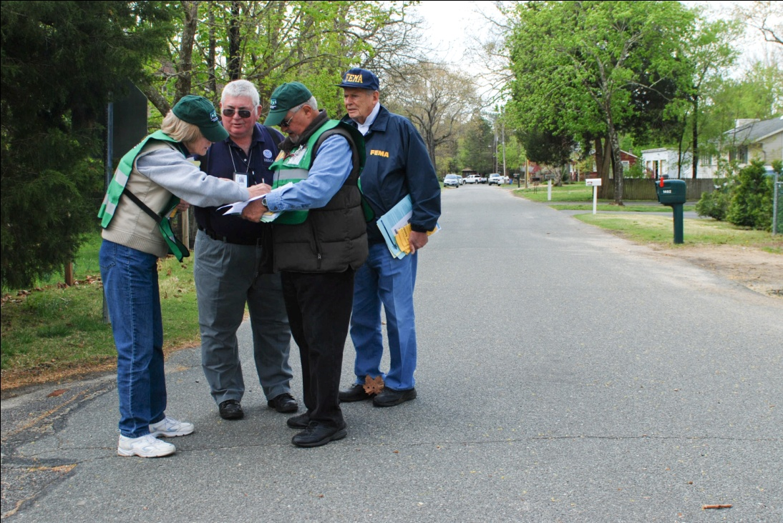
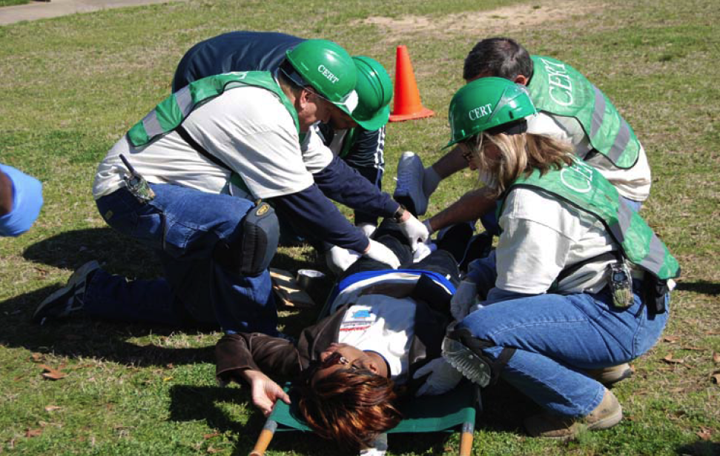
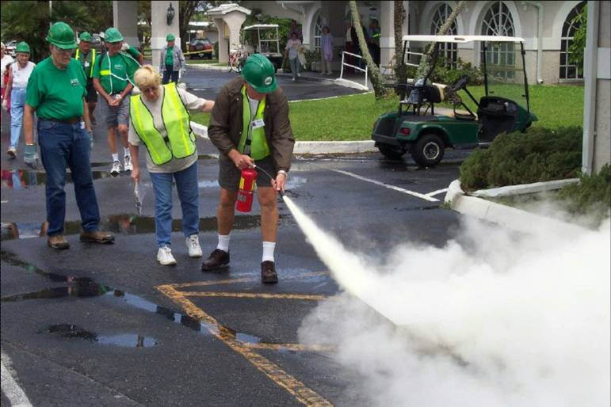
Goal Setting Process
How to set program goals
PM 2-8

Slide 12
5 Goal Setting Steps
Identify community and sponsor needs
Develop draft goal and objectives
Test goal/objectives with sponsors and stakeholders
Periodically evaluate
  a. Progress toward achieving objectives
  b. Appropriateness of objectives
Develop new goal/objectives as needed
PM 2-8

Slide 13
Iterative Process
CERT program must periodically re-assess its goal/objectives
  To keep in alignment with community needs
Go back to Step 1 and repeat process
Program goal probably will not change
Specific objectives should be reviewed regularly and updated as needed
PM 2-8

Slide 14
#1: Identify Needs
All program goal/objectives are local
Program goal/objectives must be developed by local program
  This is entity that will be implementing them
Program goal/objectives must respond to needs of community
PM 2-8

Slide 15
What do you Think?
How can you find out what your community’s needs are?
PM 2-8

Slide 16
Community Needs
When you ask about your community’s needs, what do you want to find out?
  What hazards are possible in community?
  What is emergency management system in community? Who are players?
  Have there been other community-based public safety efforts? How successful?
  Have some homeowners and businesses implemented preparedness measures?
  What support is there for CERT?
PM 2-9

Slide 17
People to Talk With
Whom do you need to talk with to find out what needs the community has?
  Fire department; law enforcement agency
  Emergency manager
  Neighborhood associations
  Community leaders
  Transportation department
  Local college or university
  Businesses prepared for emergencies
PM 2-9

Slide 18
Vision-Promotion Overlap
Have to set program’s vision and promote program at same time
  You can’t promote your program without having a program vision
  You can’t set the vision for your program without getting input from other people
  And people can‘t give you input without knowing about the program
PM 2-9

Slide 19
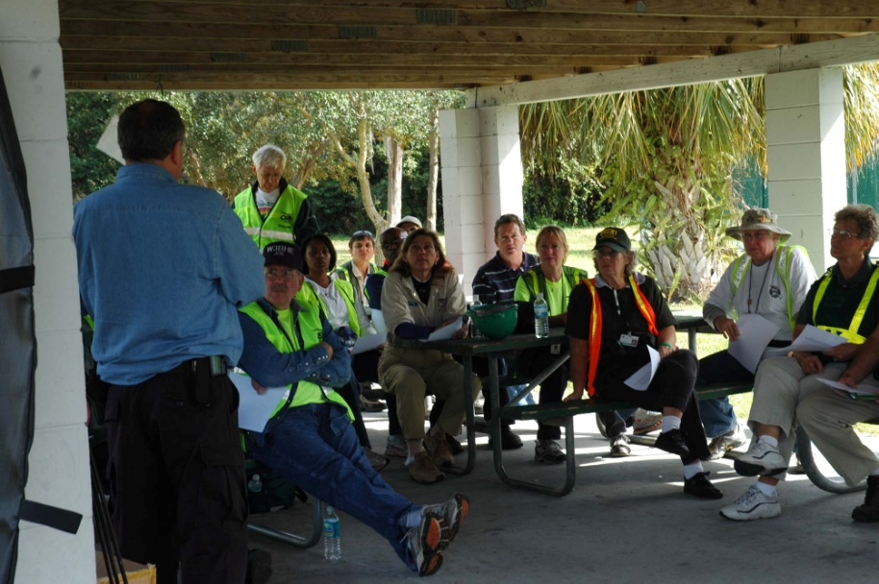
Educate about CERT
What its purpose is
How it has been used around the country
How it can be an asset to department, agency, or organization
How it can be an
asset to
community
PM 2-10

Slide 20
#2: Develop Draft Goals
One overall program goal
Several objectives
  Program decides how many to develop
Start Small!
PM 2-10

Slide 21
#3: Test Goal/Objectives
Get feedback on program goal/objectives from people you talked with during assessment
Process accomplishes two things
  If goal has missed mark, representatives will provide that feedback
  It encourages buy-in
    People who feel ownership of program will be stronger supporters
PM 2-10

Slide 22
Activity
Draft Program Plan:
Develop Program
Goal and Objectives
PM 2-11

Slide 23

#4: Evaluate Progress
Periodically ask:
  Is the program making progress toward the objective?
  Is the objective still appropriate for the program?
PM 2-11

Slide 24
Strategic Planning
How does a program review its own objectives?
  Through strategic planning
    Where organization is going over next year
    How organization is going to get there
    How organization will know if it got there
  Strategic planning resources
    Online
    Get help from local resource
PM 2-11

Slide 25
Two Tools
Questions to Get You Started
SWOT Analysis
  Strengths, Weaknesses, Opportunities, Threats
  Process
    Identify an opportunity
    Identify internal and external factors that are helpful or harmful to making opportunity a reality
PM 2-12

Slide 26
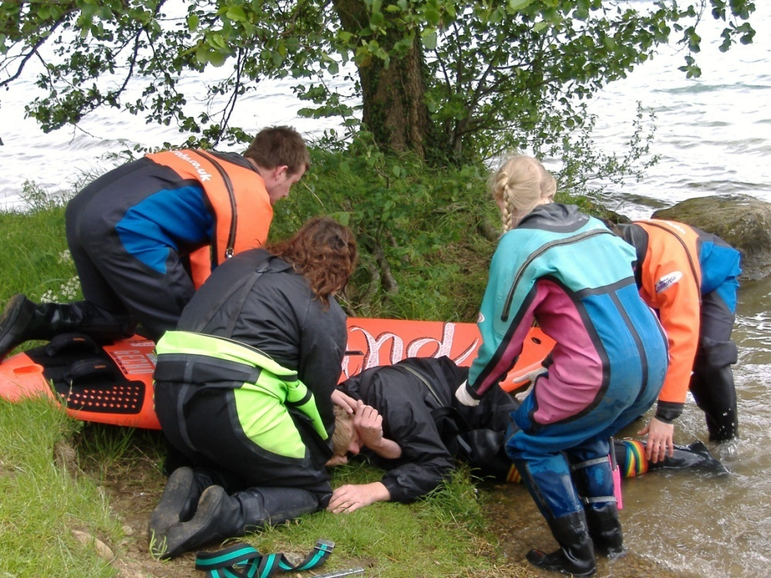
#5: Develop New Goals
CERT program changes as community needs change
Update goals to reflect changes
Repeat full goal-
setting process
PM 2-16

Slide 27
Unit Summary
Goals important to all programs, ongoing and new
  Overall program goal
  Specific objectives
Use 5-step goal-setting process
PM 2-16

