Slide 1

Welcome
CERT Program Manager Course

Slide 2

Unit 1: Introduction and Overview
CERT Program Manager

Slide 3
Housekeeping
Restrooms
Smoking Policy
Cell phone policy (silent mode)
Emergency exits
Breaks
PM 1-1
1-3
Notes:
3

Slide 4
Introduce Yourself
Name
Your CERT program
Your expectations for this course
PM 1-1
1-4
Notes:
4

Slide 5
Course Purpose
To prepare CERT Program Managers for the tasks required to establish and sustain an active local CERT program
Relevant for all Program Managers
  Those starting new program
  Those building on existing program
PM 1-1
1-5
Notes:
5

Slide 6
Learning Objectives
Overall: To draft or update basic local CERT program plan
Primary learning objectives
  Define purpose and core components of CERT program
  Use strategic planning to define mission and goals for local CERT program
  Describe purposes and strategies for promoting local CERT program
PM 1-1
1-6

Slide 7
Learning Objectives (cont’d)
Primary learning objectives (cont’d)
  Establish process for working with volunteers
  Establish process for working with instructors
  Establish process for acquiring and managing program resources
PM 1-1
1-7

Slide 8
Learning Objectives (cont’d)
Primary learning objectives (cont’d)
  Build plan for delivering and managing safe training and exercises
  Describe the role of policies and procedures in operating CERT program
  Develop process for evaluating CERT program
  Describe how to sustain a local CERT program
PM 1-2

Slide 9
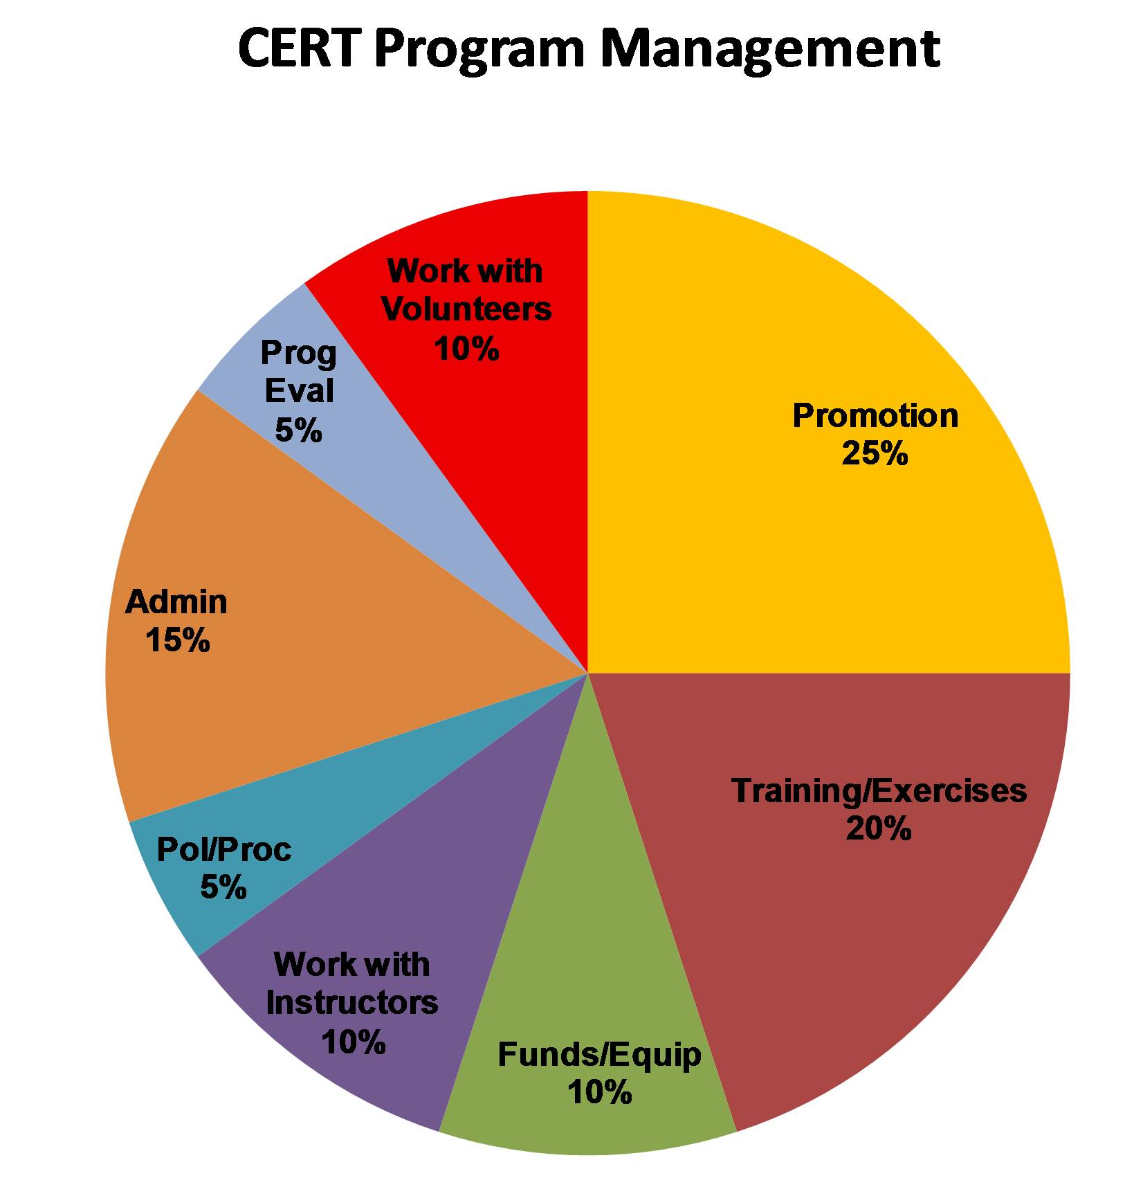
CERT Program Management
PM 1-5

Slide 10
What Is a CERT Program?
How CERT programs got started
What a CERT program is
How CERT programs interact with emergency response system and the community
PM 1-8
1-10

Slide 11
CERT Impetus
What was the impetus for CERT?
  As many as 10,000 killed in 1985 Mexico City earthquake
    700 saved by untrained volunteers
    100 volunteers died trying to help
  City of Los Angeles Fire Department (LAFD) recognized that citizens likely to be on their own during early stages of disaster
PM 1-8
1-11

Slide 12
CERT Pilot
When was the first CERT program piloted?
  1986 Los Angeles earthquake response
PM 1-8
1-12

Slide 13
How CERT Spread
How did the CERT Program spread?
  Other jurisdictions adapted CERT model for earthquake response
  Orlando (FL) then adapted CERT model for hurricane response
  Early 1990s FEMA felt that CERT should be made available to communities nationwide
  1994 FEMA Emergency Management Institute began conducting CERT Train-the-Trainer course
PM 1-8
1-13

Slide 14
CERT Program
Where is the CERT Program currently housed?
  Since 2003, CERT has been:
    Part of Community Preparedness Division
    Partner program to FEMA’s Citizen Corps Program
PM 1-9
1-14

Slide 15
CERT Purpose
What is the purpose of the CERT Program?
  To be a response asset
  To be an extension of first responder services until professional services arrive
PM 1-9
1-15

Slide 16
CERT Member Priorities
Whether preparing for or responding to an emergency or a disaster, what are a CERT member’s priorities?
  First, they help themselves and their families
  Second, they help their neighbors, coworkers, or others nearby
  Third, they help the larger community
PM 1-10
1-16

Slide 17
Other CERT Activities
As CERT concept has taken hold across country, CERTs have become involved in community’s preparedness and response capability
In addition to disaster response, what other activities are CERT programs involved in?
PM 1-10
1-17

Slide 18
CERT and
Emergency Response
No community can staff for major disasters or even large emergencies
Community counts on help from neighboring communities
  Mutual aid agreements
Sometimes they can’t respond
At these times CERT program augments community’s
response capability
PM 1-11
1-18

Slide 19
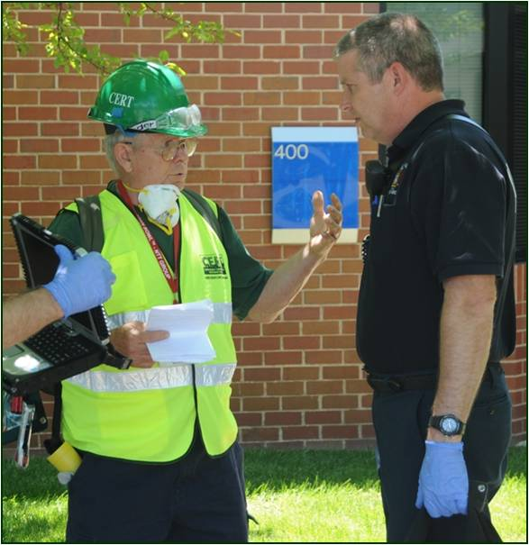
Emergency Response Linkages
Local CERT program must establish linkages with existing response system
In this course think about:
  What relationships with
  response agencies
  are or should be
  How to establish
  or improve them
PM 1-11
1-19

Slide 20
Program Plan
You will design a draft plan for your program
  New Program Managers will start from scratch
  Experienced Program Managers will revise and update existing plan
  You will find an electronic version of the blank Draft Program Plan template at www.fema.gov/cert
PM 1-11
1-20

Slide 21
Unit Summary
Course preview
  Purpose and learning objectives
What is a CERT program?
  CERT history, purpose, and activities
  CERT and the community
  CERT and the emergency response system
The Draft Program Plan
PM 1-34
1-21

