Slide 1


Unit 11: Manage the Classroom
CERT Basic Train-the-Trainer

Slide 2
Unit Objectives
At the conclusion of this unit, the participants will be able to:
  Describe ways for an instructor to get to know his or her learners in a regular CERT Basic Training class
  Explain what to do with the information learned
  Identify ways to work with younger learners
PM 11-1

Slide 3
Unit Objectives (con’t)
PM 11-1
  State guidelines for responding appropriately to situations that might make a learner feel left out
  Describe seven kinds of behavior that might be disruptive in the classroom
  Discuss what motivates those behaviors and how instructors might respond
  Explain what kinds of accommodations may need to be made for some learners
Notes:
3

Slide 4
What Do You Think?
PM 11-2
What would you like to know about the people in your class?
Notes:
4

Slide 5
What You Want to Know
PM 11-2
What would you like to know about these 20 people?
  Names
  Why they are here
  What they want to get out of the class
  What limitations they have
  If any of them will be a challenge to work with
  Who will be a help during activities
  How they are feeling
Notes:
5

Slide 6
What Do You Think?
PM 11-2
How can you find out this information?
Notes:
6

Slide 7
Gathering Information
PM 11-2
How can you find out this information?
  Introductions
  Gathering expectations
  General conversations
  Observations
  Asking specific questions
Notes:
7

Slide 8
What Do You Think?
PM 11-2
What is another way to get to know people?
Notes:
8

Slide 9
Non-Verbal Information
PM 11-2
What is another way to get to know people?
  Non-verbal communication/body language
Notes:
9

Slide 10
What Do You Think?
PM 11-2
What can body language tell you?
Notes:
10

Slide 11
Body Language
PM 11-2
What can body language tell you?
  I’m bored
  I’m confused
  I’m apprehensive
  I don’t want to be here
  I’m excited about this
  I’m physically uncomfortable (cold or hot)
Notes:
11

Slide 12
Exercise
PM 11-3
Exercise: Body Language Roleplay
Notes:
12

Slide 13
What Do You Think?
What is cultural sensitivity and why is it important to you as an instructor?
PM 11-3

Slide 14
Cultural Sensitivity
What is cultural sensitivity and why is it important to you as an instructor?
  Cultural sensitivity means that you are aware of cultures different than yours
    Get to know the traditions and the culture of the people you are training
    Work with members of that culture to resolve any potential issues
PM 11-3

Slide 15
Recommendations
In advance of the training:
  Meet with a community representative
  Identify any culturally sensitive topics that will be covered in the training
  Develop strategies for presenting these topics
  Make note of phrases that might be culturally inappropriate
  Get a member of the community you are teaching to co-teach the class
PM 11-4

Slide 16
Recommendations (con’t)
During the training:
  Avoid making assumptions about the beliefs or attitudes of the learners
  Talk to students before class and during breaks about their traditions
  Practice humility in regards to cultural issues
  Do not make jokes or be flippant regarding such issues
PM 11-4

Slide 17
Recommendations (con’t)
During the training:
  Be aware of how your target audience may feel about certain topics
  Encourage learners to discuss ways that people within their community may cope with such issues
PM 11-4

Slide 18
Examples of Sensitive Topics
Disaster psychology
Death
Physical contact
PM 11-4

Slide 19
Scenario
PM 11-5
You have been checking in with people at the beginning of each session and talking to them at breaks. You have also been watching their body language. In the process, you have learned a lot about your learners, as individuals and as a group.
Notes:
19

Slide 20
What Do You Think?
PM 11-5
What can you do with the information you have learned?
Notes:
20

Slide 21
What Do You Think?
PM 11-5
What can you do with the information you have learned?
  Teach to level of group
  Adjust the pace of the training
  Motivate and encourage
  Have a relationship with each learner
Notes:
21

Slide 22
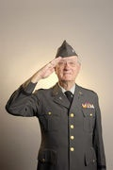



Teaching for All Ages
Gen X
Veteran
Boomer
Gen Y
PM 11-5
Notes:
22

Slide 23
Teaching Considerations
Computer and Internet are part of life
Staying connected is important; they expect quick responses
Doing is more important than knowing facts
They are perfectly happy with trial and error
They don’t require linear learning
They are used to multitasking
They prefer typing; often have poor handwriting
PM 11-8

Slide 24
What Do You Think?
Think about situations that might make a learner feel left out. What might those be?
PM 11-15

Slide 25
Don’t Leave Learners Out
Think about situations that might make a learner feel left out. What might those be?
  Instructor ignoring some learners
  Instructor having favorite learners
  Inability to do some exercises
  Discomfort with some exercises
  Instructor using inappropriate language/jokes
  Feeling that other learners “take charge” during activities/exercises
PM 11-15

Slide 26
Guidelines for Appropriate
Behavior
Watch language
Be consistent
Get to know learners
Deal with touching appropriately
PM 11-15
Notes:
26

Slide 27
Watch Your Language
No place for jokes/comments about race, religion, gender, ethnicity, etc.
Watch acronyms
PM 11-15
Notes:
27

Slide 28
Be Consistent
Address questions and comments to everyone
Don’t give additional attention to any one learner
Handle situations in the same way each time
Watch for learners who withdraw
  Encourage everyone to participate
  Manage those who exclude or overlook others
PM 11-16
Notes:
28

Slide 29
Get to Know Learners
Talk with learners before and after class
Find out who might have limitations in doing exercises
PM 11-16
Notes:
29

Slide 30
Deal with Touch
When touching is involved, explain and ask permission
Model appropriate behavior to help participants feel more comfortable about touching survivors
“Ask permission” to touch is used to help CERT members become more comfortable with touching someone else
PM 11-16
Notes:
30

Slide 31
What Do You Think?
For those of you who have taught CERT Basic Training, what methods have you found to be effective for asking permission to touch?
PM 11-16
Notes:
31

Slide 32
Review
Unit 5: Importance of creating positive learning environment
  Teach to various learning styles (auditory, visual, tactile)
  Use techniques that maximize learning, like motivation and reinforcement
Unit 11: Create positive learning environment
  Learn about your learners
  Control sensitive situations
PM 11-16

Slide 33
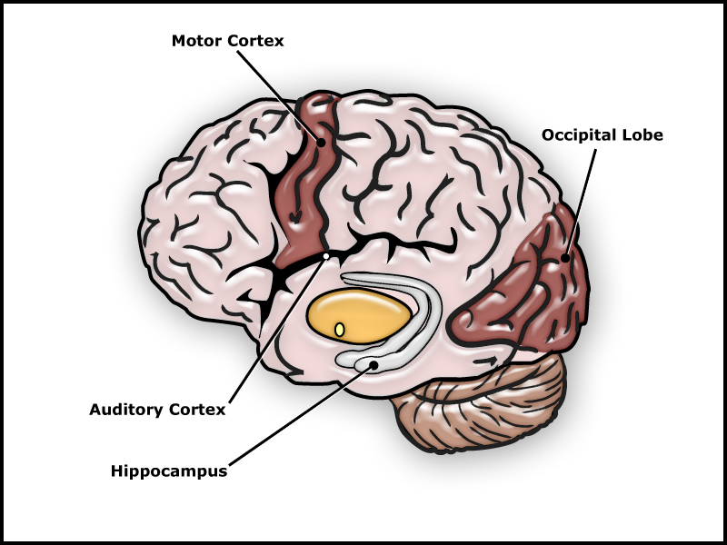
Brain and Hippocampus
PM 11-16

Slide 34
Rule of Thumb
Break large content chunks into smaller chunks
Present 5-10 minutes of content
Let learners “play” with content (talk about it, ask/answer questions about it, do an activity with it)
During “play” time hippocampus processes information
Repeat process
PM 11-18

Slide 35

Building Blocks
Pre-expose learners to ideas and concepts
This starts learning process and gives hippocampus pegs that it
can hang new information
onto
Hippocampus can process
information faster if it has
already made pegs
PM 11-18

Slide 36
What Do You Think?
What kinds of behaviors have you seen that indicate a learner might not be fully engaged in the class?
PM 11-19

Slide 37
Disruptive Behaviors
What kinds of behaviors have you seen that indicate a learner might not be fully engaged in the class?
  Side conversationalist
  Non-participator
  Expert
  Dart thrower
  Hare
  Noisemaker
  Class clown
PM 11-19

Slide 38
What Do You Think?
How did the challenging behaviors enacted during the previous section impact your ability to learn or concentrate?
PM 11-19

Slide 39
Effect of Disruptive Behaviors
Disruptive behavior may cause others in the class to:
  Have trouble concentrating
  Have difficulty hearing instructor
  Feel less motivated
  Feel angry or irritated
  Feel left out
  Participate less
PM 11-19

Slide 40
Exercise
Exercise: Addressing Disruptive Behaviors
PM 11-20

Slide 41
Scenario # 1
What if you have a group of mostly older people? What difficulties should you anticipate that they might have?
PM 11-21

Slide 42
Older Audience
What if you have a group of mostly older people? What difficulties should you anticipate that they might have?
  Auditory
  Visual
  Bending
  Grasping
  Strength
PM 11-21

Slide 43
What Do You Think?
What kinds of accommodations will you want to make?
PM 11-21

Slide 44
Make Accommodations
What kinds of accommodations will you want to make?
  Don’t make assumptions about limitations
  Arrange classroom so participants may sit close to front/instructor
  Use microphone if possible
  Provide CERT Basic Training course Participant Manual in low-vision format if requested
  Emphasize that there are functions for every person on a CERT
  In exercises requiring physical agility, encourage all participants to try
PM 11-21

Slide 45
Scenario # 2
What if someone arrives at the first class in a wheelchair? Do you automatically assume that this person can’t be a CERT member?
PM 11-22

Slide 46
What Do You Think?
How would you respond?
PM 11-22

Slide 47
How to Respond
How would you respond?
  Don’t make assumptions about limitations
  Ensure classroom has clearance for wheelchairs
  In exercises requiring physical agility, encourage all participants to try everything
  For those with physical challenges, suggest manageable functions, e.g., group leader, safety officer, documentation
PM 11-22

Slide 48
Unit Summary
People can tell you about themselves in several ways, verbally and non-verbally
Read and listen to cues to make training effective
Use guidelines for sensitive situations in the classroom
Work with participants on the issue of asking permission to touch
PM 11-23
Notes:
48

Slide 49
Unit Summary (con’t)
At times instructors encounter learners who present challenges
  Behaviors that might disrupt the class
  Functional limitations
Instructors can learn how to respond to any of these situations
PM 11-23
Notes:
49

