Slide 1


Unit 4: CERT Basic Training Unit 2 Review
CERT Basic Train-the-Trainer

Slide 2
What Do You Think?
What is the purpose of CERT Basic Training Unit 2?
PM 4-1

Slide 3
The Purpose of Unit 2
What is the purpose of CERT Basic
Training Unit 2?
  To teach about fire hazards and personal fire safety
  To introduce concept of sizeup
  To reinforce concept of teamwork
PM 4-1

Slide 4
What Do You Think?
What are the learning objectives for this unit?
PM 4-1

Slide 5
What Do You Think?
What are the learning objectives for this unit?
To explain role of CERTs in fire safety
To identify and reduce potential fire and utility risks in home and workplace
To know nine steps of CERT sizeup process
To conduct basic sizeup for fire emergency
To operate portable fire extinguisher correctly
PM 4-1

Slide 6
What Do You Think?
What are the learning objectives for this unit? (continued)
To understand minimum safety precautions, including safety equipment, utility control, buddy system, and backup teams
To identify locations of hazardous materials in community and home and reduce risk from hazardous materials in home
PM 4-1

Slide 7
Key Topics
Give brief overview of unit
Provide basic information about fire, fire hazards, and hazardous materials
Teach how to reduce hazards
Teach what can and can’t respond to
  How to do it safely
PM 4-2

Slide 8
Key Topics (cont’d)
PM 4-2
Highlight:
  Role of CERT members
  Importance of buddy system
  Importance of personal protective equipment (PPE)
Continue modeling
Notes:
8

Slide 9
Training Videos
PM 4-3
If time permits, show 18-minute video Fire Safety: The CERT Member’s Role
Video provides information on how to:
  Size up fire
  Select right extinguisher
  Use extinguishers correctly
Notes:
9

Slide 10
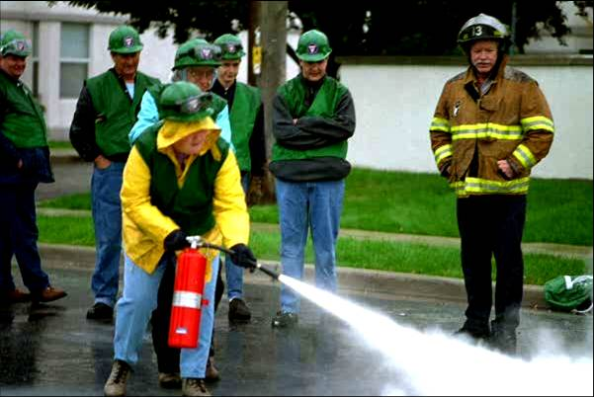
Hands-On Activities
Suppressing Small Fires
PM 4-3

Slide 11
Tips for Teaching Unit
Be prepared to answer “what if” questions
Emphasize role of CERT members
Highlight importance of buddy system
  Demonstrate how to work together as a team
Emphasize importance of PPE
  Tell participants to follow PPE guidelines as specified by local jurisdiction
  Wear PPE as part of all demonstrations and activities
PM 4-4

Slide 12
More Tips
Know when and why you turn off utilities
  Learn about rural and urban differences in types of utilities
Make sure to have all types of fire extinguishers
  Consider asking participants to bring extinguishers from home
  Place extinguishers at front of room
  Ventilate classroom when using CO₂ extinguisher
PM 4-5

Slide 13
More Tips
Demonstrate each step using a buddy:
  Approaching fire
  Discharging extinguisher
  Backing out
Explain each step as you demonstrate
Emphasize how quickly fire spreads
Encourage people to think creatively about what would be fire suppression resources
PM 4-5

Slide 14
More Tips
Emphasize how everyday products can be hazardous, e.g., dairy creamer.
Don’t get too in-depth about placards
  Emphasize that they are a “stop sign”
Prepare props for demonstration
  Breaker box
  Fuse box
  Gas meter
Consider taking cotton ball exercise outside
PM 4-5

Slide 15
Connection to Course
Unit introduces concept of sizeup
Reinforces concepts of:
  Teamwork
  The buddy system
  PPE
  Personal safety
  Limitations
PM 4-6

