Slide 1


Unit 2: Your Role as Instructor
CERT Basic Train-the-Trainer

Slide 2
What Do You Think?
What is the goal of every CERT Basic Training class?
PM 2-1
Notes:
2

Slide 3
Goal of CERT Basic Training
PM 2-1
What is the goal of every CERT Basic Training class?
To prepare people to help themselves, their families, and their neighbors, coworkers, and others in the event of a catastrophic disaster
Notes:
3

Slide 4
Unit Objectives
At the conclusion of this unit, the participants will be able to:
  Describe the roles of the CERT instructor
  State desired qualities of an effective CERT instructor
  List the qualities of a good presenter
  Explain how to develop a teaching style that conveys those qualities
PM 2-1

Slide 5
Instructor Roles
PM 2-1
An effective CERT instructor should be:
  A subject matter expert
  A trainer
  An evaluator
  A friend and coach
  A role model
  A classroom manager
Notes:
5

Slide 6
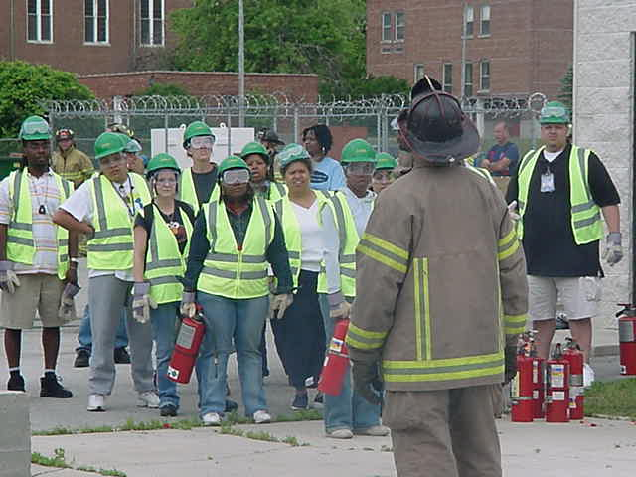
The CERT Instructor
PM 2-2
Notes:
6

Slide 7
Role #1: SME
Learning objectives and content for each of the CERT Basic Training units
How units relate to each other
How to conduct hands-on exercises effectively
PM 2-2

Slide 8
Role #2: Trainer
Knows how to transfer knowledge
  How people learn and how to teach to different learning styles
  What adults need from the instructor to learn best
  Effective presentation skills
PM 2-2

Slide 9
Role #3: Evaluator
Knows how to determine if behavior has changed
  Formal and informal ways
  Questioning skills
  Giving feedback
PM 2-3

Slide 10
Role #4: Friend/Coach
Have relationship with class as a whole and individuals in class
Put learners at ease
Motivate learners
PM 2-3

Slide 11
What Do You Think?
What things does an effective instructor do to motivate learners?
PM 2-4

Slide 12
Providing Motivation
What things does an effective instructor do to motivate learners?
An effective instructor should:
  Be enthusiastic
  Expect a good performance
  Make the training relevant
  Use positive reinforcement
  Correct with sensitivity and empathy
  Encourage and encourage
PM 2-4

Slide 13
Role #5: Role Model
Show how CERT member should behave
Reinforce important habits
  Safety
  Appropriate use of humor
PM 2-4

Slide 14
What Do You Think?
How does an instructor model CERT’s values and messages?
PM 2-4

Slide 15
Modeling CERT Values
How does an instructor model CERT’s values and messages?
  Always wear correct safety equipment
  Work effectively as part of a team
  Value the learners as important assets
  Be prepared
  Function effectively as a leader
  Insist that skills are practiced multiple times
PM 2-4

Slide 16
Role #6: Classroom Manager
Time management and transitioning
Transitioning from one unit to next
Running training equipment
Arranging for activity supplies
Working with participants with different agenda or with physical or mental limitations
Being inclusive
Dealing with sensitive topics
PM 2-5

Slide 17
Instructor Roles
Learn more about each instructor role:
  Subject Matter Expert: CERT Basic Training review in Units 3, 4, 6, 7, 8, 10, 12, 13, 14
  Trainer: Unit 2, Your Role as Instructor, and Unit 5, Maximize Learning
  Evaluator: Unit 5, Maximize Learning
PM 2-5

Slide 18
Instructor Roles (con’t)
  Friend and Coach: Unit 11, Manage the Classroom
  Role Model: Throughout this course
  Classroom Manager: Unit 11, Manage the Classroom and Unit 16, Preparing for the CERT Basic Training Course
PM 2-5

Slide 19
What Do You Think?
What qualities are found in a good CERT instructor?
PM 2-6

Slide 20
CERT Instructor Qualities
What qualities are found in a good CERT instructor?
  Prepared
  Energetic
  Enthusiastic
  Interested
  Sensitive
  Makes training fun, safe, and interactive
  Leaves the ego and war stories at home
  Patient
  Sense of humor
PM 2-6

Slide 21
Presenter Qualities
Learners often judge an instructor by how he or she speaks and looks
A trainer must be “credible”
Credibility is based:
  45% on how you appear
  45% on how you sound
  10% on actual words you say
PM 2-6

Slide 22
What Do You Think?
When someone speaks of a good presenter, what qualities are they talking about?
PM 2-6

Slide 23
A Good Presenter
When someone speaks of a good presenter, what qualities are they talking about?
  A good presenter is:
  Sincere
  Enthusiastic
  Lively
  Expressive
  Interesting
  Assertive
  Convincing
      Credible
      Confident
      Poised
      Professional
      Funny
      Accepting
PM 2-6

Slide 24
Exercise
Exercise: The Super Trainer
PM 2-7

Slide 25
What Do You Think?
What should a presenter’s general appearance be?
PM 2-7

Slide 26
Presenter Appearance
What should a presenter’s general appearance be?
  Neat and clean
  Simple
  No jingles
  Professional attire
PM 2-7

Slide 27
What Do You Think?
What should the eyes be doing?
PM 2-7

Slide 28
Presenter Eyes
What should the eyes be doing?
  Make eye contact
  Scan the group
PM 2-7

Slide 29
What Do You Think?
What should the ears be doing?
PM 2-7

Slide 30
Presenter Ears
What should the ears be doing?
  Listening to participants
    Ask fellow instructor to tell you if you miss something
PM 2-7

Slide 31
What Do You Think?
What should the face be doing?
PM 2-7

Slide 32
Presenter Face
What should the face be doing?
  The presenter’s face should be:
    Animated
    Smiling a lot, with mouth and eyes
PM 2-7

Slide 33
What Do You Think?
What should the voice be doing?
PM 2-7

Slide 34
Presenter Voice
What should the voice be doing?
  The presenter’s voice should:
    Vary pace; not too slow or too fast
    Vary volume
    Use inflections
    Use pauses for emphasis and suspense
    Watch “er” and “um”
PM 2-7

Slide 35
What Do You Think?
What should the body stance be?
PM 2-7

Slide 36
Presenter Stance
What should the body stance be?
  The presenter’s stance should be:
    Open
    Inviting
    Good posture
    Poised and confident
PM 2-7

Slide 37
What Do You Think?
What should the arms be doing?
PM 2-7

Slide 38
Presenter Arms
What should the arms be doing?
  Use gestures purposefully
  Don’t flail or point
PM 2-7

Slide 39
What Do You Think?
What should the feet be doing?
PM 2-7

Slide 40
Presenter Feet
What should the feet be doing?
  The presenter’s feet should:
    Move around purposefully
    Not stand in one place but not move constantly
    Not fidget, rock, or pace back and forth
PM 2-7

Slide 41
Presenter Attitude
An effective presenter’s attitude is:
  Positive
  Accepting
  Enthusiastic
  Encouraging
The presenter’s manner should be:
  Confident
  Calm
  Matter of fact
PM 2-7

Slide 42
Unit Summary
An instructor is a:
  Subject matter expert
  Trainer
  Evaluator
  Friend and coach
  Role model
  Classroom manager
PM 2-12

Slide 43
Unit Summary (con’t)
Focus is on participant
Good teaching is a performance
Every instructor has to find his or her own style
  Must reflect good presenter qualities
PM 2-12

