Slide 1


Unit 1: Introduction
CERT Basic Train-the-Trainer

Slide 2
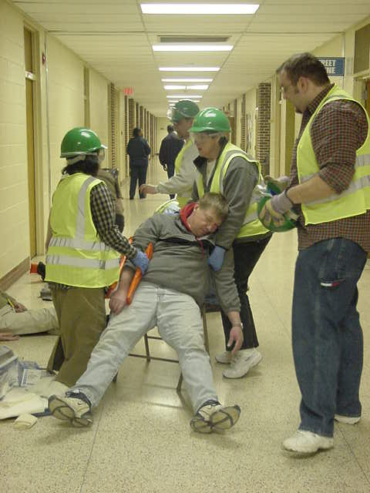
Welcome
Welcome to the Community Emergency
Response Team
Train-the-Trainer course!
CERT Train-the-Trainer: Introduction
1-2

Slide 3
Housekeeping
Restrooms
Smoking policy
Cell phone policy (silent mode)
Emergency exits
Parking lot
CERT Train-the-Trainer: Introduction
1-3
Notes:
3

Slide 4
Introductions
Introduce yourself with:
  Your name
  Your CERT program
  Your expectations for this training
CERT Train-the-Trainer: Introduction
1-4
Notes:
4

Slide 5
CERT Instructors
Completion of CERT T-T-T can qualify you to teach CERT Basic Training
Some sponsoring agencies may have additional requirements
FEMA recommends the following:
  Completion of CERT Basic Training
  Completion of CERT T-T-T course
  Significant training background
  Is recognized and/or authorized by the State
PM 1-1
CERT Train-the-Trainer: Introduction
1-5
Notes:
5

Slide 6
CERT T-T-T Purpose
To produce competent instructors for CERT Basic Training course
A competent instructor:
  Delivers course accurately
  Ensures that students achieve course objectives
  Delivers training effectively at appropriate level
  Creates comfortable yet managed learning environment
PM 1-1
CERT Train-the-Trainer: Introduction
1-6
Notes:
6

Slide 7
Learning Objectives
At the conclusion of this training, participants will be able to:
  Demonstrate knowledge of CERT Basic Training course
  Demonstrate ability to present assigned portion of course (teach-back)
  Communicate core values of program
  Demonstrate classroom management techniques
  Demonstrate effective teaching techniques
  Model appropriate behavior as an instructor
PM 1-2
CERT Train-the-Trainer: Introduction
1-7

Slide 8
Course Agenda
 | DAY 1 | DAY 2 | DAY 3
Morning | Introduction and Administrative Announcements Introduction Your Role as Instructor Unit 1 Review | Unit 4 Review Unit 6 Review Teach-Back #1 Continued (Presentations) | Unit 7 Review Unit 8 Review Unit 9 Review Teach-Back #2 Continued (Presentations)
Afternoon | Unit 2 Review Maximize Learning Unit 3 Review Teach-Back #1 (Assignment) | Teach-Back #1 Continued (Presentations) Unit 5 Review Manage the Classroom Teach-Back #2 (Assignment) | Teach-Back #2 Continued (Presentations) Preparing for CERT Basic Training course Course Summary
Evening | Teach-Back #1 preparation | Teach-Back #2 preparation
PM 1-2
CERT Train-the-Trainer: Introduction
1-8

Slide 9
What do You Think?
What was the impetus for CERT?
PM 1-3
1-9

Slide 10
CERT Impetus
What was the impetus for CERT?
  At least 9,000 (maybe as many as 100,000) killed in 1985 Mexico City earthquake
    700 saved by untrained volunteers
    100 volunteers died trying to help
  City of Los Angeles Fire Department (LAFD) recognized that citizens likely to be on their own during early stages of disaster
  Piloted CERT training in 1986
PM 1-3
CERT Train-the-Trainer: Introduction
1-10

Slide 11
What do you Think?
How did the CERT Program spread?
PM 1-3
1-11

Slide 12
How CERT Spread
How did the CERT Program spread?
  Other jurisdictions adapted CERT model for earthquake response to their communities.
  Orlando (FL) then adapted CERT model for hurricane response
  Early 1990s Federal Emergency Management Agency (FEMA) felt that CERT should be made available to communities nationwide
  1994 Emergency Management Institute (EMI) at FEMA began conducting CERT Train-the-Trainer course
PM 1-3
1-12

Slide 13
What do You Think?
Where is the CERT Program currently housed?
PM 1-3
1-13

Slide 14
CERT Program
Where is the CERT Program currently housed?
  Since 2003, CERT has been:
    Part of FEMA Community Preparedness Division
    Partner program to FEMA’s Citizen Corps Program
PM 1-3
1-14

Slide 15
What do You Think?
What is the purpose of the CERT Program?
PM 1-3
1-15

Slide 16
CERT Purpose
What is the purpose of the CERT Program?
  To be a response asset
  To be an extension of first responder services until professional responders arrive
PM 1-3
1-16

Slide 17
What do You Think?
What are the key messages and values of the CERT Program?
PM 1-3
1-17

Slide 18
CERT Values
What are the key messages and values of the CERT Program?
  Safety, safety, safety
  Teamwork
  Community members helping each other
  Valuing volunteers and CERT
  Preparedness
PM 1-3
1-18

Slide 19
CERT Values (con’t)
  Importance of each individual’s contribution
  Practice, practice, practice
  Self-sufficiency and problem-solving
  Leadership
  Ability to do greatest good for greatest number in shortest amount of time
PM 1-3
1-19

Slide 20
What do You Think?
How are CERTs deployed?
PM 1-4
1-20

Slide 21
CERT Introduction
Introduction and Course Overview covers information about CERT:
  History
  Purpose of CERT Basic Training
  Need for individual and community preparedness
  How CERTs operate
PM 1-4
1-21

Slide 22
CERT Introduction (con’t)
Introduction and Course Overview also covers information about course:
  Overview and objectives
  Target audience
  Course agenda
PM 1-4
1-22

Slide 23
Instructor Responsibilities
This section covers:
  Instructor qualifications
  How to prepare content and classroom
  Instructor Guide Table of Contents
  Description of Instructor Guide and Participant Manual
    Available at www.fema.gov/cert/
PM 1-5
1-23

Slide 24
Unit Introduction
Each unit begins with:
  Training Methods: Explains how unit is taught
  Resources Required and Equipment: Tells what materials are needed for unit
  Preparation: Tells what to prepare BEFORE class starts
  Notes: Suggests how to allocate time for unit
  Remarks: Has useful hints and tips
PM 1-5
CERT Train-the-Trainer: Introduction
1-24

Slide 25
Instructor Guide
Instructor Notes - left column
  Mini-copies of slides
  References to pages in Participant Manual
  Information for instructor only
PM 1-5
1-25

Slide 26
Instructor Guide (con’t)
Lesson Content - right column
  Lesson plan
  Instructions for facilitating the exercises
Question icon
  Ask bolded discussion question in the right-hand column
PM 1-5
CERT Train-the-Trainer: Introduction
1-26

Slide 27
Reminders
CERT Basic Training course is classroom-based, instructor-led training
All nine units must be covered
Tailor information to your community
Additional modules may be offered for teams
Add your own images to the slides
PM 1-6
CERT Train-the-Trainer: Introduction
1-27

Slide 28
Participant Manual
Includes key content of course without notes for instructor
PM 1-6
CERT Train-the-Trainer: Introduction
1-28

Slide 29
Unit Summary
It is important to know basic information about the CERT Program so you can answer questions from participants
PM 1-6
CERT Train-the-Trainer: Introduction
1-29

