Slide 1
Pandemic Influenza
CERT Basic Training
Hazards

Slide 2
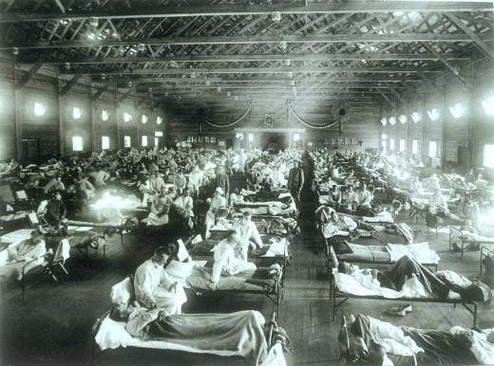
Pandemic Defined
A pandemic is a global disease outbreak

Slide 3
Community Preparedness and Risk
A community strategy can significantly delay or reduce impact of a pandemic
A pandemic is likely to occur at least once every century

Slide 4
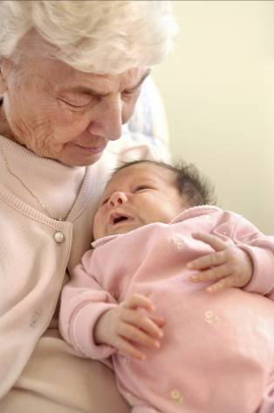
Assessing the Risk
Groups most susceptible to pandemic:
  Infants
  Adults with autoimmune diseases
  Elderly

Slide 5
Essential Services Disrupted
Services may be limited or non-existent:
  Hospitals and other healthcare facilities
  Banks
  Restaurants
  Government offices
  Telephone and cellular phone companies
  Post offices

Slide 6

Food and Water Access Limited
How to prepare:
  Store two weeks of non-perishable food
  Make sure that formulas for infants and any child's or older person's special nutritional needs are part of plan

Slide 7
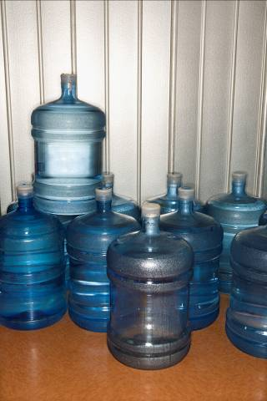
Potable Water Access Limited
How to prepare:
  Store two weeks of water
    1 gallon of water per person per day
    Avoid using containers that will decompose or break

Slide 8
Pandemic and the Workplace
Ask your employer how business will continue
  Discuss staggered shifts or working at home
  Discuss on-site daycare
  Discuss possible flexibility in leave policies
  Discuss how much leave you can take to care for yourself or a family member
Plan for possible loss of income

Slide 9
Pandemic Preparedness in Schools
Talk to teachers, administrators, and parent-teacher organizations
Plan now for children staying at home for extended periods of time
  Plan entertainment and recreational activities
  Plan home learning activities and exercises

Slide 10
Prevent the Spread of Disease
Cover nose and mouth when you cough or sneeze
Wash hands often with soap and water
Avoid close contact with sick people
If you get the flu, stay home
Try not to touch eyes, nose, or mouth

Slide 11
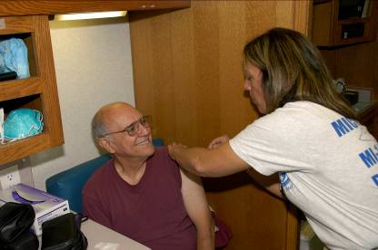
Potential Treatments
Current pandemic flu treatments are limited:
  Vaccination
  Antiviral medication

Slide 12
Sources for Reliable Information
www.pandemicflu.gov
Centers for Disease Control and Prevention (CDC) Hotline
  1-800-CDC-INFO (1-800-232-4636)
Local and state government Web sites
  Links are available to each state department of public health at www.pandemicflu.gov

