Slide 1
Volcanoes
CERT Basic Training
Hazards

Slide 2
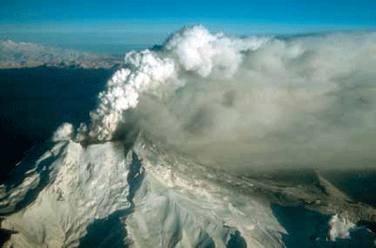
A Volcano…
Is a vent through which molten rock escapes to Earth’s surface

Slide 3
Volcano Hazards
Toxic gases
Lava and pyroclastic flows
Landslides
Earthquakes
Explosive eruptions

Slide 4
Accompanying Hazards
Volcanic eruptions can be accompanied by other natural hazards, including:
  Mudflows (including lahars)
  Flash floods
  Wildland fires
  Tsunamis (under special conditions)
  Earthquakes
Notes:
3

Slide 5
Volcanic Ash
Causes severe respiratory problems
Diminishes visibility
Contaminates water supplies
Causes electrical storms
Disrupts the operation of all machinery and causes engine failure
Collapses roofs
Notes:
4

Slide 6
Preparing for an Eruption
Understand the risk
Talk to your insurance agency
Prepare disaster supply kit
Develop evacuation plan
Develop shelter-in-place plan
Notes:
5

Slide 7
During an Eruption
Follow evacuation orders
Avoid areas downwind and river valleys downstream of the volcano
If outside, protect yourself from ashfall
Be prepared for accompanying hazards
Notes:
6

Slide 8
After an Eruption
Stay away from volcanic ashfall areas
Avoid driving in heavy ashfall
If you have a respiratory ailment, avoid contact with any amount of ash
Notes:
7

