Slide 1
Tornadoes
CERT Basic Training
Hazards

Slide 2
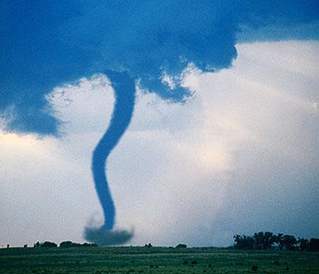
A Tornado Is…
Violently rotating column of air:
  Extending between, and in contact with, cloud and earth’s surface
  May be accompanied by winds in excess of 200 miles per hour

Slide 3
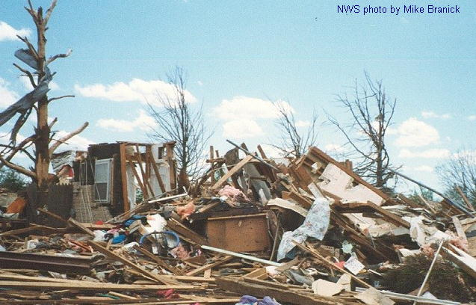
Tornado Risks
Rip trees apart
Destroy buildings
Uproot structures and objects
Send debris
and glass flying
Overturn cars
and mobile
homes

Slide 4
Tornado Facts
Occur in every state
About 800 reported every year
About 180 people killed every year
Season runs March – August, but tornadoes can occur any time of year
Can occur any time of day but most likely to occur 3:00 p.m. to 9:00 p.m.
Annual damage can be hundreds of millions
Notes:
3

Slide 5
Fujita Wind-Damage Scale
Measures tornado strength
Six levels:
  F0: Light damage
  F1: Moderate damage
  F2: Considerable damage
  F3: Severe damage
  F4: Devastating damage
  F5: Incredible damage
Notes:
4

Slide 6
Tornado Preparedness
Know the risk
Identify potential shelter areas
Learn the community’s warning system
Conduct family tornado drills
Notes:
5

Slide 7
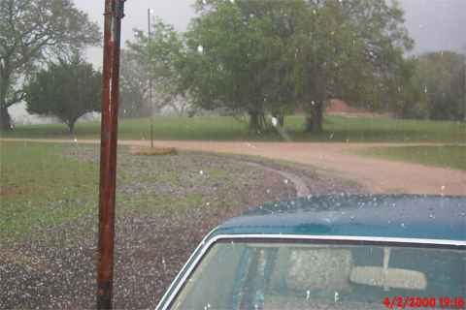
Tornado Warning Signs
High winds
Very large hail
Notes:
6

Slide 8
During a Tornado
Keep windows and doors closed and stay away from them
Use shielding and protective clothing
  Furniture
  Blankets
  Bike helmets
Listen to EAS or NOAA Weather Radio
Notes:
7

Slide 9
After a Tornado
Avoid fallen power lines or broken utility lines
Stay out of damaged areas
Stay out of damaged buildings
Use a flashlight to look for damage
Turn off utilities
Reserve telephone for emergencies
Notes:
8

