Slide 1
Landslides
CERT Basic Training
Hazards

Slide 2
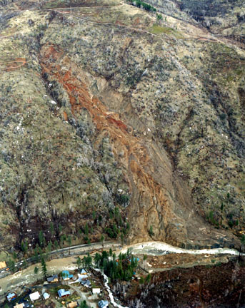
A Landslide Is…
A rapid shift in land mass
  Typically associated with
  periods of heavy rainfall
  or rapid snowmelt
  Tends to worsen effects
  of flooding that often
  accompanies
  landslides

Slide 3
Areas Prone to Landslides
Existing old landslides
Bases of steep slopes
Bases of drainage channels
Developed hillsides where leach-field septic systems are used

