Slide 1
Hurricanes and Coastal Storms
CERT Basic Training
Hazards

Slide 2
Hurricanes and Coastal Storms
Hurricanes:
  Violent areas of low pressure forming in tropics
  Have winds of 75 mph or more
  Accompanied by torrential rains
Coastal Storms
  Typically form along East Coast
  Produce similar damage to hurricanes

Slide 3
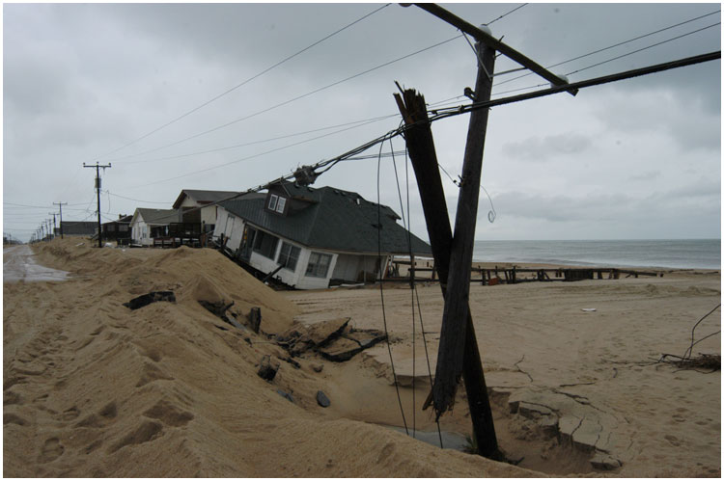
Hurricane and Coastal Storm Risks
Strong winds and storm surge can:
  Damage or destroy structures
  Lift and move unstable structures and objects
  Damage utility and sewage lines
  Give rise to tornadoes
  Make roads impassable
  Disrupt communication
  lines
  Cause coastal erosion
  Cause floods
  Threaten lives

Slide 4
Saffir-Simpson Scale
Measures wind speed
Has five categories
  I: 74-95 mph
  II: 96-110 mph
  III: 111-130 mph
  IV: 131-155 mph
  V: More than 155 mph
Notes:
3

Slide 5
Statistics
100 million Americans are at risk for hurricanes
Almost 14 million live in an area where winds greater than 125 mph have been recorded (i.e., tip of Florida to North Carolina coast)
More than 6 million live in storm surge areas
Notes:
4

Slide 6
Preparing for a Hurricane
Know risk and evacuation routes
Develop action plan
Secure needed supplies
Floodproof property
Create personal disaster supply kit for your family
Secure mobile homes
Notes:
5

Slide 7
Before a Hurricane
Board up all windows and glass doors
Check batteries
Stock up on nonperishable food
Listen to EAS
Notes:
6

Slide 8
Stay or Go?
If in evacuation zone, leave immediately
  Determine where you will go
  Leave as early as possible
If not in evacuation zone:
  Follow sheltering guidelines
  Determine safe room in home
  Fortify house
  Assist those with special needs
Notes:
7

Slide 9
During a Hurricane
Stay indoors
Stay away from flood waters
Be aware of the “eye”
Be alert for tornadoes
Notes:
8

Slide 10
After a Hurricane
Do not reenter area until it is declared safe
Use flashlight to inspect for damage
Wear protective clothing, sunscreen, and bug repellant
Check on neighbors
If you use a generator, take safety precautions
Stay away from downed power lines
Turn off utilities, if necessary
Listen to EAS
Notes:
9

