Slide 1
Excessive Heat
CERT Basic Training
Hazards

Slide 2

Heat Wave
Prolonged period of excessive heat, often combined with excessive humidity

Slide 3
Effects of Excessive Heat
Body must work extra hard to maintain its normal temperature
Those at risk
  Elderly
  Very young
  Disabled
  Men (perspire more than women)
People in urban areas at greater risk

Slide 4
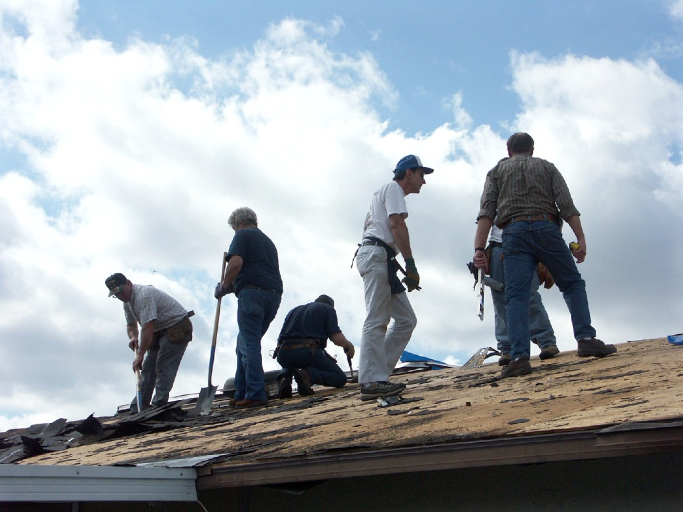
Heat Wave Risks
Heat cramps
Heat exhaustion
Heat/Sun stroke

Slide 5
During a Heat Wave
Seek air conditioning
Avoid strenuous activities during heat of day
Wear lightweight, light-colored clothing
Check on family members and neighbors
Drink plenty of fluids
Take frequent breaks

Slide 6
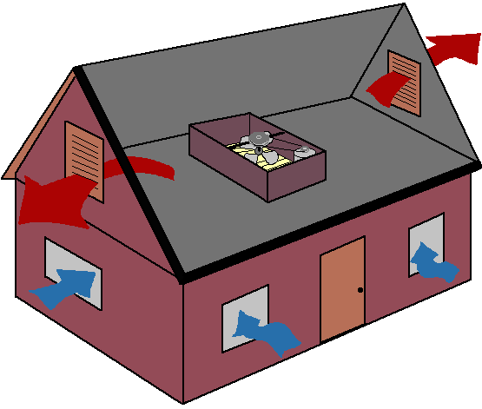
Preparing the Home
Install additional insulation
Protect windows and glass doors
Use attic fans

