Slide 1
Floods
CERT Basic Training
Hazards

Slide 2
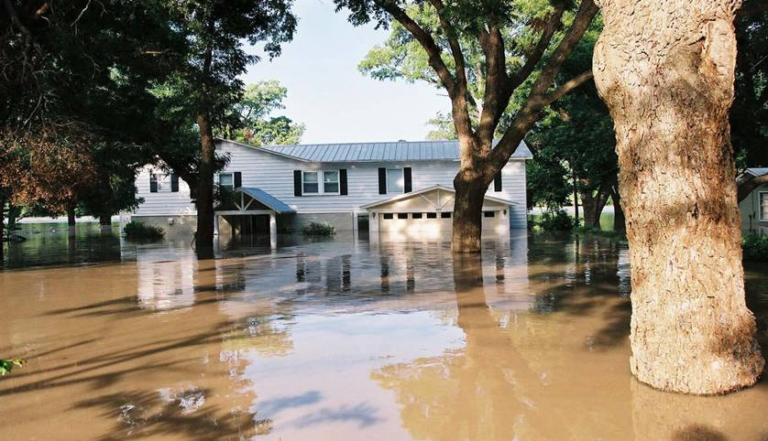
When Floods Occur
Any time a body of water rises to cover what is usually dry land
One of most common hazards
  75% of Federally declared disasters
May be local
or widespread
May develop
slowly or fast

Slide 3
Causes of Floods and Flood Damage
Heavy rain
Spring snowmelt
Dam and levee failure
Low absorption or no soil percolation
Business and residential growth in flood areas

Slide 4
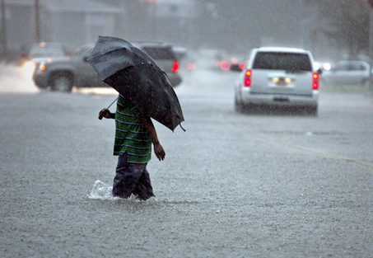
Factors Contributing to Flooding
Rainfall intensity
Rainfall duration
Topography
Soil conditions
Ground cover

Slide 5
Flood Hazards
Heavy rainfall exacerbates problems with:
  Runoff
  Absorption
  Flood-control measures
Ravine flooding can inundate downstream areas
In rocky and heavily paved areas, lack of absorption can cause flash flooding

Slide 6
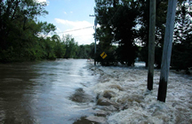
Flood Risks
Most communities have some risk of flooding
Damage increases with development in:
  Coastal areas
  Floodplains

Slide 7
Flood Preparedness
Know flood risk in area
Prepare flood evacuation plan
Obtain flood insurance if living in floodplain
Keep important documents in water-proof box
Check portable radio for current information and emergency messages

Slide 8
Protecting Property
Elevate furnace, water heater, and electric panel
Move furniture and other items to higher level
Install check valves
Waterproof basement floor and walls

Slide 9
If You Must Evacuate
Do not walk, swim, or drive through flood waters
Stay off bridges over fast-moving water
Keep away from waterways
Pay attention to barricades
Avoid storm drains and irrigation ditches
Keep family together

Slide 10
After a Flood
Stay out of flooded areas
Reserve telephone for emergencies
Avoid driving, except in emergencies
Wait for authorities to issue message that it is safe to return
Be aware that snakes and other animals may be in your house

