Slide 1
Fire
CERT Basic Training
Hazards

Slide 2
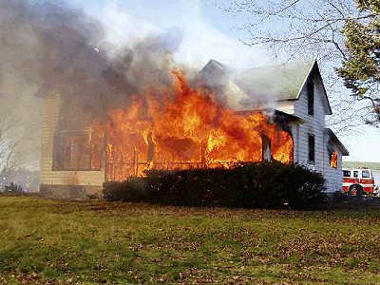
Dangers of Fire
Asphyxiation
Heat
Smoke

Slide 3
Fire Statistics
85% of all fire deaths occur where people sleep, mostly during night
Most are preventable
2006: 2,620 people died in reported home fires in the U.S.
  Victims are disproportionately children or elderly

Slide 4
Developing a Family Fire Plan
Install smoke alarms
Identify two escape routes
Practice escape plan
Practice alerting family members
Learn fire department’s emergency number

Slide 5
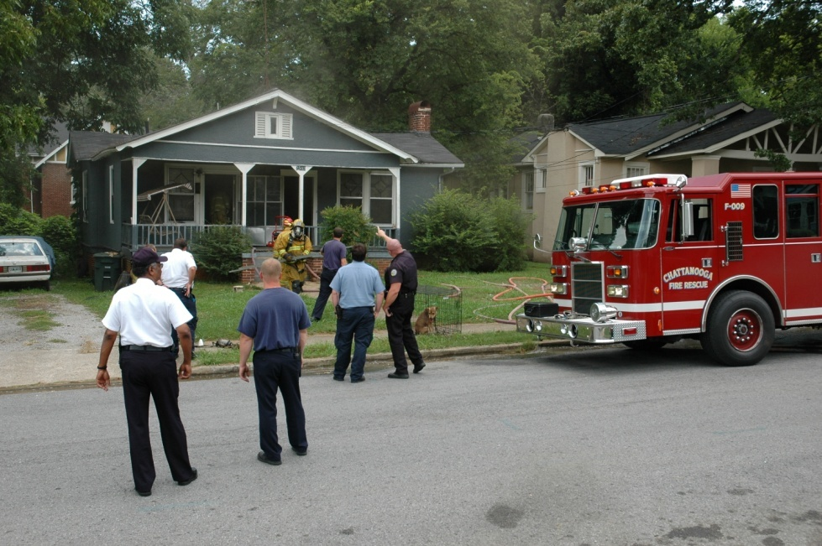
If a Fire Starts
Yell “Fire!” several times
Get out quickly
Go to meeting place
Call fire
department

Slide 6
If You Can’t Escape
Stuff wet cloth around doors and vents
Call fire department
Open windows slightly at top and bottom
Stay low and by a window
Hang or wave a bright-colored or white cloth at the window

Slide 7
Preventing Fires
Conduct home hazard hunt
Inspect wood stoves and chimneys annually
Purchase only “laboratory-tested” heaters
Keep heaters at least 3 feet from any flammable items

Slide 8
Preventing Fires (contd.)
Keep matches and lighters away from children
Check electrical wiring
Keep combustibles away from stove

Slide 9
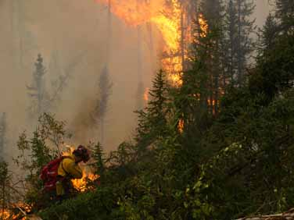
3 Classes of Wildfires
Surface fire
Ground fire
Crown fire

Slide 10
Wildfire Preparedness
Keep garden hose long enough to reach any area of home
Get portable gasoline-powered water pump if pool, lake, or stream is available
Equip chimneys and stovepipes with spark arresters

Slide 11
Wildfire Preparedness (contd.)
Keep fire tools handy
Use proper building and landscape design
  Create “defensible space” or “safety zone”
  Use fireproof or fire resistant roofing

Slide 12
During a Wildfire
Listen for emergency information
Confine pets to one room or arrange for them to stay with a friend or relative
Move flammable furniture to the center of the home
Remove flammable drapes and curtains
Close all doors and windows

Slide 13
After a Wildfire
Use caution when reentering
Inspect the roof immediately
Have propane or heating oil tanks inspected
Check the stability of trees around the home
If there is no power, check the main breaker

