Slide 1
Earthquakes
CERT Basic Training
Hazards

Slide 2
An Earthquake is…
A sudden slipping or movement of a portion of the Earth’s crust
  Caused by a sudden release of stresses
  Usually less than 25 miles below the surface

Slide 3
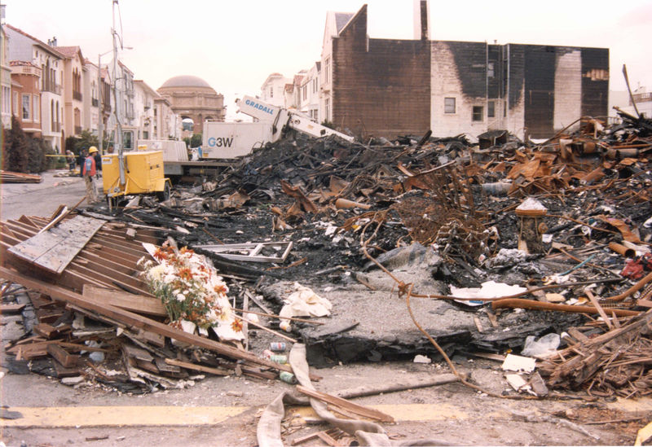
Earthquake Damage
Collapsed buildings
Damage to utilities, structures, and roads
Fires and explosions
Structural
instability,
e.g., dams

Slide 4
Likelihood of an Earthquake
Greatest likelihood
  Western United States
    San Andreas Fault
    Western Oregon and Washington
    Alaskan coast
  New Madrid Fault Zone in Missouri
  Few pockets on East Coast
    Coastal South Carolina
    New England

Slide 5
Earthquake Statistics
75 million Americans in 39 states face significant risk
Residents of California face the highest risk (17 million people) followed by residents of western Washington State
4 million people along New Madrid Fault Zone at great risk
Residents of Massachusetts, North Carolina, and South Carolina also at risk

Slide 6
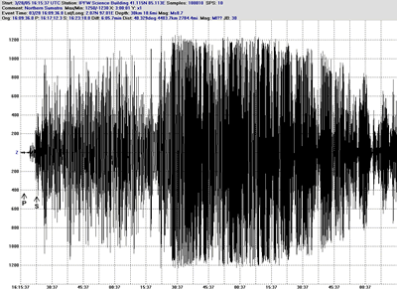
Richter Scale
Small: 5.0 to 5.9
Moderate: 6.0 to 6.9
Major: 7.0 to 7.9
Great: 8.0
or greater

Slide 7
Earthquake Preparedness
Develop home earthquake plan
Conduct earthquake drills
Develop plan for reuniting family members
Develop family communication plan
Keep supplies on hand

Slide 8
Earthquake Preparedness
Store heavy and breakable objects on low shelves
Secure bookshelves and water heaters
Install flexible pipe
Move beds away from windows
Move or secure hanging objects over beds, sofas, or chairs
Keep shoes and flashlight under bed

Slide 9
During an Earthquake
Drop, cover, and hold
If indoors, stay there until shaking stops
If outdoors, find a spot away from buildings, trees, streetlights, power lines, and overpasses
If in a vehicle, drive to clear spot and stop

Slide 10
After an Earthquake
First:
  Check selves for injuries
  Protect selves from further danger
Then:
  Extinguish small fires
  Clean up spills
  Inspect home for damage
  Help neighbors
  Tune to Emergency Alert System (EAS)
  Expect aftershocks

